Slide 1
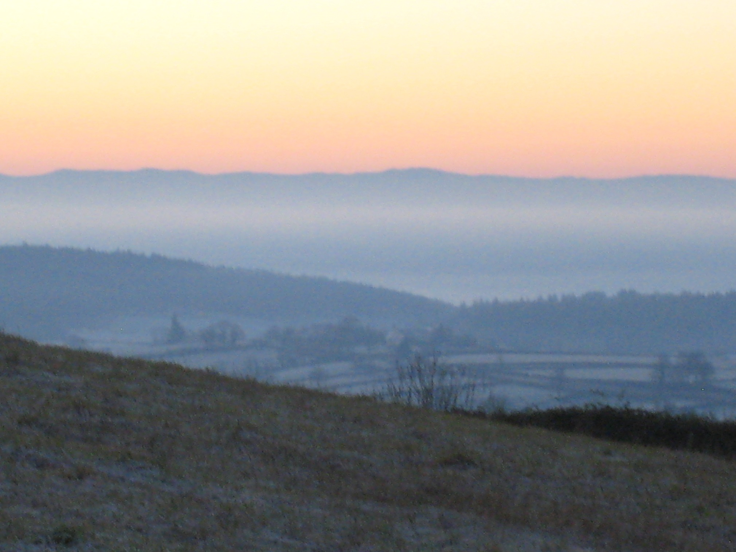
A Tour of the Horizon: Roles for Social Science and Humanities Research in Shaping the Bio Economy
Carole Crumley
Uppsala University, Sweden
Swedish Agricultural University, Sweden
University of North Carolina-Chapel Hill, USA

Slide 2
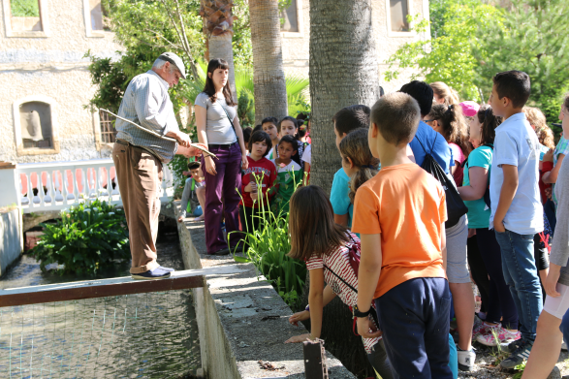
Critical Approaches and Values-Based Perspectives
Integration of multiple spatial and temporal scales
local to global
past & future
many dimensions
Place-based practice
An appreciation for all knowledge
Inclusivity: communities of scholarship & practice
diverse disciplines, methods, theories
local/indigenous people, farmers, hunters, managers, NGOs, governments
Clearly articulated values
equity, transparency, communication
A conviction that the human past matters to the human future
Local students learn from a member of Channel Watch, the traditional water management collective, Granada, Spain.
Courtesy MEMOLA Project, ihopenet.org
Notes:
Spatial: local to global
Temporal: deep past to future

Slide 3
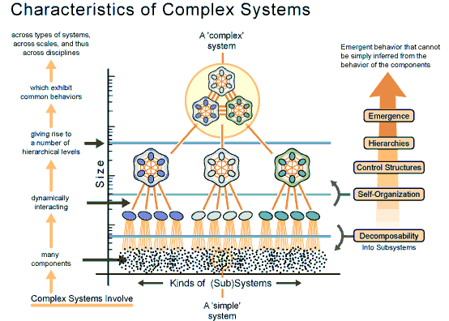
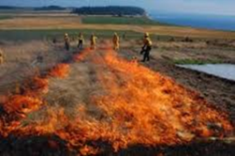
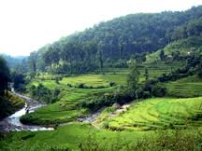
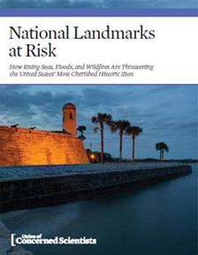
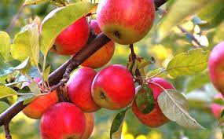
Overview: Pragmatic Uses for Historic Data and Contemporary Conversations
Completed experiments in complex systems
Land use, land management, restoration
Sustainable management strategies
A measure of sustainability over time
Shields stocks of knowledge from loss
Corrects and regionalizes climate models

Slide 4
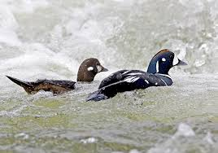
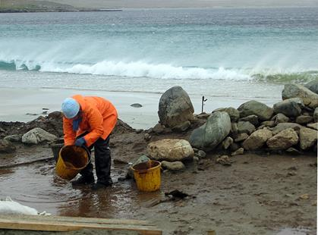
Pragmatic Examples
Enduring management strategies:
a millennium of Icelandic success in managing migratory birds
Guarding the library:
Distributed Observing Networks of the Past yield history of fish stocks, management strategies
Old apples to new products:
Lithuanian apple growers and the Institute of Agriculture collaborate on new products

Slide 5
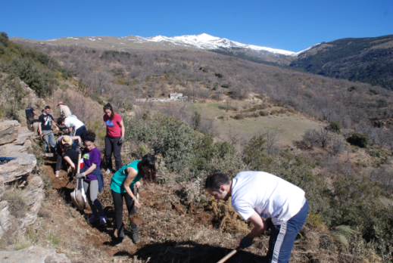
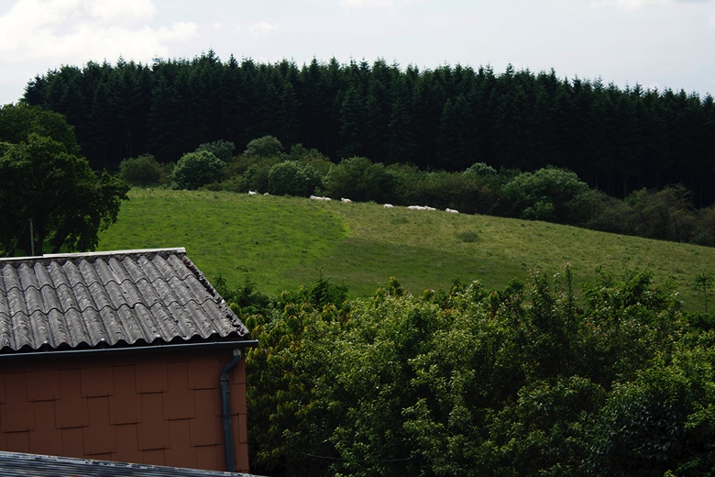
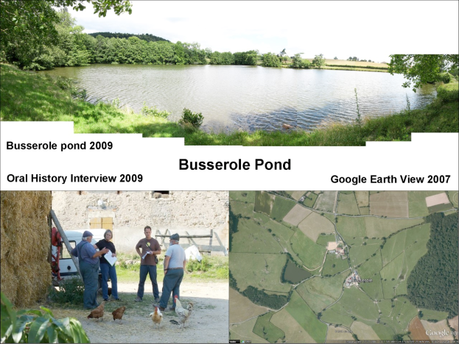
Pragmatic Examples
MEMOLA [MEditerranean MOuntainous LAndscapes in Europe: Sierra Nevada/Spain, Vjosa Valley/Albania, Trapani Mountains and Colli Euganei/Italy] works with residents to:
Restore ancient Sicilian fruit trees to abandoned lands
Retrofit Medieval water management for the future
Burgundy Dynamic Landscapes Project
Identifying past & future sustainable responses to climate change

Slide 6
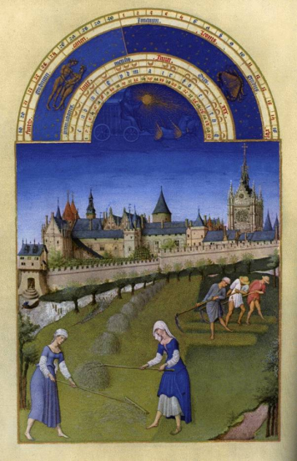
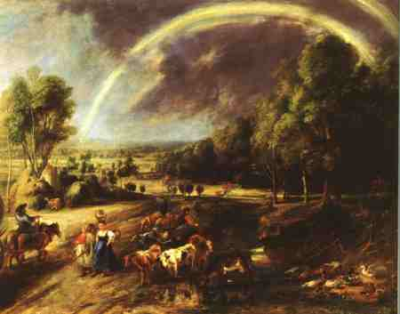
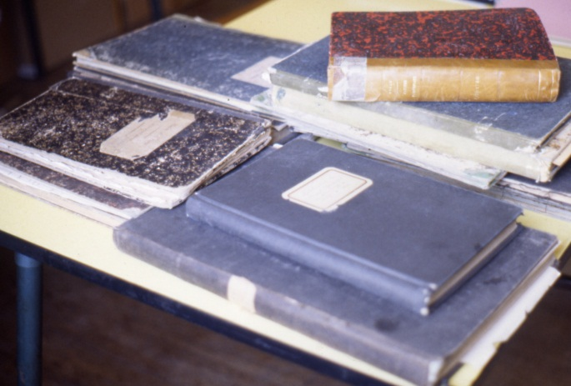
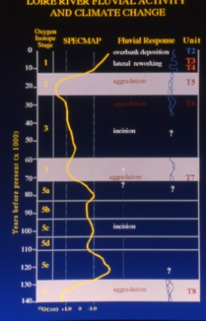
Archaeology, environmental studies, documents, and ethnographic sources of knowledge about land use history permit the analysis of changes over time

Slide 7
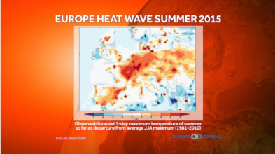
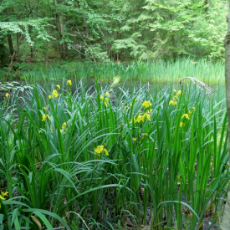
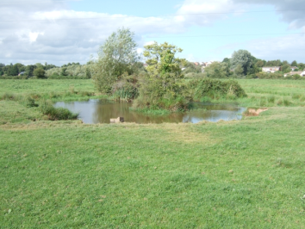
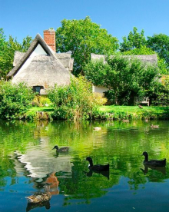
Dominance of Mediterranean regime Feb-Oct 2003
Increased climate variability poses challenges to EU agricultural policy
2002, 2003, 2015
2008
What happened to the ponds???
Rainfall in Europe
June through August 2003

Slide 8
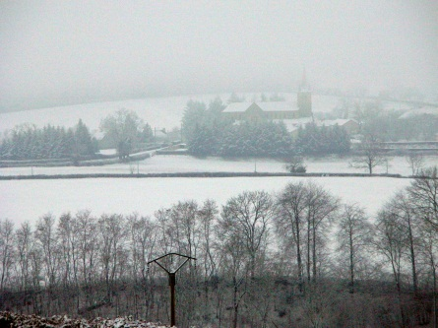
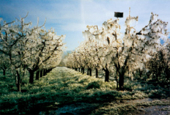
The seasonal rhythm is broken
The variability of weather has increased: “out of season” weather ruins harvests, makes planning difficult.
Human societies respond effectively to weather extremes but
not to highly variable short term conditions.
The most variable period in French history was the decade
before the French Revolution.
unpredictable climatic variability = increased agricultural vulnerability

Slide 9
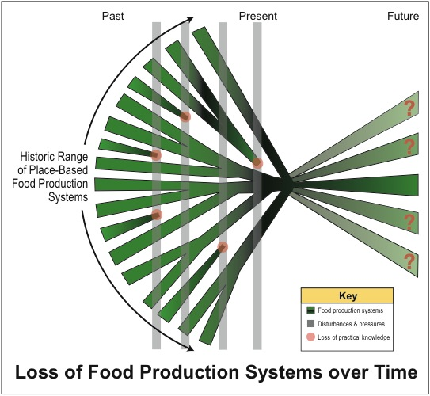

Slide 10
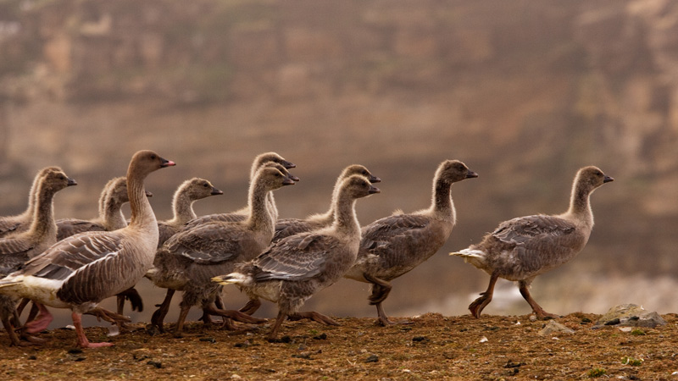
Heritage & Innovation
Innovation benefits communities as well as corporations
Old ideas stimulate new ones: retrofits to natural resources, agriculture, & architecture yield new solutions
It’s not just materiality: many old management strategies are still valuable today
A sense of place and of community can be strengthened around such broadly beneficial activities

Slide 11
Social Sciences and Humanities Research
in Sustainable Environments
Ecological Restoration
Environmental Humanities
Environmental Conservation
Environmental Sciences
Complexity Science
Political and Cultural Ecology
Anthropology
Geography
Historical Ecology
Future Studies:
Narratives, Scenarios, Models
Archaeology
Historic Conservation
Environmental and Cultural Heritage Management
History
A Collaborative, Transdisciplinary Research Network

Slide 12
A Collaborative, Transdisciplinary Research Network Integrates Earth sciences, social sciences, environmental humanities, futures and complexity scholars, stakeholders Links global & local, past & future scales; integrates different perspectives on issues Promotes pragmatic, sustainable, and ethical management strategies. Offers and umbrella framework to “grow” regional expertise in managing the future. Can Advance the Exploration of Critical Issues: The Role of Biodiversity in Food Security Recycle/Redesign/Innovate Architecture and Engineering Model Regional Landscapes and Climates of the Future Co-design Future Landscapes of Production

Slide 13
Integrated History and Future of People on Earth IHOPE www.ihopenet.org

