Slide 1
The SDGs and the European research and societal impact challenges, with special reference to agro-food and the bio-economy in the EU.
Uno Svedin,
Professor (ret.), PhD,
Stockholm University/ Resilience Center
Brussels 19 June 2018

Slide 2
WORKSHOP TOPIC
The SDGs
Relevance to the European research and innovation strategy domain
The special reference to agro-food and the bio-economy
About the width of impact challenges
Especially the interest in the societal impacts

Slide 3
ON THE SDG:s
Of the 17 SDGs several are DIRECTLY related to the
- agricultural domain
- land use
- food
- bio economy
- In addition most of the SDG:s are INDIRECTLY related (also systemically
connected)

Slide 4
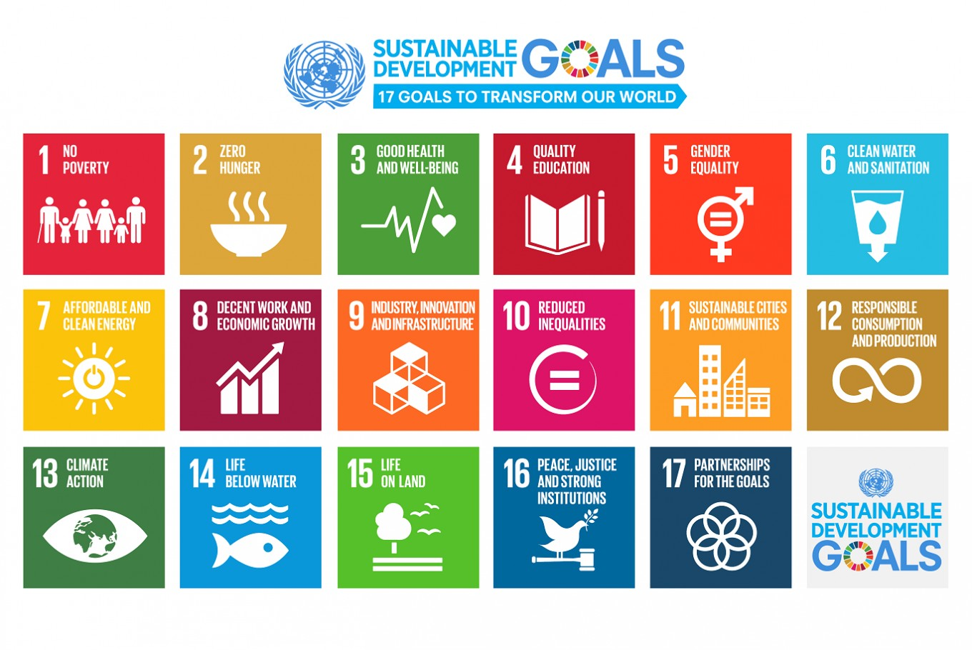

Slide 5


Slide 10
Concerns to be discussed
Research strategies have to take all these goals into account
New considerations of how to evaluate IMPACT
What types of impact?
Methods to assess these impacts
The broader understanding of societal impacts
Being open for new discipline contributions AND combinations of trans disciplinary kinds
New project partners and thus new research combinations
Approaches with regard to co-production of knowledge.
Scaling level considerations

Slide 11
I. Challenges of the SDGs and their relation to agriculture and food issues
(”The societal challenge” issue)
The multiple dimensions of the SDG:s
The special concerns for the European agro/food/fishing secto
- How the societal impacts could be perceived and be judged

Slide 12
II. How to know that the chosen approaches and potential results are relevant to the agro-food issues and challenges?
(The “process and assessment” issue)
To discuss the different strategic approaches in different countries
Different approaches in different research organisations.
The issue of integration of approaches and increased overall reflexivity capacity

Slide 13
III. Distributed roles of involved actors?
(The actor issue)
Examine the respective frameworks in which
- governments,
- private sector actors,
- pressure groups and
- citizens
could be included
How to frame the continued reflectivity process
How to integrate actors constructively and
how to understand the different roles of actors?

Slide 14
IV. The case of the SDGs – policy and implementation
(The impact issue)
Political opportunities and dilemmas.
How could we create relevant frameworks in which society could accept outcomes
How to start processes of change?

Slide 15
V. Cross going discussions
SDGs are GOALS
IMPACTS are effects of actions from the persuit of goals – but also effects of not following the goals or changing the directions
The time aspects about goals and effects
The competition of the goals and their systemic interactions

Slide 16
AGRO - FOOD –
BIO ECONOMY
STRATEGIC THINKING
HOW THE AGRO-FOOD SECTOR SHALL RESPOND TO SOCIETAL CONCERNS RELATED TO e.g. :
Multilevel varied concerns (global, regional, local)
Deep international panorama of concerns
Innovation structures + directions
Changed consumer behaviour and preferences

