Slide 1
Knowledge Brokerage for Sustainable Development
Distributed roles of involved actors?
Norma Schönherr
a.Prof. Dr. André Martinuzzi
WU Vienna, Institute for Managing Sustainability
www.sustainability.eu

Slide 2



Different worlds

Slide 3
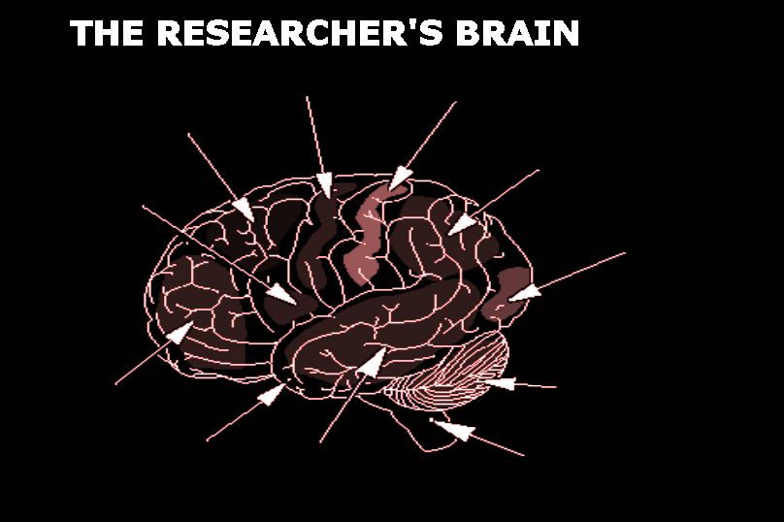
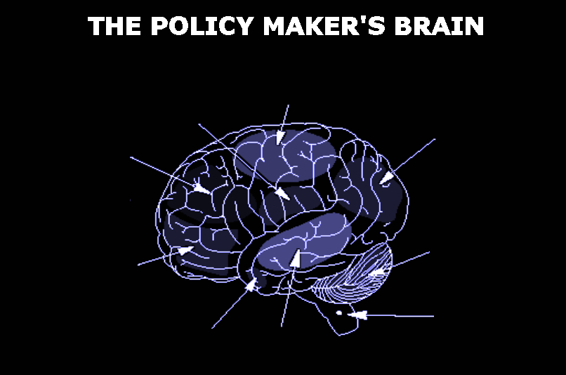
Different worlds
Different rationalities
Different mind sets

Slide 4
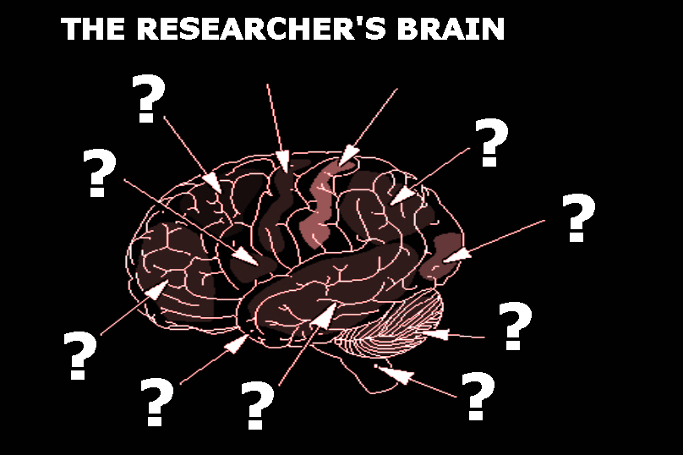
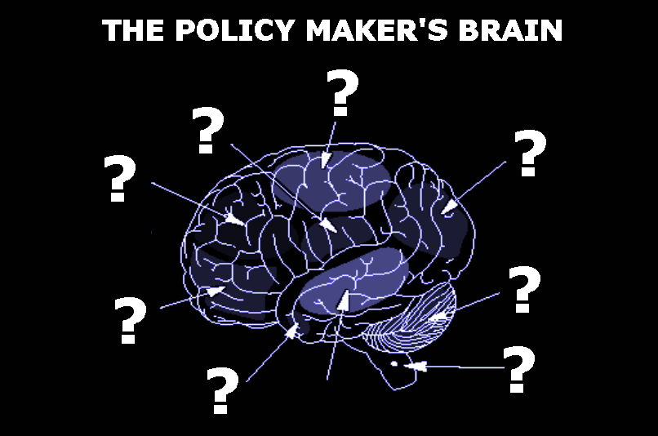
Different worlds
Different rationalities
Different mind sets

Slide 5
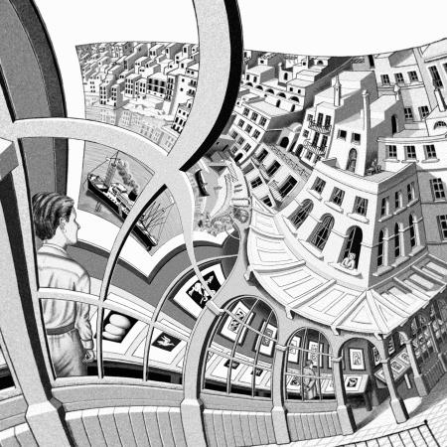
How to bridge the gap?
Simplified approaches
follow a linear model of knowledge flows and assume that the provision of correct information (science) automatically leads to a different decision (policy)
no real problem
Network-based approach
is are characterized by long-term interactions to build up trust mutual understanding of contexts, rationalities, perspectives, and interests
need for insights & tools
System theory based approaches see science and policy-making as self-referential and autopoietically closed social systems and discusses the fundamental limits of knowledge transfer
no real solution

Slide 6
How to bridge the gap?
11 EU funded projekts on „Knowledge Brokerage
between Research and Policy Making“
AWARE | water ecosystems management
BESSE | sustainable sanitation
BRAINPOoL | alternative policy indicators
CORPUS | sustainable consumption
FOODLINKS | food consumption & production
PACHELBEL/STAVE | citizens & the environment
PRIMUS | local sustainability
PSI-connect | river basin management
RESPONDER | sust. consumption & growth
SPIRAL | biodiversity
WaterDiss | water research

Slide 7
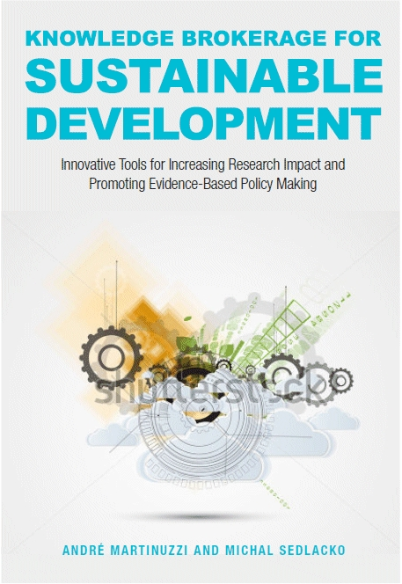

How to bridge the gap?
11 EU funded projekts on „Knowledge Brokerage
between Research and Policy Making“
average project duration 3 years
total EU contribution ~ 14.5 mio €
average EU contribution ~ 1.3 mio €

Slide 8


AWARE:
Sustainable Water Ecosystem Management
Tools: ‘European Citizens’ Juries’: small panels of randomly selected citizens judging research goals and outcomes as well as solutions in the form of management options in the frame of professionally facilitated citizens conferences.
Learnings: Citizens’ juries help developing
trust between stakeholders and
legitimate socially acceptable
solutions.
Notes:
8

Slide 9

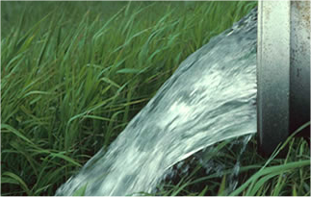
BESSE:
Sustainable Sanitation
Tools: ‘Strategic Maps’ jointly developed by technologists and policy makers, involvement of the local community through participatory technology validation.
Learnings: Scientific knowledge is inextricably
interwoven with other kinds of knowledge.
Notes:
9

Slide 10


BRAINPOOL:
Sustainability Indicators
Tools: knowledge brokerage events and a permanent network around an online platform, aiming to stimulate interaction between NGOs, scientists, statisticians and policy makers dealing with Beyond-GDP-Indicators.
Learning: establishing a smaller but legitimate group of event participants acting as the event’s memory, preserving its momentum and further developing its results.
Notes:
10

Slide 11


CORPUS:
Sustainable Consumption
Tools: interactive web platform (‘knowledge units’, some of them provided on policy makers’ demand) and a series of workshops testing different tools and session formats (collaborative envisioning, joint development of research agendas).
Learning: Scientific knowledge needs to be
‘enriched’ through social processes,
reframed through the views of
participants and thus fused with
values and judgments.
Bundesministerium für Land- und Forstwirtschaft, Umwelt und Wasserwirtschaft (Austria)
Ministry of the Environment (Finland)
Notes:
11

Slide 12

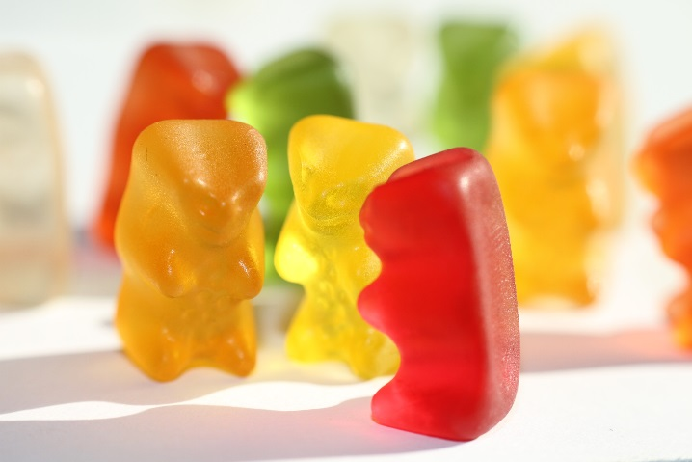
FOODLINKS:
Food Policy Issues
Tools: Three thematic communities of practice (CoPs) built around concrete municipal food initiatives,
each jointly led by a policy maker and a researcher.
Learning: Social dimensions and temporal
dynamics of learning are more important
than the technical and managerial
perspective of knowledge management
or knowledge transfer.
Notes:
12

Slide 13

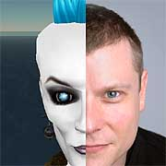
PACHELBEL:
Consumers’ Attitude-Behaviour Gap
Tools: facilitation of the interface between citizens/consumers and policy makers; ‘Systematic Tool for Behavioural Assumption Validation and Exploration’ (using cartoons, diary excerpts, simulated newspaper articles).
Learning: Processes of dialogue have resulted in
higher degree of reflection in policy makers.
Notes:
13

Slide 14


PRIMUS:
Local & Urban Sustainability
Tools: promoting personal linkages between researchers and policy makers through networking workshops, facilitation of personal interaction, exchange of experience, and collection of good practices of cooperation between local governments and researchers.
Learning: The ability of research to
produce critical results which
might be difficult for policy makers
to accept needs to be protected.
Notes:
14

Slide 15


PSI-CONNECT:
River-basin Management
Tools: Instead of translating research results into the languages of target communities, the project attempted the opposite – bringing members of other communities (water authorities, NGOs and citizen groups, businesses, labour unions) onto the platform of science.
Learning: three different roles in the processes of KB:
  ‘facilitative leader’
  (credibility and trust of policy makers)
  ‘knowledge broker’
  (bridges professional languages)
  ‘facilitator’
  (designing event methodology, facilitation).
Notes:
15

Slide 16


SPIRAL: Biodiversity-
related Knowledge
Tools: ‘Dynamic Network of Advisers’ (a panel of over 50 representatives of various communities including the scientists)
Learning: Policy making structures do not have
any preference for scientific findings.
Therefore scientists should find a
group close to policy making which
will ‘carry’ their results.
Notes:
16

Slide 17

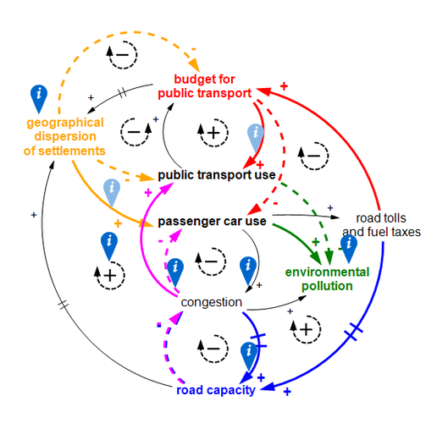
RESPONDER: Sustainable
consumption and growth debates
Tools: Participatory system mapping as a tool for knowledge
co-creation and to increase mutual understanding.
Learning: Main difference is not between
a scientists and a policy makers mind,
but the much deeper rooted values
attitudes (e.g. regarding innovation
or personal liberty).
Bundesministerium für Umwelt, Naturschutz und
Reaktorsicherheit (Germany)
Federal Department for Environment, Transports,
Energy and Communication (Switzerland)
Notes:
17

Slide 18
The (often implicit)
games of knowledge brokerage
‘Questions-And-Answers-Game’
  are policymakers willing and able to formulate questions (in public)
  are researchers are willing and able to give and commit to clear answers
  runs the risk of setting too narrow a framework for scientific inquiry
‘Agenda-Setting-Game’
  legitimacy of agenda setting remains contested
  political responsibility may be delegated to the scientists
  Risk of constructing an artificial lack of alternatives and reducing policy making to a form of implementation management
‘Community-Formation-Game’
  questionable if a common interest and shared practice exists
  questionable whether time and contact intensity are sufficient to create a viable community
  fundamental contradictions of science and policy making are downplayed
‘Re-Framing-Game’
  too time intensive and complicated for policymakers interested in fast and easy solutions
  means to question patterns of explanation and world-views

Slide 19
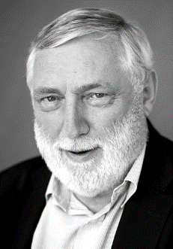
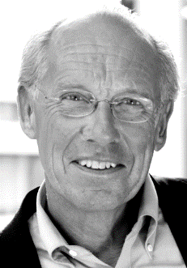
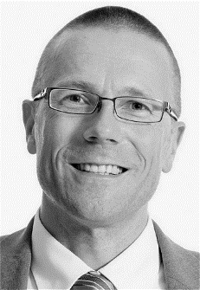
Interviews with high level
policy makers and top scientists
Franz Fischler:
A new narrative for Europe
Jørgen Randers:
Communicating
Limits to Growth
Uwe Schneidewind:
The need for more
transdisciplinary research
Notes:
19

Slide 20
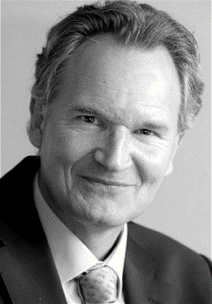
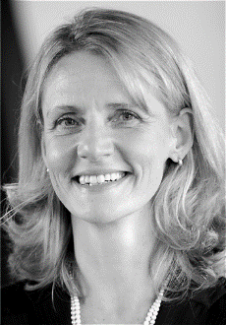
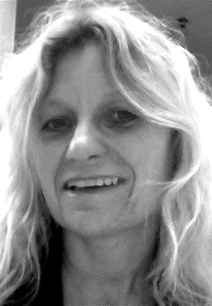
Interviews with high level
policy makers and top scientists
Robert-Jan Smits:
Agenda setting in European policy
Lucia Reisch: Providing scientific
advice in critical situations
Leida Rijnhout: The role(s)
of NGOs in linking science
and policy making
Notes:
20

Slide 21
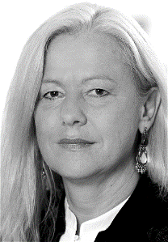
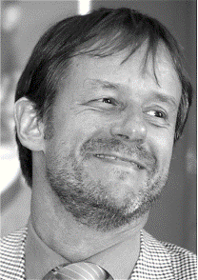
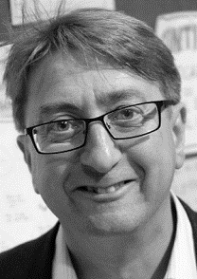
Interviews with high level
policy makers and top scientists
Elisabeth Freytag
and
Wolfram Tertschnig:
Policy learning in EU Member States
Peter Woodward:
The role(s) of
professional facilitators
Notes:
21

Slide 22
What researchers
should keep in mind
  Policymaking takes place at different places
  by different actors at different times.
  As policymaking requires fast and pragmatic decisions, the time for adequate and detailed discussions is often lacking.
  Policymaking is primarily based in political values and beliefs, persuasion and negotiation, rather than scientific evidence and truth.

Slide 23
What policy makers
should keep in mind
  There is a lack of incentives for scientists
  to engage in knowledge brokerage with policymakers
  Scientific communities, careers and reputations
  are organised in academic disciplines
  while inter- and transdisciplinarity fields are
  perceived only as an add-on.
  Scientific results cannot be directly translated
  into policy recommendations or decisions.

Slide 24
What business leaders
should keep in mind
  Codes like efficiency, cost-benefit ratios or delivery on time/in budget are not (always) relevant achievements for scientists.
  Science is committed to the pursuit of knowledge and truth-seeking. Application of this knowledge in practice is not necessarily a priority.
  Time-scales needed for reliable research may be much longer than those for business decisions and processes.

Slide 25
What activists/civil society organizations
should keep in mind
  Co-creation and citizen science are on the rise. This requires a readiness to engage with researchers on their turf – new skills required on both sides.
  Most research strives for objectivity. The mission-orientation of CSOs and activists is sometimes hard for them to accommodate.
  Scientific impact assessments tend to be self-referential within the academic system. Results are not primarily aimed at generating impact on people and the planet.

Slide 26
What should be considered in
designing knowledge brokerage systems
  Quality, types and sources of knowledge
      A. descriptive statements (‘facts’) – measuring ‘how it is’
      B. causal statements (‘causalities’) – clarifying ‘why is it that way’
      C. predictive statements (‘futures’) – inferring ‘what will happen if’
      D. interpretive statements (‘explanations’) – understanding ‘how it makes sense’
      E. framing statements (‘systems’) – delineating ‘how it could be understood’
      F. normative statements (‘goals’) – postulating ‘how it should be’
  Multilevel embeddedness of Knowledge Brokerage
  Professional design and implementation

Slide 27
What should be considered in
designing knowledge brokerage systems
  Quality, types and sources of knowledge
  Multilevel embeddedness of Knowledge Brokerage
  Professional design and implementation
research
policy making
societal systems …
codes
paradigms …
beliefs
organizations …
missions
roles …
expecations
individuals …
socialisation
settings …
design
KB

Slide 28
What should be considered in
designing knowledge brokerage systems
  Quality, types and sources of knowledge
  Multilevel embeddedness of Knowledge Brokerage
  Professional design and implementation
  Temporary institutional arrangements for specific purposes
  e.g. citizen panels, communities of practice
  Documents adapted to the needs of target audiences
  e.g. policy briefs, simulated newspaper, knowledge units
  Co-Production of shared outcomes
  e.g. joint research agendas, evidence documents
  Specialized event formats
  e.g. webinars, summer schools, brokerage events
  ‘Micro-level’ work formats and event tools
  strategy mapping, system mapping, buzz sessions, real-time surveys

Slide 29

… and what role do YOU expect for science to play?
minions
networkers
heroes
pirates

Slide 30

But most important of all …

