Slide 1
The SDGs… How to know that the chosen approaches and potential results are relevant to the agro-food issues and challenges?
Olivier Le Gall, INRA, France
EURAGRI workshop, 19 June 2018, Brussels

Slide 2
Food systems in a major transition → The Health – Food – Agriculture – Environment nexus
Major challenges ahead of us
Planetary overflow
Climate deregulated
Nutrition
Increasing connections with other domains
"Food-Feed-Fiber-Fuel" (2.0)
Health
Territorial development
A context of scientific and technological revolutions
High throughput biology and biotechnologies
Digital sciences and technologies
Notes:
Evolution of INRA mandate :
Agriculture and food security
Agrifood industry
Life sciences
Environment
Sustainable development and the Food-Agriculture-Environment nexus
Shared international issues
Internationalization and opening to nearby areas

Slide 3
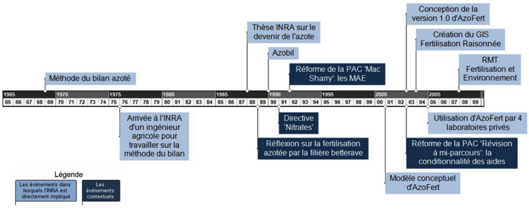
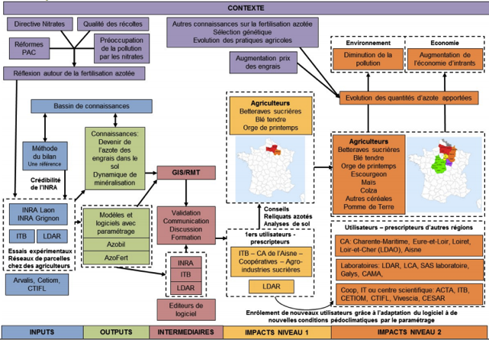
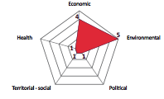
From research to outcomes
(see http://www6.inra.fr/asirpa)
Impact of public Ag research:
(Complementary to an Internal Return Rate approach)
Takes about 20 years
Requires excellent & international standard of research
Needs partnerships and ready-to-adopt end-users
Etc.
Decision-support tool
for Nitrate fertilization
Notes:
La diversité des types d’impact, les radars pour la caractériser
Comment l’impact se construit: une frise chronologique et un impact pathway (ici AzoFert)
Quelques conclusions
Renvoyer vers ASIRPA pour en savoir plus

Slide 4
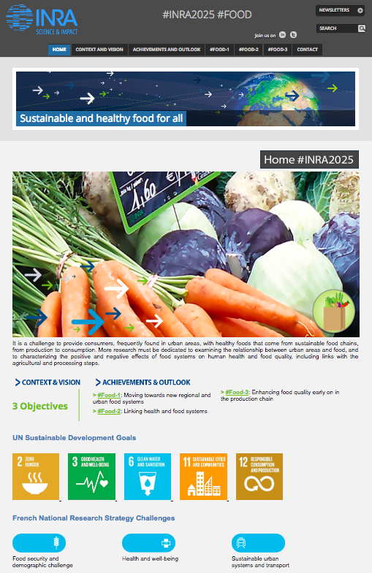
#Inra2025: conceived for appropriation
http://2025.inra.fr/en

Slide 5
The SDGs in Inra's 10-year strategy

