Slide 1
Biodiversity and agricultural practice
Gianluca Brunori
Workshop EURAGRI «Green Deal»

Slide 2
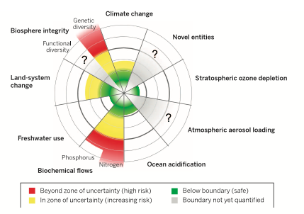
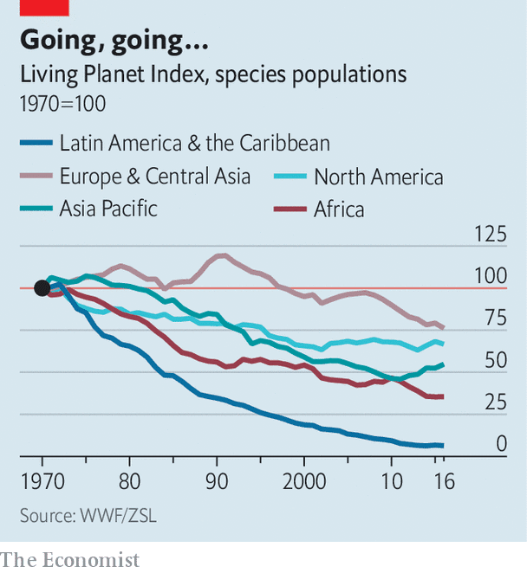
Biodiversity in the anthropocene
Notes:
Biodiversity loss and ecosystem collapse are one of the biggest threats facing humanity 14
Biodiversity degradation is a human-made effect. The concept of anthropocene, says Latour, bring us to overcome the separation of nature from society, nature from culture, nature from science.
Understanding the socio-economic mechanisms that bring to biodiversity degradation we can understand how to change them. The concept of socio-ecological system opens a new avenue for research and for policies.
inthenextdecade (World economic forum)
The Living Planet Index (LPI) is a measure of the state of global biological diversity based on population trends of vertebrate species from around the world. It does this in much the same way that a stock market index tracks the value of a set of shares or a retail price index tracks the cost of a basket of consumer goods.

Slide 3
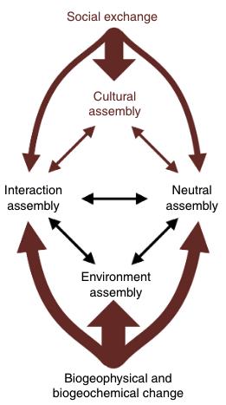
How to restore diversity? Implications for research
Diversity of knowledge: openness
Diversity of people: collaborative approaches
Diversity of problems: Nexus approaches
Diversity of impacts: responsibility
Diversity of values: science-policy-society interfaces

Slide 4
The value of diversity
Diversity provides options
Diversity is source of creativity and innovation
Diversity helps to face adversities
(Dietary) diversity is good for health
Diversity improves quality of life
Notes:
: «The diversity of nature maintains humanity’s ability to choose alternatives in the face of an uncertain future» (IPBES 2019)

Slide 5
One goal, three pathways: the SCAR Vth foresight
circularity
How to get ensure nutritious, healthy and sustainable food for all?
How to set up full circularity of food systems – in short, zero waste?
How to restore the diversity of our food, farm and social systems?
Safe and just
operating space
nutrition
diversity
Notes:
Transitions of the foresight are intended to generate research questions

Slide 6
Diversifying the food system
Food environment
Food supply
Food demand

Slide 7
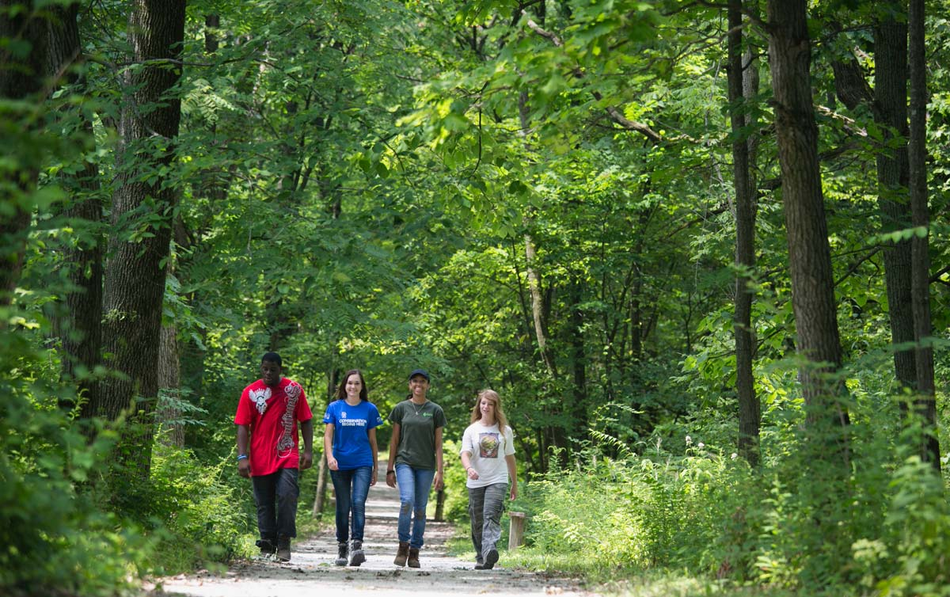
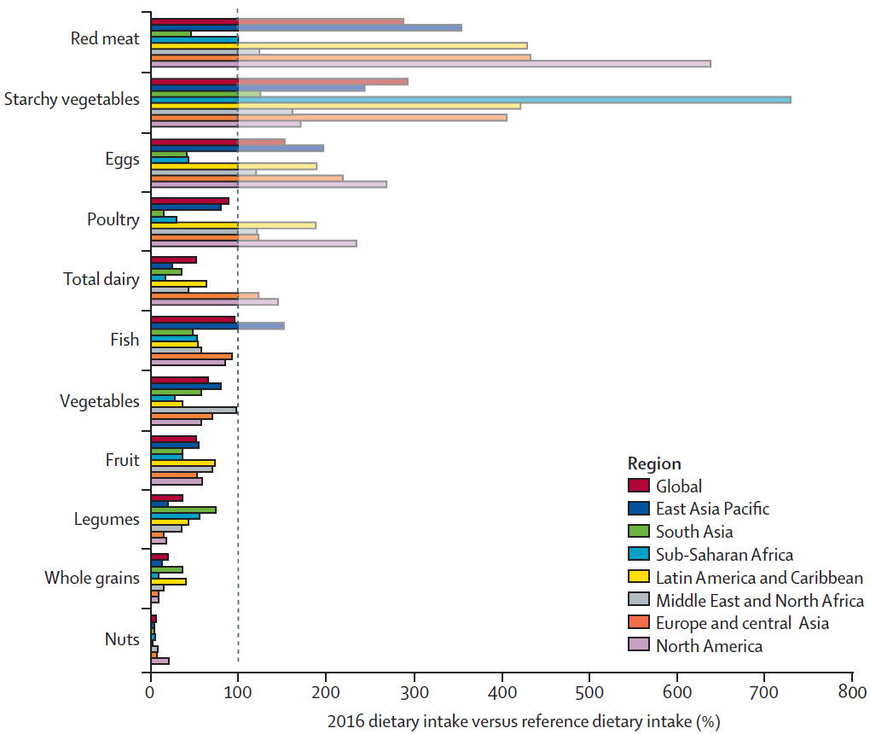
Changing demand: new lifestyles
Food environment
Food supply
Food demand

Slide 8
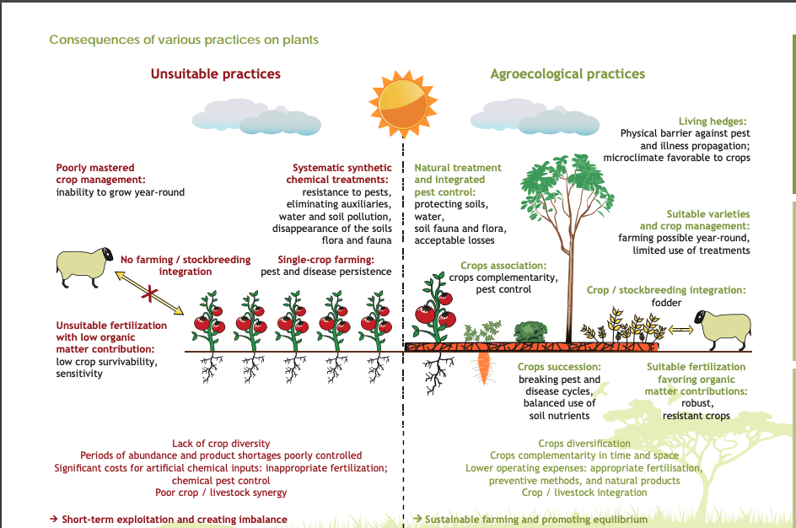
Changing supply: agroecology
Food environment
Food supply
Food demand

Slide 9
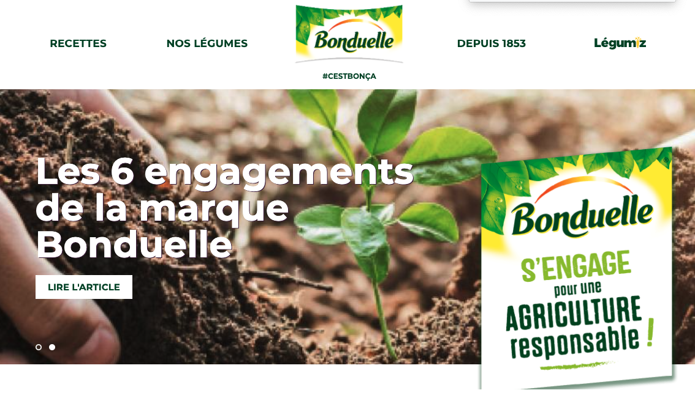
Business models
Food environment
Food supply
Food demand

Slide 10
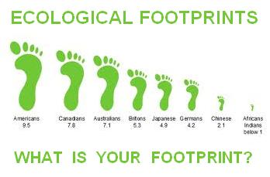
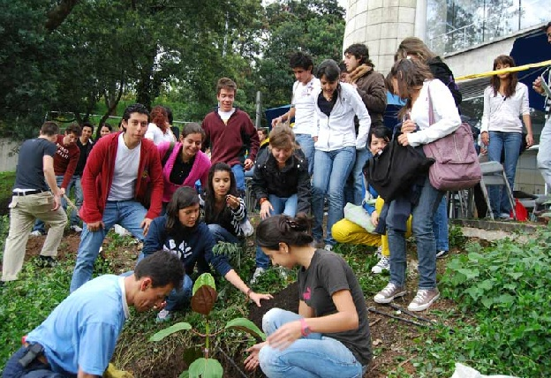
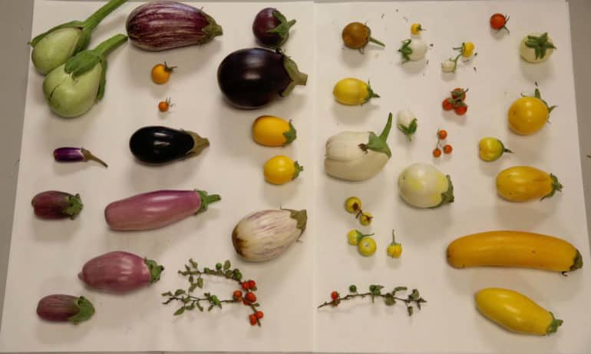
Changing the food environment: Increasing citizens’- consumers’ awareness
Food environment
Food supply
Food demand

Slide 11
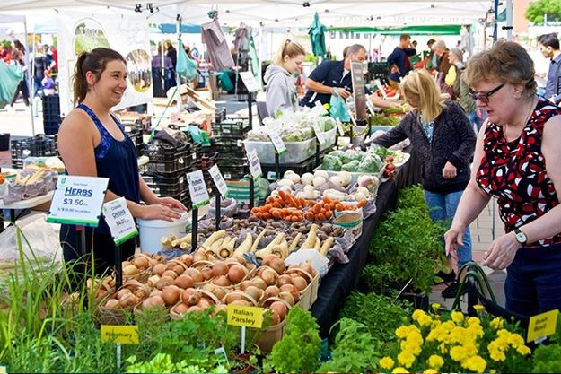
Changing the food environment: diversity of food retailing
Food environment
Food supply
Food demand

Slide 12
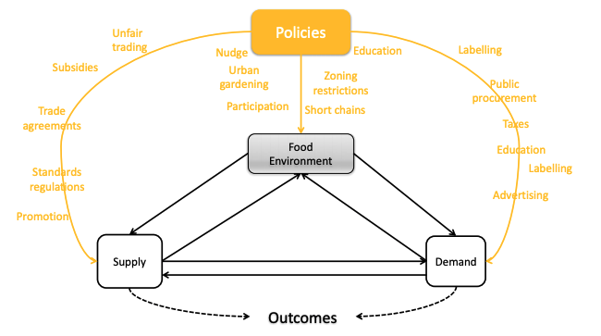
Food policy

Slide 13
Thank you!

Slide 14
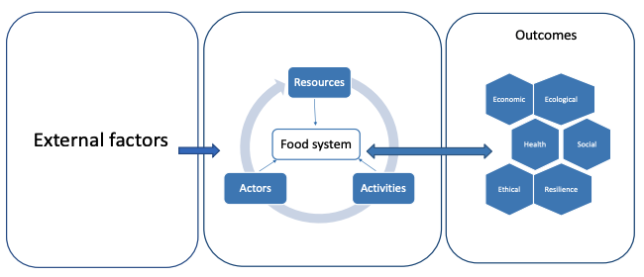
Biodiversity and food: a system approach

Slide 15
Digitali-zation
Target | Impact of digitization | Risk
A change of technical paradigms | Digitization can support education and access to information and training. Platforms to share trial data | Inadequate skills
Raising consumers and citizens’ awareness | Social media to share knowledge; educational tools, support to decision tools | Inadequate skills. Inappropriate use of information
A system of interconnected biodiversity databases | Biodiversity digitization, Knowledge sharing platforms, Open Big data | Costs of complexity of systems. Quality of data
Monitoring biodiversity in the systems | Satellites+drones+sensors+cloud+advanced analytics; AI for decision support systems | Accountability of AI systems
An ecosystem of farms with ‘functional diversity’ surpluses; | Improved communication between firms: B2B platforms⁹ | Inadequate skills Inadequate networking
Availability of market and technical alternatives | Digitization can substantially accelerate the phenotyping and genotyping (ICT applied to life sciences), improve the capacity to recognize and characterize genetic diversity (open database, AI), monitor biodiversity (sensors, citizens’ science). Decision support systems based on AI for recognition of biodiversity at farm level. | Concentration of data ownership Further standardization (opposite of the intention)
A change of business models | Blockchain can help conserving identity of the genetic variety along the chain. Disintermediation can foster diversification of the B2B relationships to find market channels appropriate to product size and characteristics. Sensors and improved analytics can make social responsibility reports more accurate. | Concentration of power related to technology ownership Blockchain needs a lot of energy
A change of consumers’ practices | Education, Improved access to information (footprinting) | Inappropriate use of information
Supporting policies | Monitoring impact of policies, mapping biodiversity distribution and risk | Inadequate skills. Stigma to polluters
Food environment
Food supply
Food demand

Slide 16
The Biodiversity Strategy: protected areas
By 2050 all of the world’s ecosystems are restored, resilient, and adequately protected
Improving and widening the EU network of protected areas and developing an ambitious EU Nature Restoration Plan
  at least 30% of the land and 30% of the sea should be protected in the EU
  10% of EU land and 10% of EU sea – should be strictly protected (actually 1% and 3%)
  Effectively managing protected areas

Slide 17
The Farm to Fork strategy
50% reduction of overall use of pesticides by 2030
10% of agricultural areas under high diversity landscape features
25% of land should be organically farmed by 2030

Slide 18
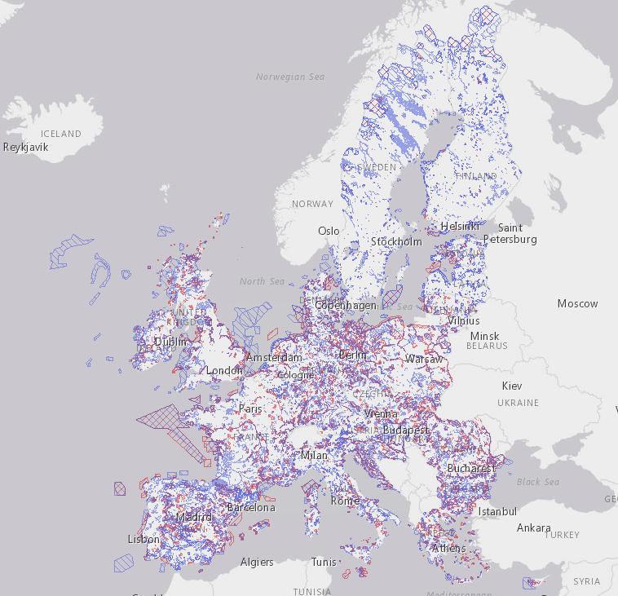
Protected areas

Slide 19
Other targets
Halt the decline of genetic diversity
Protect soil fertility, reduce soil erosion and increase soil organic matter
Planting 3 million trees

Slide 20
How to achieve these objectives?

