Slide 1
Equity for smallholders in tackling “imported deforestation”
Alain Karsenty, Senior Researcher
(Environmental Economics)
CIRAD, France

Slide 2
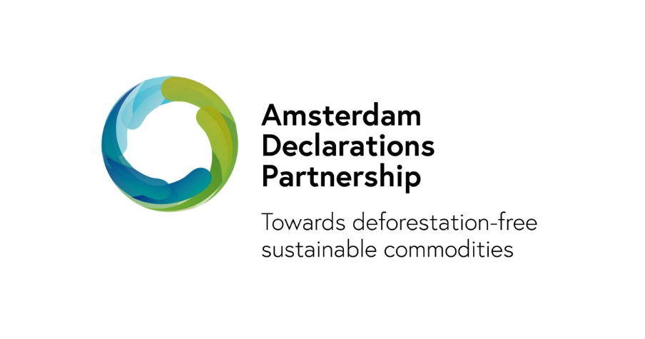
Context
Ending agricultural imports linked to deforestation, major objective of EU Green Deal (e.g. Amsterdam declarations on deforestation & palm oil)
French National Strategy against imported deforestation: legal obligation of due diligence for large importing companies
Corporate commitments: several companies admit not fulfilling their objectives (e.g. Nestlé)
Suppliers, often small-scale producers, being scattered largely contributed to this failure
Would this justify internalising production and leaving smallholders aside?
Issue: How to help small-scale producers progress in their practices and avoid harming them.

Slide 3
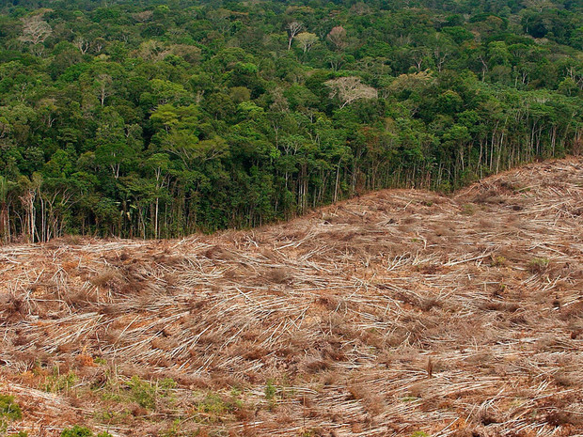
Can EU States ban imports resulting from legal deforestation?
Productions linked to illegal deforestation should be banned from EU market
Importers who violate due diligence procedures may be prosecuted
But what about legal deforestation?
Producer countries tend to adopt forest and deforestation definitions (‘degraded forests’) that give them leeway for converting forests into cash crops
Corporations can adopt policies preventing the import of commodities linked to deforestation, even if legal
But, for EU members, banning imports resulting from legal deforestation might prove extremely sensitive and hardly feasible (WTO rules, trade retaliation…)
Less sensitive: modulation of import tariffs to penalise imported deforestation, even if legal

Slide 4
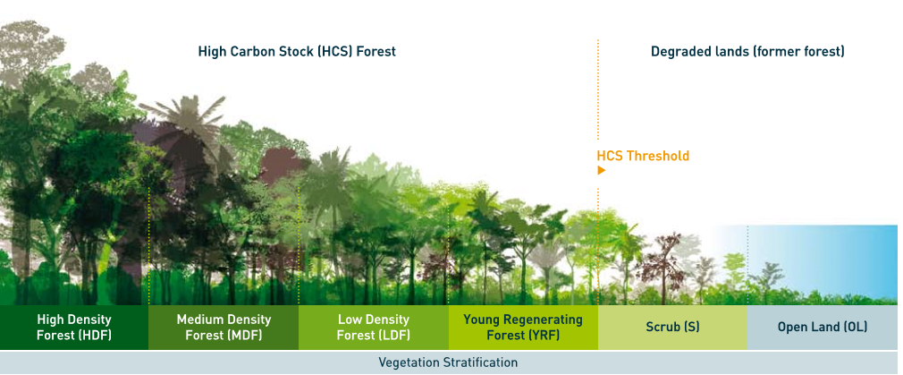
Governing private certification schemes
Zero-deforestation production assessment through independent certification with robust traceability (agreed by the EC)
Product certification increasingly includes provisions for zero deforestation and sometimes refers to the High Carbon Stock (HCS) approach, and conservation of High Conservation Value forests (RSPO). Since 2018, new Rainforest Alliance certification scheme, etc.)
Forest stratification using the High Carbon Stock approach (http://highcarbonstock.org/
Public authorities can drive evolution of private certification schemes through accreditation (based on specifications) and incentives
Fiscal incentive: Tariffs lower for ZD certified products than for uncertified products
Non fiscal incentive: simplified due diligence for imported products with an accredited certification (‘green lane’)

Slide 5
Using additional fiscal receipts for PES in partner countries
Hurdles for small-scale producers:
Cost of adopting deforestation-free practices (e.g. agroforestry for cocoa)
Cost for getting certified
Since most of the tariffs have been removed, differentiation should come from raising rates for uncertified products (need new rounds of negotiations)
Allocating the proceeds of this ‘ecological tax’ to small-scale producers in developing countries’ partners through ‘assets-building PES’
Co-finance the cost of transition and certification, pay on results (i.e. effective implementation of the contracts)
Potential issue with non-discrimination WTO rules…
… However, potential for exceptions through GATT article XX and ‘processes and production methods’ (PPM)
Exception is currently allowed only for product-related PPMs, i.e. those that have an impact on the consumption of the product
Exceptions not allowed so far when PPMs do not concern the product, but have an impact at the time of production, such as deforestation
EU must lobby at the WTO for recognition of both types of PPMs as legitimate cases for exception
EU customs tariffs for some agricultural, forestry and animal products (2019)
Production and sub-product (or its custom code CN8) | GSP-General regime | EPA-ACP/SADC | Other preferential tariff | Without agreement | Share of the sub-product in EU imports
Soya
Beans | 0% | 0% | 0% | 0% | 45% of all soya imported in the EU
Oil, industrial uses | 0% |  |  | 3,2% | 0.95%
Oil, other uses | 0% | 0% | 0% | 6,4%
Soybean meal | 0% | 0% | 0% | 0% | 54%
Palm oil (‘crude oil’)
15 11 10 10 | 0% | 0% | 0% | 0% | 23%
15 11 10 90 | 0% (Ex: Indonesia) | 0% | 0% | 3,8% (Malaysia) | 34%
Palm oil (Solid fractions and other)
15 11 90 19 | 3.8% (Ex: Indonesia) | 0% | 0% | 10,9% (Malaysia) | 10%
15 11 90 91 | 1.6% (Ex: Indonesia) | 0% | 0% | 5,1% (Malaysia) | 24%
15 11 90 99 | 3.1% (Ex: Indonesia) | 0% | 0% | 9% (Malaysia) | 10%
Cocoa
Beans | 0% | 0% | 0% | 0% | 77%
Paste | 6.10% (Ex: Nigeria) | 0% (Ex: Ivory Coast. Ghana…) | 0% | 9,6% | 14%
Butter, fat and oil | 4.2% (Ex: Nigeria) | 0% (Ex: Ivory Coast. Ghana…) | 0% | 7,7% | 9%
Wood pulp | 0% | 0% | 0% | 0% (cf. Uruguay Round)
Natural rubber | 0% | 0% | 0% | 0%
Beef meat | 12.8% + 303.4€/100kg | 0% | Note: Quota system including a non-preferential tariff quota of 20%
Timber |  | 0% | Note: More than 200 tariff positions. Most tariffs at 0%

Slide 6
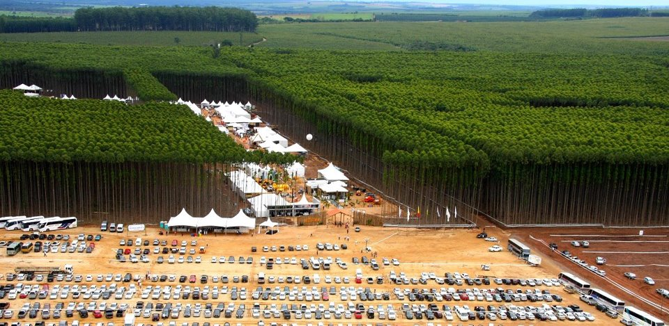
Thank you for listening.
PS: This is NOT a forest!

