Slide 1
The EU Green Deal – living up to the challenges
The EU policy context
Gijs Schilthuis, DG Agriculture
Peter Wehrheim, DG Research and Innovation
25 September 2020

Slide 2
Part I: Policy context European Green Deal, Farm to Fork and the Common Agricultural Policy (CAP)

Slide 3
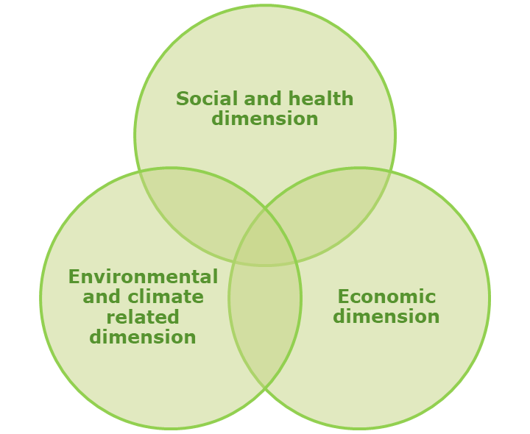

Slide 4
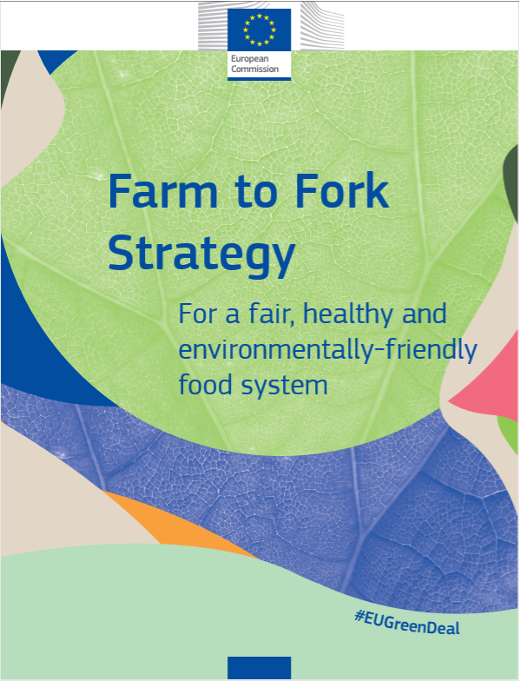
Farm to Fork Strategy (adopted 20 May 2020)
Targets:
Primary production (CAP, CFP, sustainable aquaculture, organic farming, pesticides, fertilisers, animal welfare, AMR, …)
Food processing, distribution, food services, retail (new innovative food and feed products, packaging, environmental footprint, food environment…)
Consumer empowerment (food information /awareness/ behavioural change/digital means…)
Reduce food loss and waste (prevention, valorisation)
Combat food fraud
International dimension (support global transition)
Enablers:
Inclusivity /partnerships/ broad societal consensus in favour of sustainable food systems
Cooperation across governance levels and policy areas
Leaving no one behind / just transition
Role of research & innovation in driving the transition
Financial support to speed up investments and support actions
Role of cities and rural communities
Successfully integrate external/international dimension
& Action Plan

Slide 5
^{INCREASE COMPETITIVENESS}
^{REBALANCE} ^{POWER IN FOOD CHAIN}
^{ENSURE} ^{VIABLE INCOME}
^{CLIMATE CHANGE}
^{ACTION}
^{KNOWLEDGE} ^{& INNOVATION}
^{THE 9}
^{CAP}
^{ENVIRONMENTAL}
^{CARE}
^{OBJECTIVES}
RESPOND TO CITIZENS' CONCERNS in terms of
^{FOOD & HEALTH QUALITY}
^{PRESERVE}
^{LANDSCAPES} ^{& BIODIVERSITY}
^{SUPPORT} ^{GENERATIONAL RENEWAL}
^{VIBRANT} ^{RURAL AREAS}

Slide 6
Part II: Research and Innovation as an Enabler

Slide 7
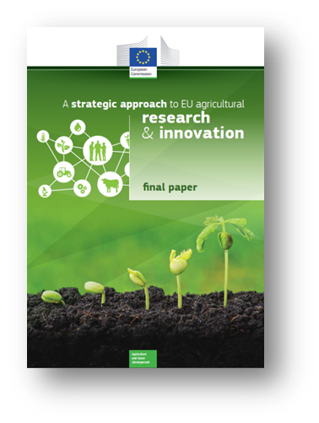
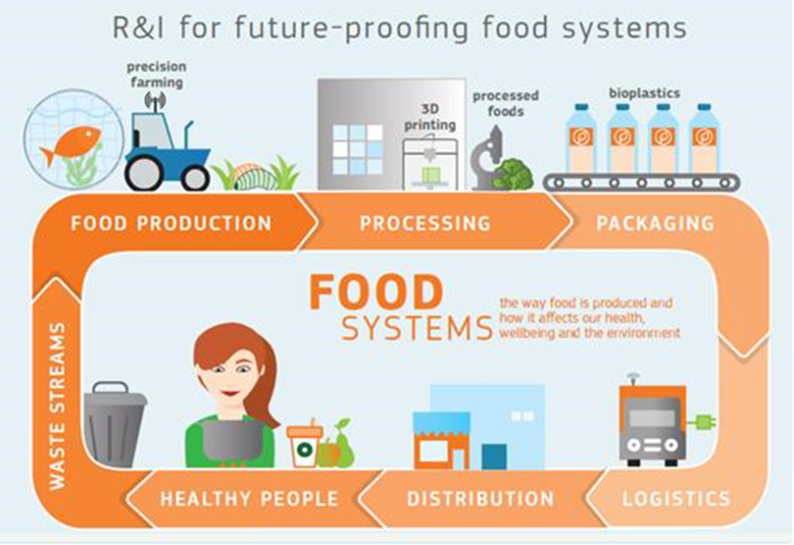
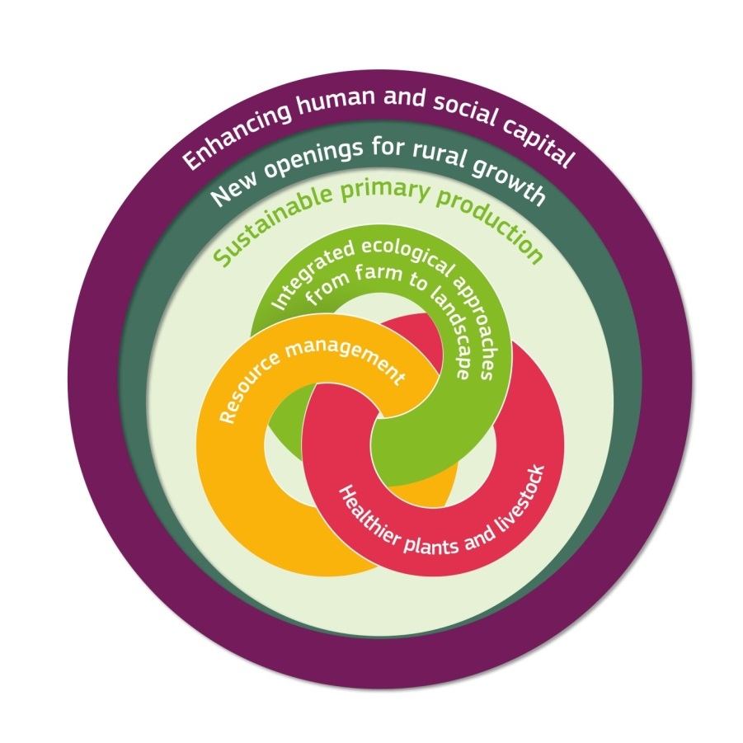
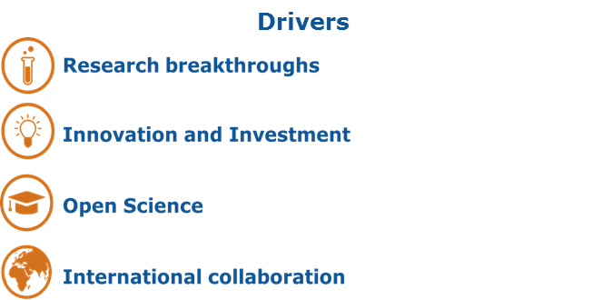
We have (at least one) a plan!

Slide 8
Horizon Europe: 2021-2027
Pillar 1
Excellent Science
Pillar 2
Global Challenges and European Industrial Competitiveness
Pillar 3
Innovative Europe
European Research Council
Health
Culture, Creativity and Inclusive Society
Civil Security for Society
Digital, Industry and Space
Climate, Energy and Mobility
Food, Bioeconomy, Natural Resources, Agriculture and Environment
European Innovation Council
Marie Skłodowska-Curie Actions
Clusters
European innovation
ecosystems
European Institute of Innovation and Technology
Research Infrastructures
Joint Research Centre
Widening Participation and Strengthening the European Research Area
Widening participation and spreading excellence
Reforming and Enhancing the European R&I system

Slide 9
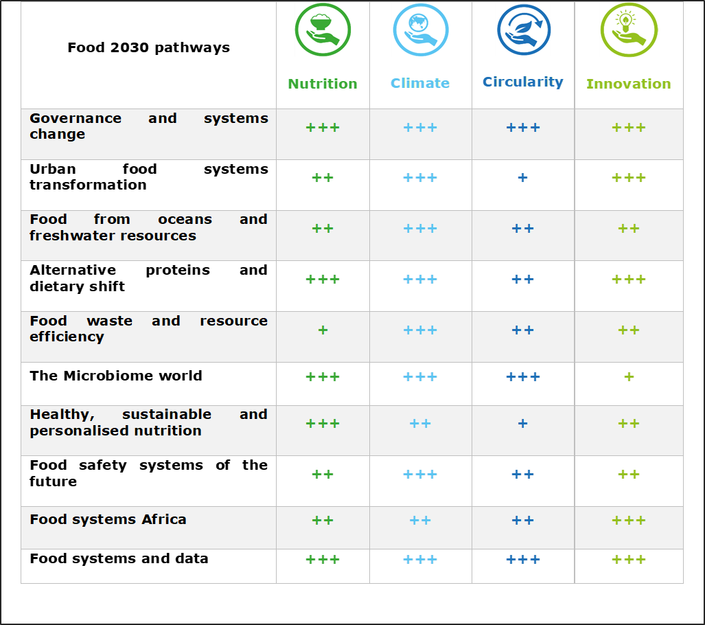
Cluster 6: What is in it?
Environmental Observation
Biodiversity and Natural Resources
Agriculture, Forestry and Rural Areas
Seas, Oceans and Inland Waters
Bio-based innovation systems in the EU Bioeconomy
Circular Systems
Food Systems
7 Intervention Areas (IAs)

Slide 10
Leaving space for new approaches: Research Missions
Adaptation to climate change, including societal transformation
Agriculture, Forestry, Rural Areas, Food
Soil health and food
Mission areas
Cancer
Healthy oceans, seas, coastal and inland waters
Climate-neutral and smart cities

Slide 11
Horizon 2020 European Green Deal Call Adopted on 17-9-2020
The Commission launched a €1 billion call for research and innovation projects that respond to the climate crisis and help protect Europe's unique ecosystems and biodiversity. The Horizon 2020-funded European Green Deal Call, will spur Europe's recovery from the coronavirus crisis by turning green challenges into innovation opportunities.
Mariya Gabriel, Commissioner for Innovation, Research, Culture, Education and Youth : “The €1 billion European Green Deal call is the last and biggest call under Horizon 2020. With innovation at its heart, this investment will accelerate a just and sustainable transition to a climate-neutral Europe by 2050. As we do not want anyone left behind in this systemic transformation, we call for specific actions to engage with citizens in novel ways and improve societal relevance and impact.”
The projects funded under this call are expected to deliver results with tangible benefits in areas reflecting the key work streams of the European Green Deal:
Increasing climate ambition
Clean, affordable and secure energy
Industry for a clean and circular economy
Energy and resource efficient buildings
Sustainable and smart mobility
Farm to fork
Biodiversity and ecosystems
Zero-pollution, toxic-free environments
Notes:
This Green Deal Call differs in important aspects from previous Horizon 2020 calls. Given the urgency of the challenges it addresses, it aims for clear, discernible results in the short to medium-term, but with a perspective of long-term change. There are fewer, but more targeted, larger and visible actions, with a focus on rapid scalability, dissemination and uptake.

Slide 12
Next steps & key events
Farm to Fork Conference 15-16 Oct
Food 2030 World Food Day HL Event under DE Presidency with FAO – 16 Oct 2020
Fit4Food2030 Final Conference – 24-25 Nov 2020
EIT Food Future of Food Conference – 1-2 Dec
SCAR Foresight Conference & Report – 14-16 Dec 2020
Launch of first Horizon Europe calls for proposals – XXX
UN World Food Systems Summit – Q3 2021 (tbc)

Slide 13
Thank you #InvestEUresearch - #AgriResearchEU - #H2020SC2 #HorizonEU www.ec.europa.eu/agriculture/research-innovation_en www.ec.europa.eu/research/bioeconomy
Twitter: #FOOD2030EU
Sign up to our Food 2030 stakeholders list:
https://ec.europa.eu/eusurvey/runner/FOOD2030StakeholdersPermission
Notes:
Update/add/delete parts of the copy right notice where appropriate.
More information: https://myintracomm.ec.europa.eu/corp/intellectual-property/Documents/2019_Reuse-guidelines%28CC-BY%29.pdf

