Slide 1
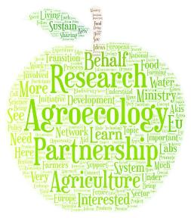
Setting the scene – What are LLs and what experiences exist already?
Alexia ROUBY
European Commission
Agriculture and rural development
Research and innovation
EURAGRI Webinar
09 June 2021

Slide 2
Contents
Why this interest on living labs?
How do we understand living labs?
Towards soil health living labs
Which LL examples can we build on?

Slide 3
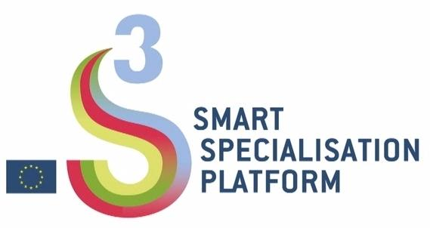
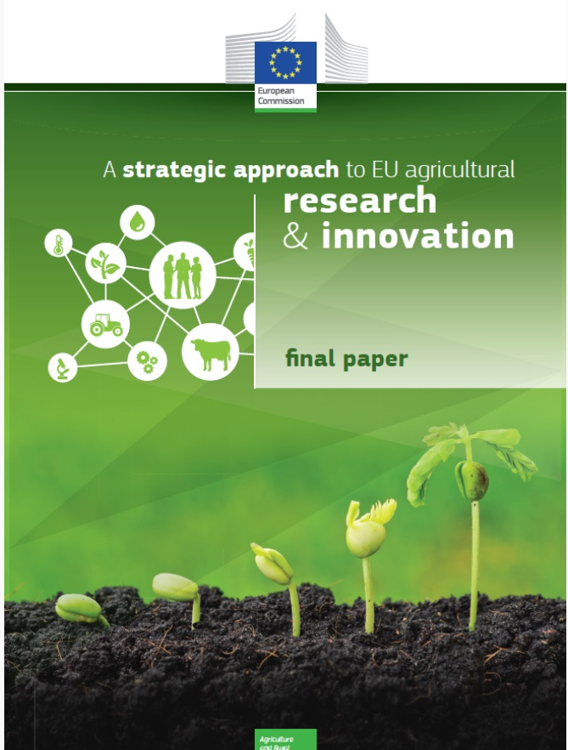
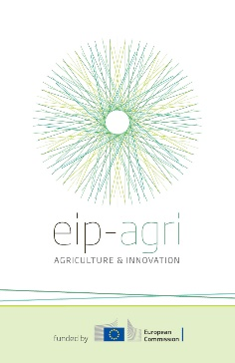
Why living labs?
Could LL be a powerful tool for change?
Multi-actor projects
Digital farming, S3
G20
Agroecosystem living labs

Slide 4
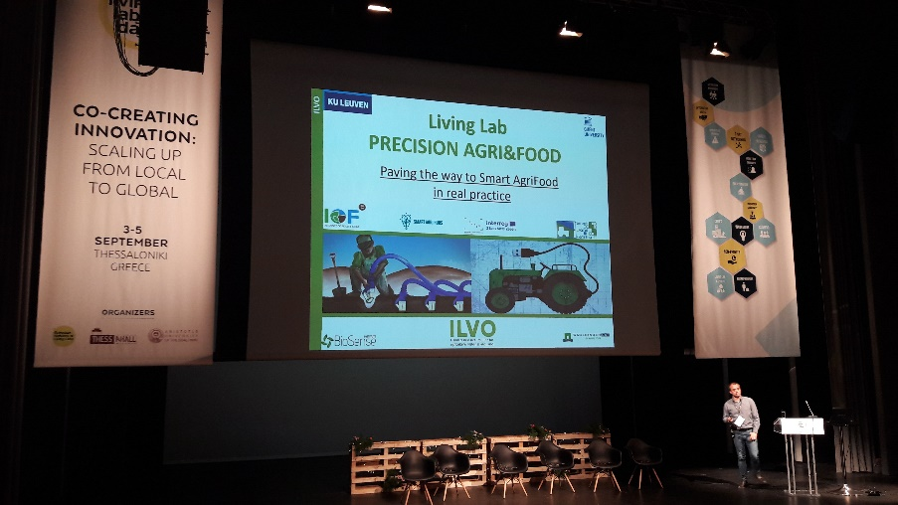
Living labs on the rise

Slide 5
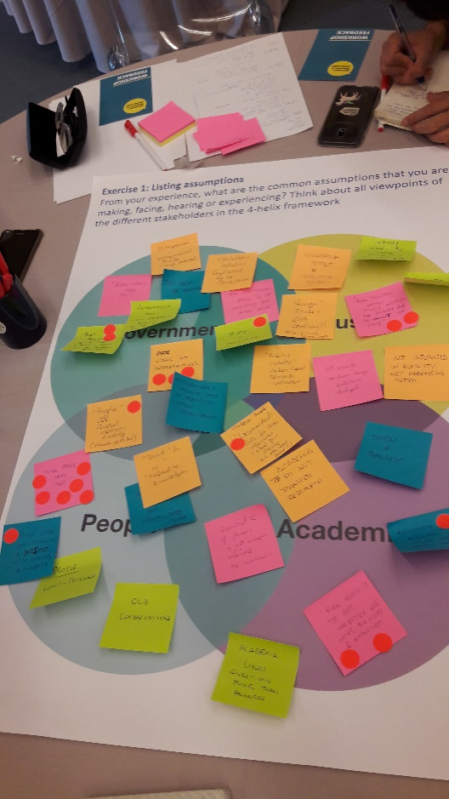
Living labs: an international community of practice
Already a lot developed:
Learning/capacity building tools
Coordination methods
Monitoring and evaluation indicators
Governance approaches
Connect and build on the existing
International exchanges

Slide 6
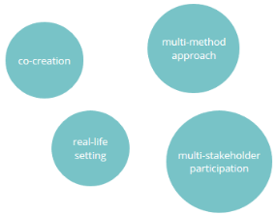
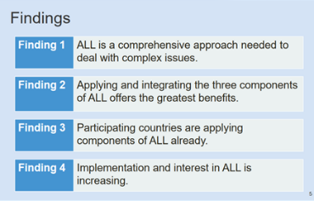
Understandings of living labs
Living Labs (LLs) are defined as user-centred, open innovation ecosystems based on systematic user co-creation approach, integrating research and innovation processes in real life communities and settings.
(EnoLL)
Living Labs <-> Social innovation
Key interesting features:
Place-based/embedded in real working landscapes/communities
Multi-method= transdisciplinarity = More systematic use of a wide range of social sciences (behaviour)
Beyond projects, structuring the innovation ecosystem

Slide 7
How could living labs enrich the approach?
User-centred innovation
Multi-actor (agri + adv. science + ind. etc.)
Social
and behaviour sciences
Place-based landscape + Long-term
More actors (public, consumers)
Identifying Needs from practice
Knowledge exchange

Slide 8
Several levels of analysis Living lab networks, living labs, living lab projects

Slide 9
Proposed understanding of living labs under the mission on soil health and food (definition)
participatory, user-centred, place-based and transdisciplinary research and innovation approaches that…
… involve land managers and other relevant actors in joint work with researchers to:
conduct systemic research in real-life settings,
identify practitioners’ knowledge needs on soil health, and
co-design, test, monitor and evaluate new or existing solutions
to improve their effectiveness and early adoption.
Notes:
ENOLL’s building blocks
1. active user involvement (i.e. empowering end users to thoroughly impact the
innovation process)
2. real-life setting (i.e. testing and experimenting with new artefacts “in the wild”)
3. multi-stakeholder participation (i.e. the involvement of technology providers,
service providers, relevant institutional actors, professional or residential end
users)
4. a multi-method approach (i.e. the combination of methods and tools
originating from a range of disciplines including ethnography, psychology,
sociology, strategic management, engineering) => « transdisciplinarity »
5. co-creation (i.e. iterations of design cycles with different sets of stakeholders)
Living Laboratories (or living labs) are spaces for co-innovation through participatory, transdisciplinary and systemic research. They allow highly committed landowners and land managers, stakeholders from various sectors, public authorities and citizens, including consumers, to work together with researchers from multiple disciplines to develop solutions and identify gaps in our knowledge on soil health. This includes the enhanced use of agroecological principles and of organic agricultural practices that have shown evidence of notable effects on soil health. In living labs there is also research on land managers’ motivations, socio-economic drivers, incentive mechanisms, business models and enabling environments for successful transformation towards improved soil health and improved ecosystem services.

Slide 10
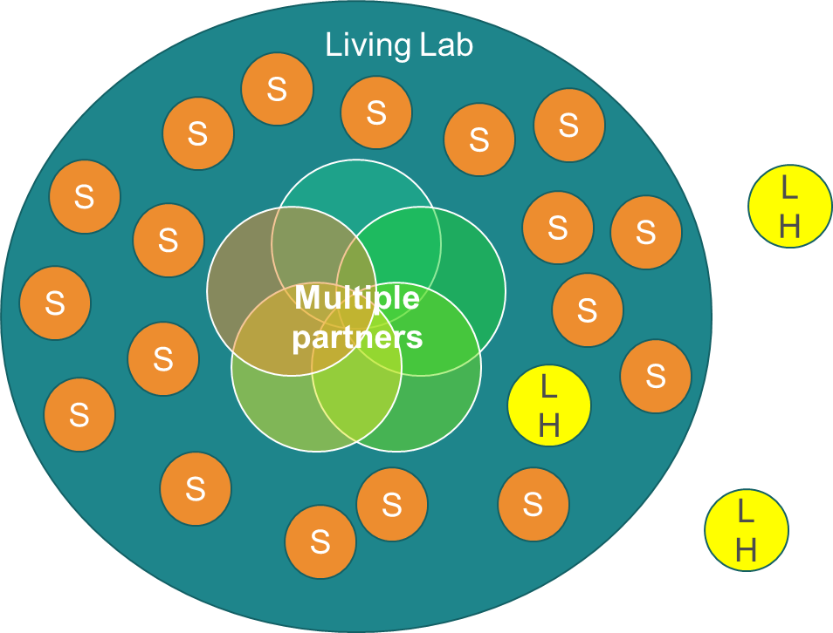
Proposed understanding of living labs (and lighthouses) under the mission on soil health and food (scales)
Living lab = regional/sub-regional scale, multi-partner, several sites
Lighthouse= one « exemplary » site
 | Scale | Activities | Performance in soil health improvement
Living lab | Regional/sub-regional landscape | Coordinate experimentations & partners | In progress at landscape scale
Living lab experimentation site | Local (one farm/forest, one urban site, etc.) | Co-create knowledge and innovations | In progress on the site
Lighthouse | Local (one farm/forest, one urban site.) | Experiment and/or demonstrate | Demonstrated high performance

Slide 11
Proposed understanding of living labs (and lighthouses) under the mission on soil health and food (Criteria)
Living labs*
Lighthouses
Aims
Innovation, co-creation, formal learning
Activities
Co-design, co-development & experimentation of innovations improving soil health and related ESS
Participants
Public-private-people partnerships
Context
Multiple disciplines (-> transdisciplinarity, inc. social sciences), methods, dimensions (technical, economic, social)
Contribution to societal challenges
Improving soil health and related ecosystem services (=> mission objectives)
Research on impact of these innovative practices on ecosystems
Networking and knowledge exchange
Demonstration (in particular lighthouses)
Real users (soil managers connected with broad array of stakeholders & decision-makers)
Demonstration: wider public, policy arena, EIP and relevant networks
Place-based approach and real-life context = real farms/forests/urban sites
Robust scientific setup for ecosystem assessment
Openess, communication and dissemination
Criteria based on exemplary performance in terms of soil health and related ecosystem services
* adapted from McPhee et al. (2021)

Slide 12
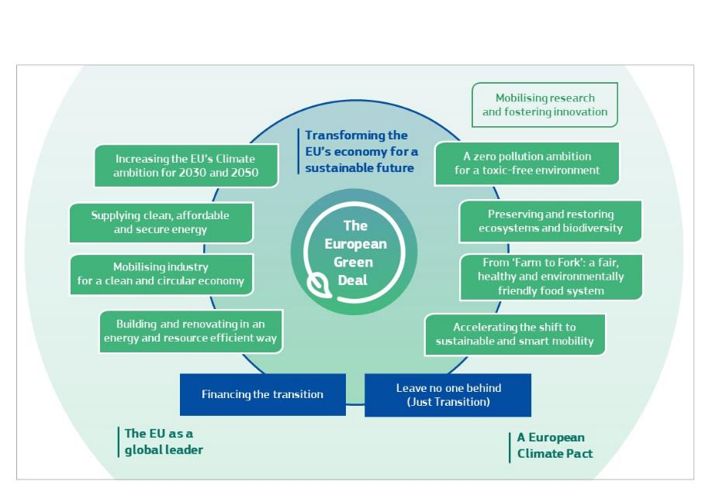
Living labs on agroecology: why?
We want to empower rapid change:
Agroecology seen as a powerful contributor
Living labs have a potential to accelerate change
Agroecology elements fit well with living labs principles:
Adapted to local ecosystems → « Place-based »
Involving actors at territorial level to achieve large scale impact
Social and behavioural dimensions
Systems approach
Understanding under development by SCAR-Agroecology working group (same departure points)

Slide 13
Living labs examples
Webinars on agroecology living labs and research infrastructures (4-5 June 2021)
Mapping exercises by:
Mission board on Soil health and food
SMS Soil mission support
European Commission first screening survey
ALL-READY
AE4EU
EnoLL interest group on agrifood living labs + action-oriented taskforce on rural LL.
Horizon 2020 projects with LL: LIVERUR, AGRILINK, DESIRA, ROBUST, STARGATE etc.

Slide 14
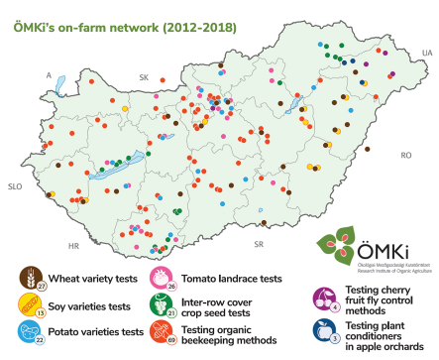
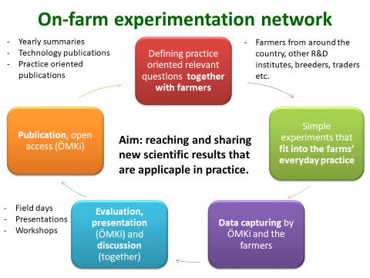
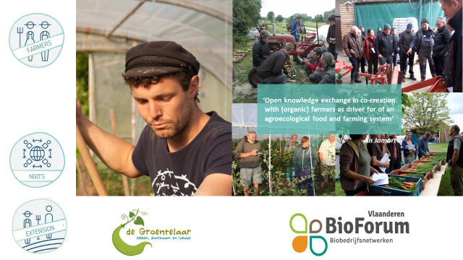
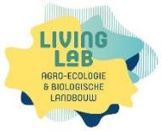
Living labs examples in Europe

Slide 15
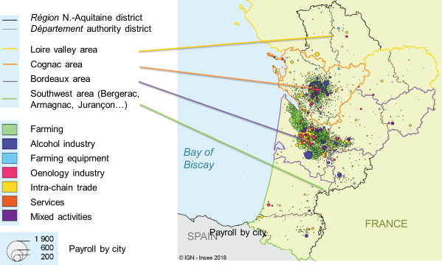
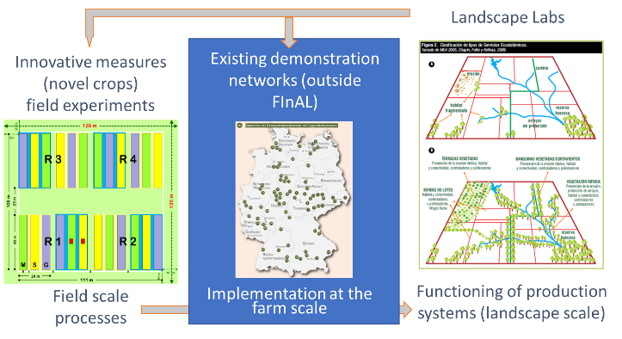
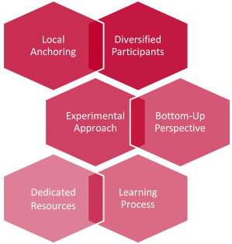
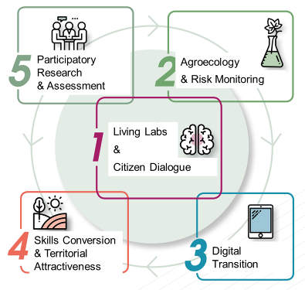
Living labs examples in Europe

Slide 16
Living labs examples in H2020 projects

Slide 17
Living labs examples overseas
CANADA
(slides from AAFC)
USA

Slide 18
Thank you
More information:
European R&I partnership on agroecology living labs and research infrastructures
Webinars on building the European partnership on agroecology living labs
© European Union 2020
Unless otherwise noted the reuse of this presentation is authorised under the CC BY 4.0 license. For any use or reproduction of elements that are not owned by the EU, permission may need to be sought directly from the respective right holders.
Slide xx: element concerned, source: e.g. Fotolia.com; Slide xx: element concerned, source: e.g. iStock.com

