Slide 1
Identifying collective challenges in the transition to a sustainable agricultural model Dr. Cynthia Giagnocavo Director, Cátedra (Endowed Chair) COEXPHAL-UAL in horticulture, cooperative studies and sustainable development Department of Economics and Business University of Almería, Spain
Transformational research – co-ordinated innovation activities for societal challenges
Webinar of the Faculty of Bioscience Engineering Research Days, Ghent University 12:00 -13.30 (CET) 7th May - Teams

Slide 2
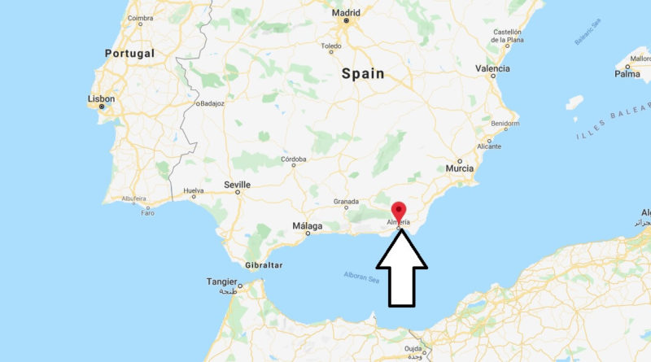
Introduction
Cátedra (Chair) COEXPHAL-UAL acts as a bridge between academia and Almería horticultural sector. COEXPHAL is the association of producer organisations - 80+ coops & 15,000 small family farmers. Leverages research and innovation to resolve sector challenges in strategic co-creation process.
University of Almería, Spain. Full service university with specialisation in agriculture. Ranked 1st in Spain in intensive agriculture and related technologies.

Slide 3
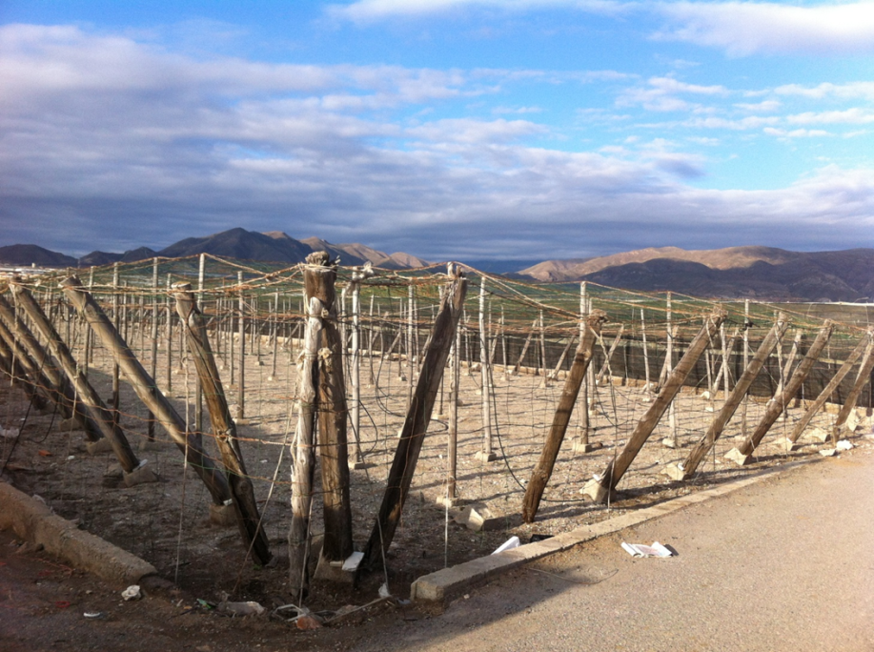
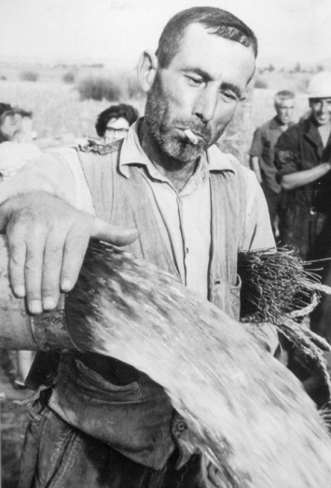
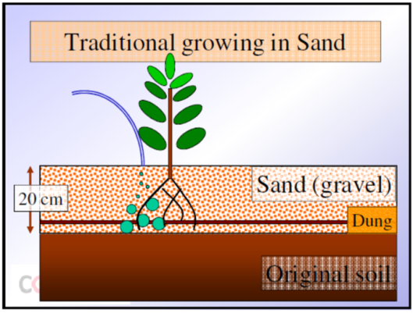
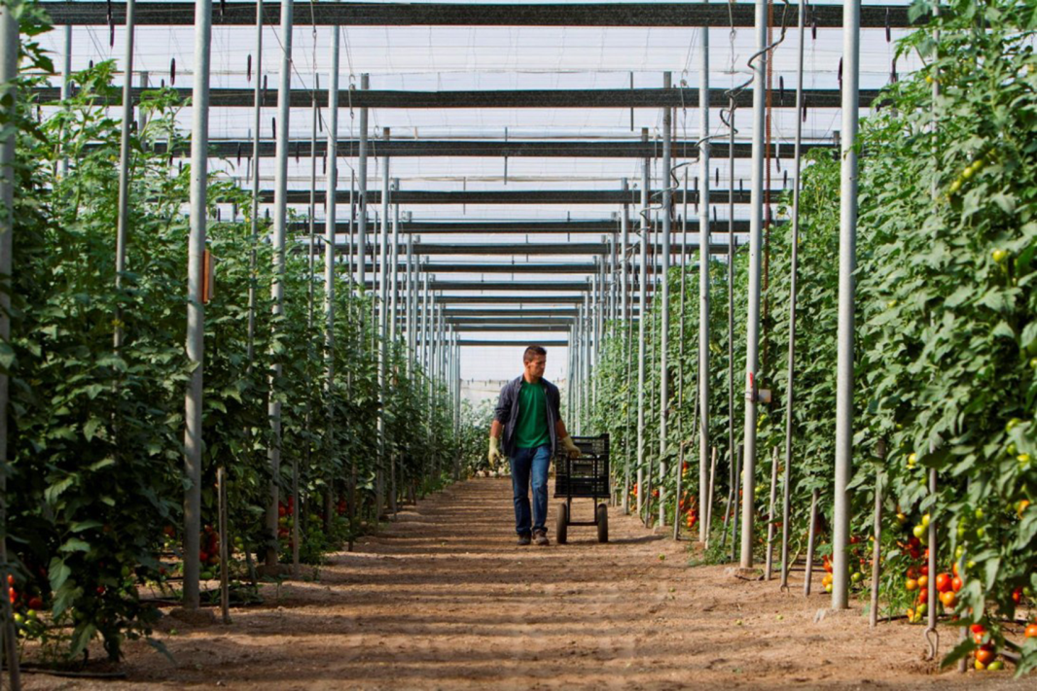
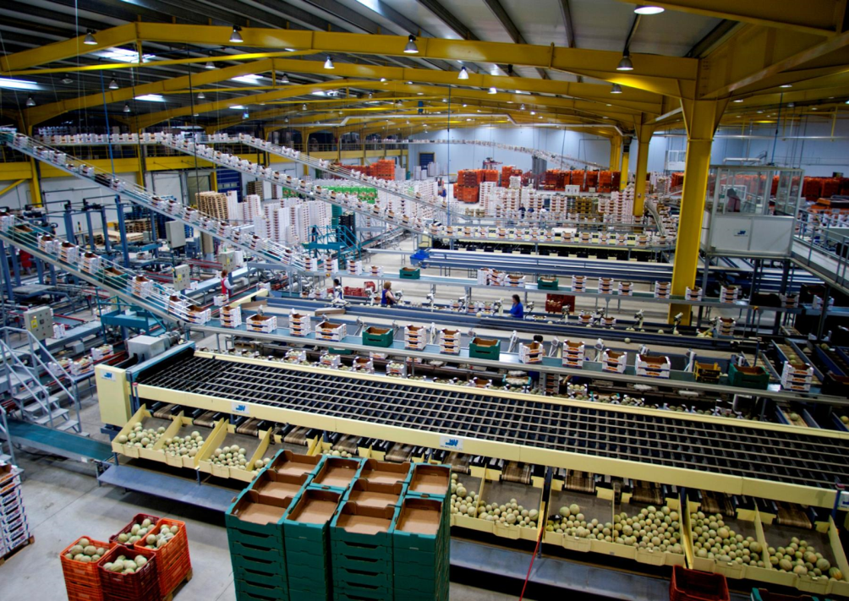
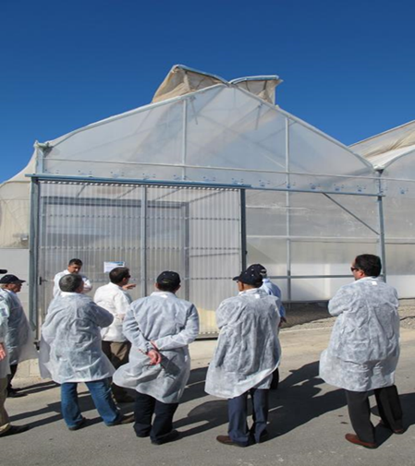
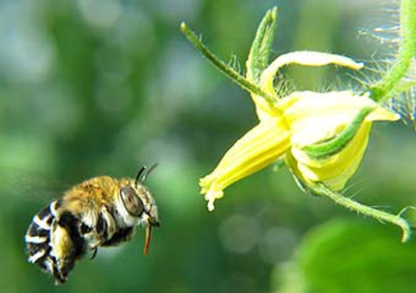
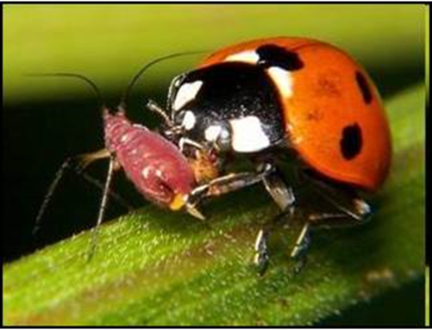
Cajamar (man with water, greenhouse structure,man with beehive); Francisco Bonilla for COEXPHAL (greenhouse interior, packing plant, insects); C.Giagnocavo (old exterior greenhouse);

Slide 4
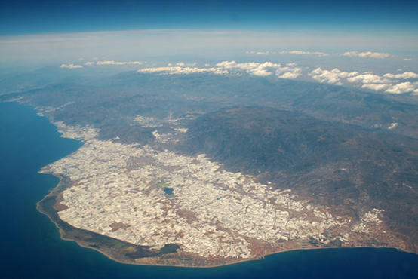
Amusing Planet (background)

Slide 5
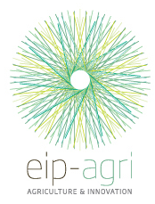
Selected Research Projects of Cátedra COEXPHAL-UAL Why? “….co-produce the suite of technological, social and institutional innovations that are co-shaping transformation…coordinate innovation activities with the objective of developing a coherent set of technological, institutional and behavioural solutions as coupled innovations….”
IoF2020 Internet of Food and Farm
SmartAgriHubs (Digital Innovation Hubs
- EU Network)
NEFERTITI & IPMWorks (peer to peer/networks of knowledge)
FairShare (digital tools for farm advisors)
“CO-creating sustainable and competitive FRuits and vEgetableS’ value cHains in Europe”
Plus a wide array of OPERATING GROUPS (regional and national)
ALMERÍA AGROECOLOGY LIVING LAB
DIH – Almería SmartAgriHub

Slide 6
Mission-oriented Innovation Policy
“….Mission-oriented innovation policy brings together elements of innovation policy, which traditionally aims to create economic growth, and transition policy, which principally aims to create change that is beneficial for society at large…”
Values are at play…

Slide 7
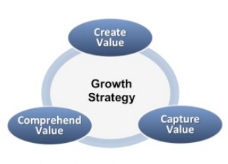
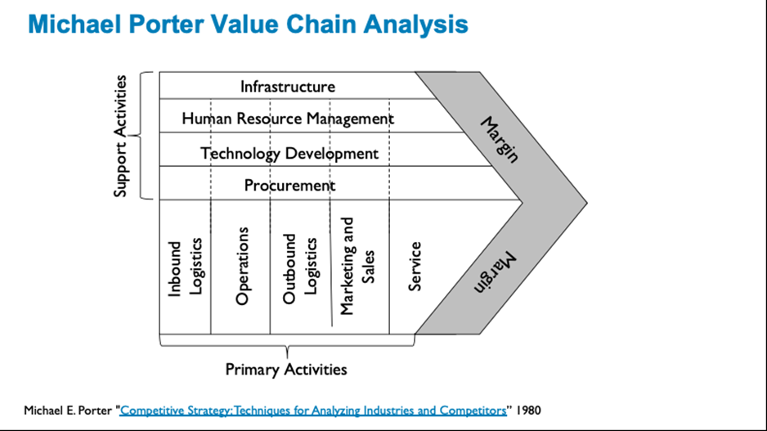
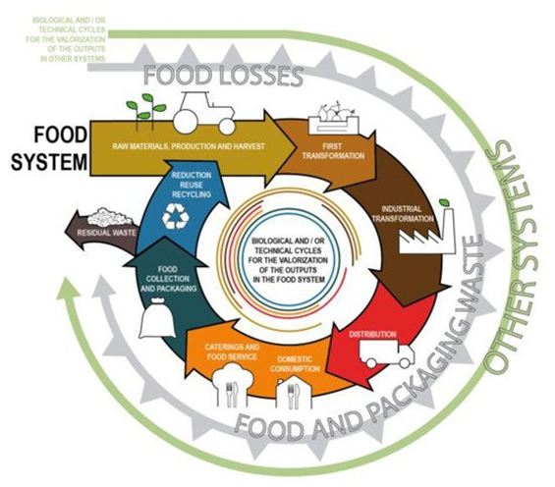
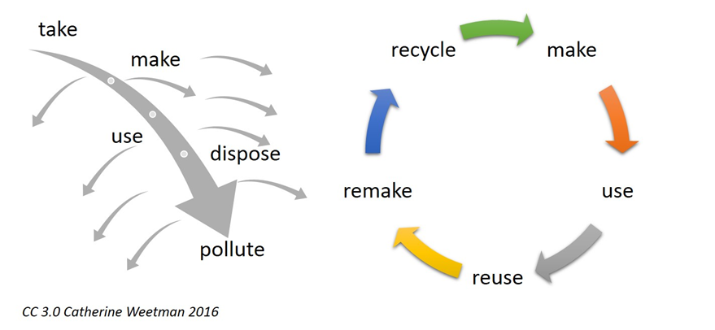
Value?

Slide 8
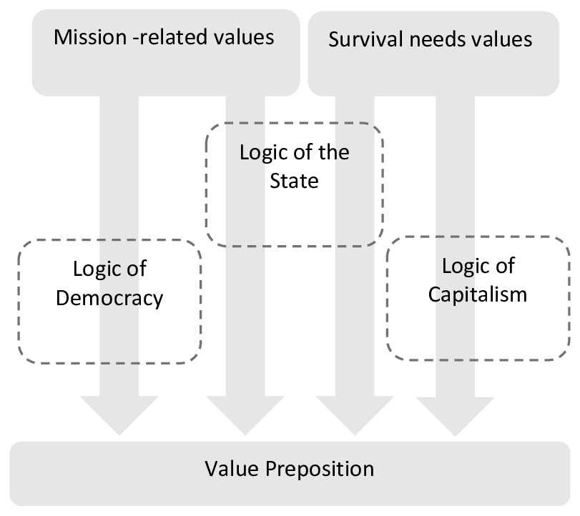
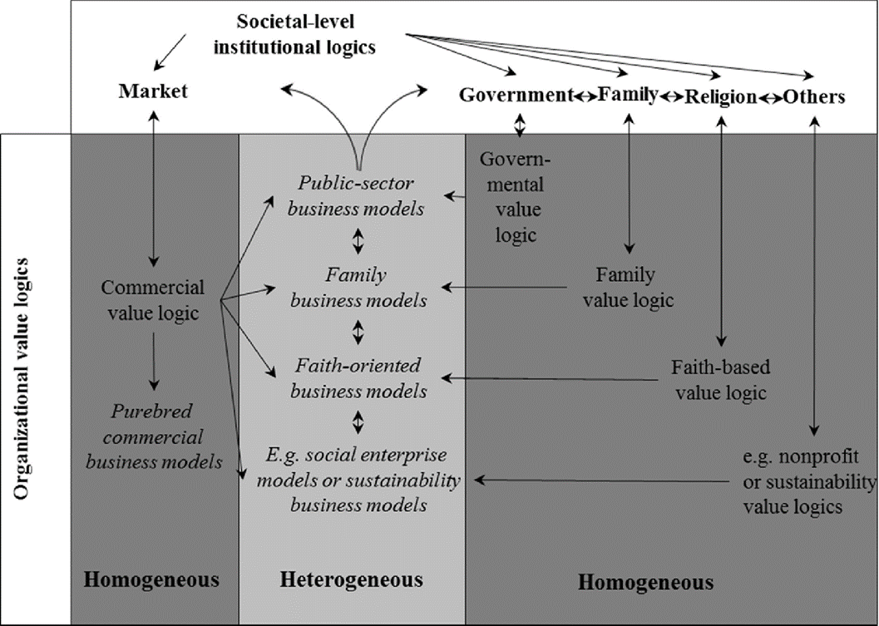
Organisational Value Logics – The Business Model has been conceived as a commercial logic of value proposition, creation, exchange/deliver and capture…
Q?:
-what value is offered, and to whom in the value proposition?
-valuation method matters: what is valued, how, and by/for whom?
-the business model is embedded in organizations and systems.
Homogeneous and heterogeneous organizational value logics are shaped by a variety of institutional logics.

Slide 9
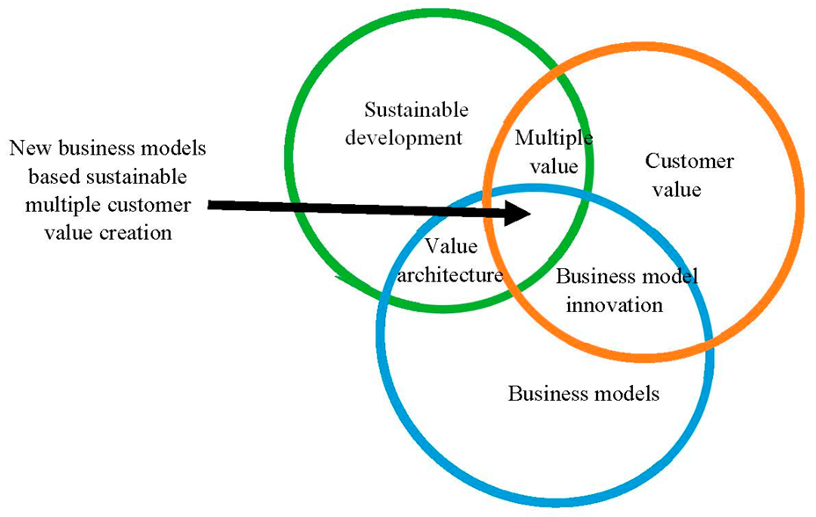
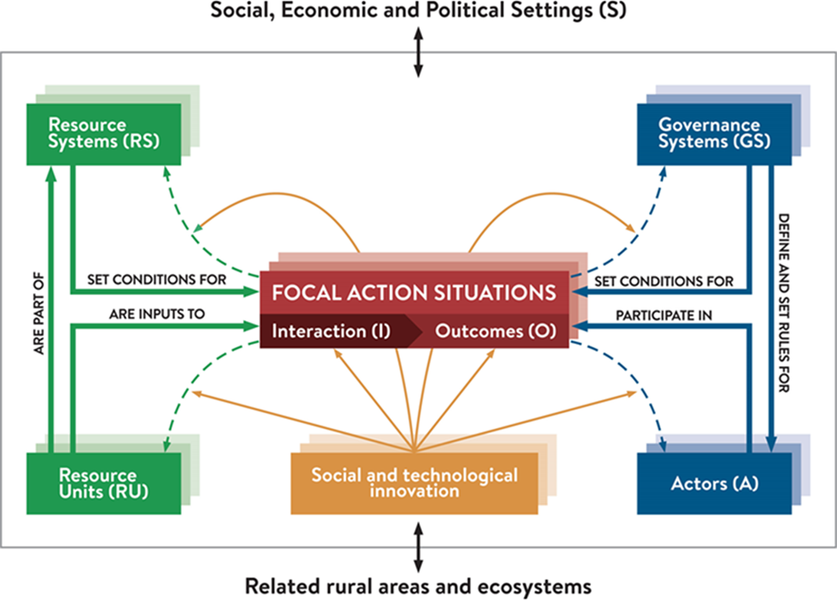
Sustainable?
How we govern exchange of value matters too: e.g.: Ostrom´s Social Ecological Systems or the set of rules for Common Pool Resources

Slide 10
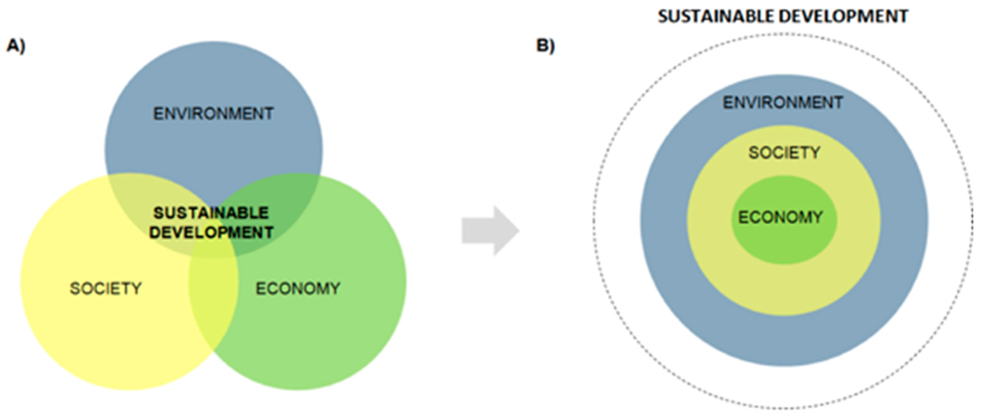
Paradigm Shift
New sustainability framework, recognizing the significance of the life-support systems and the biosphere as the foundation for the economy, society, and the human dimension.
Economy is a subsystem of society, which is a subsystem of the biosphere or environment
Within this sustainability framework, the long-term sustainability of greenhouse agriculture of Almería depends on the ability of the agricultural model to transition to a new sustainable framework which builds upon the biosphere as a precondition for socio-economic development.

Slide 11
Plural Value Dimensions - incommensurable
However, framing the agricultural sector in a new sustainability model based on recognition of the biosphere as the foundation upon which society and economy are based is extremely challenging.
Complex realities resulting from balancing costs, benefits and trade-offs among social, economic and environmental dimensions that need to be analyzed with appropriate methods.
Trade-offs are not straight forward
Plural value-dimensions are present in carrying out our analysis of the challenges that face the sustainability of Almeria’s agricultural sector.

Slide 12
Method? Plural value, multi-criteria + multi-actor and transdisciplinary research
Development of common conceptual grounds in order to address divergence of values in the analysis of complex systems, where disagreements in definition or solutions of a societal problem often exist.
Inclusion of multi-actors is coupled with plural value and multiple criteria approach.
The multi-actor approach is an adequate scientific response (underutilized*) to stimulate cooperation of scientists with practitioners, industry and other actors and can be implemented by using tools and procedures of transdisciplinary research: co-learning and knowledge co-production processes contribute to solutions or transitions.

Slide 13
MAIS Challenge…
2019 - multi-actor community of practice organized in Almería - included scientists and non-scientists with extensive experience in greenhouse agriculture from 5 knowledge domains (technology, environment, society and culture, economy, and governance).
Non-scientists included public and private actors, cooperative presidents & CEOs, public extension services, policy makers, foundations, farmer associations, technology companies, etc.
The collective dynamics were oriented specifically to
(1) explore and define the sustainability challenges,
(2) identify opportunities and barriers to address each challenge, and
(3) establish collective actions to move from theory to practice in overcoming the identified challenges.
https://www.mdpi.com/1660-4601/16/21/4097/htm

Slide 14
Six Challenges (consensus!)
The multi-actor, transdisciplinary process implemented collectively, and supported by scientific literature, identified 6 fundamental challenges to transitioning to an agricultural model that aims to ameliorate risks and avoid a systemic collapse, whilst balancing a concern for profitability with sustainability:
Governance based on a culture of shared responsibility for sustainability,
(2) Sustainable and efficient use of water,
(3) Biodiversity conservation,
(4) Implementing a circular economy plan,
(5) Technology and knowledge transfer, and
(6) Image and identity.

Slide 15
Outcomes of each challenge…..we will only look at selected examples today…(participants can read the rest later, or the article…)
Important to get a sense of Mission oriented Agricultural Innovation Systems put in practice….

Slide 16
1) Governance based on a culture of shared responsibility for sustainability
Shift to a new governance system that enables a culture of shared responsibility for long-term sustainability. Major governance issue identified - regulatory non-compliance tolerated by public local and regional administrations.
Role of civil society in creating public policies and governance has been neglected.
The diversity of governance interpretations and meanings, which are dependant on plural values, as well as multidisciplinary traditions, results in a complex task in the attempt to define a common and generic governance strategy.
Opportunities: (1) Existing legal frameworks that obligate public administrations to guarantee transparency and active participation in policies, or corporate social responsibility and environmental responsibility legal frameworks; (2) European Commission has emphasized the full engagement of public participation in governance and achievement of its research missions, where the public is not only involved in co-creation but also in co-implementation and co-evaluation.
Barriers: Public administrations have not developed an effective method by which to fulfil the obligation to include active public participation.
Key actions: (1) to advance a new governance model for Almeria, improve internal and inter-institutional coordination for the integration of environmental goals in public policies; (2) Empower Almeria’s society by offering training and experience in public participation for public policies; and (3) Create new spaces based on social learning and collective construction for sustainability, instead of the negotiation of individual interests and preferences.

Slide 17
2) Sustainable and efficient use of water
Unsustainable water management is one of the most important environmental issues worldwide. Urgent need to correct the current trend of water use by greenhouse horticulture, impacting water quality and quantity. Nitrate Vulnerable Zones require the adoption of improved management of both irrigation and nitrogen.
Opportunities: (1) compliance with the EU Water Framework Directive; (2) lntegrated use of alternative water sources to optimize cost, quality and water extraction rates; (3) Low-cost technologies developed and evaluated as result of innovative research and knowledge transfer - (Fertinnowa; IoF2020; NEFERTITI, SAH…); (4) Effective system for knowledge exchange and dynamic community of farmers/cooperatives capable of absorbing changes and promoting new strategies; and (5) Market that is increasingly demanding more sustainable production processes (certifications).
Barriers: (1) lack of public awareness regarding sustainable use of water resources and implications for long term sustainability of greenhouse industry; (2) reticence to pay for higher-cost irrigation water; (3) lack of economic incentives by public administrations to change the current water management plans; and (4) Inadequate control and enforcement by public administrations to prohibit illegal water practices.
Key Actions: (1) adapt and control water use rights according to availability (Water Exploitation Index) and progress towards compliance with the water and regulatory framework in force; (2) inform sector on general condition of groundwater bodies and create a panel of experts including both socio-economic agents and the civil society; (3) promote the use of alternative water sources and efficient and sustainable irrigation-fertilisation management systems (certification); and (4) to ensure the impact of the transfer of technologies and knowledge exchange from R&D organizations.

Slide 18
(3) Biodiversity conservation
Need for protecting one of the most unique habitats of Europe, i.e., the Spanish drylands, but also the urgent need to communicate to society the interdependent relationship between the maintenance of the greenhouse horticulture and conservation of local natural resources.
Almería greenhouses occupy 4% of the province, but are concentrated in the coastal platform where numerous habitats of priority interest are located (European Natura 2000 network) that contribute to maintenance of biodiversity and ecosystem services – negative impacts due to the expansion of greenhouse industry, urbanization and beach tourism.
Opportunities (1) Existence of local regulations (and incentives) that require establishment of green infrastructures in newly created greenhouses; (2) Adaptive character of Almería’s greenhouse industry to implement new measures and innovations; (3) New technologies and cultivation techniques to reduce harmful agricultural practices could contribute to support biodiversity; and (4) Communication with consumers to promote sustainable agricultural products.
Barriers (1) The low value given by all levels of society to biodiversity and the direct and indirect benefits (2) the restoration plant species of interest is constrained by greenhouse expansion; (3) the globalised competitive horticultural markets which prioritise high, short-term economic performance, and the focus on technology to increase production at all costs - socio-ecological vicious circle.
Key Actions (1) increased public understanding of the need to preserve ecological processes that sustain the greenhouse industry (e.g., planting of autochthonous hedges between greenhouses); (2) implementation of effective measures for acknowledging the instrumental values of biodiversity; (3) the restoration of local ephemeral streams (i.e., ramblas in Spanish) which will contribute to the maintenance of genetic diversity, and the habitat connectivity of the Nature 2000 Network; (4) Support for new technologies and techniques to support biodiversity (IPM, organic production, improved irrigation, DSS, IoT, and digitization)

Slide 19
4) Implementing a Circular Economy plan
The Almería production model lacks closure of its material circuits. Plastics (both packaging and those used to protect crops) are a serious problem for which the solutions so far have been to use regulated disposal companies.
Accumulated crop residues represent a logistical, environmental and health issue, and are not yet solved because of insufficient facilities which deal with this waste in a circular manner.
Opportunities: (1) growing societal awareness associated with sustainability issues, and among consumers in particular; (2) Local productive system could facilitate the transfer of values, knowledge and technologies; (3) Economic capital from agricultural industry surpluses and other sectors such as tourism, construction and industry could bring together the development of new sectors; and (4) wide availability of sunlight in Almeria offers a parallel opportunity to the agricultural industry associated with new photovoltaic businesses.
Barriers: (1) logistical difficulties related to the small farms agricultural model, where waste collection and recycling is complex and expensive; (2) The sector is disadvantaged by a low level of research, development and innovation and research investment by the agricultural industry itself.
Key actions: (1) the implementation by regional administration of promised initiatives that facilitate the sustainable use of resources by the agricultural industry; (2) the creation of AKIS that facilitates sustainable strategies among all relevant public and private actors; (3) increased investment in R + D + i, through sustainable finance initiatives; and (4) support for existing R + D + i initiatives between the research and business sectors, Almería SmartAgriHub, Operating groups/EIP Agri to specifically focus circular economy topics.

Slide 20
(5) Technology and knowledge transfer
Agricultural value chains are being transformed by digital technologies yet at farm level adoption lags. New data technologies drive increasing consolidation and concentration in the agribusiness sector, particularly in the seed, fertiliser, chemical, genetics, and farm machinery industries, as well as retail sector. Technologies and digitization may create new social problems, extending the “power of the powerful”.
Agri-food supply chains and value ecosystems are converting into data-rich and data-defined sectors, but the value of farmers’ data is often unrealized by the farming community, and data benefit and control issues are neglected.
Opportunities: (1) technology in the greenhouse/coops can maximize production, improve quality and minimize the use of resources and improve their management; (2) Technologies may improve and monitor regulatory compliance (and improve social conditions; (3) Increase in available public data (climate and market data) provides the groundwork for innovations.
Barriers : (1) insufficient communication between business, university and producers; (2) technologies in early stages and untested; (3) lack of data standards and interoperability between devices and systems; (3) people play a central role in digital technology thus need for appropriate knowledge acquisition and capabilities; (4) unclear laws and regulations applicable to data; and (5) given small-holding, family farming organization, doubts as to whether the necessary investments may be made by such fragmented enterprises.
Key actions. (1) Almería research centers, technology companies, cooperatives, as well as the administration, should collaborate and foster coordination in areas of research, transfer of knowledge and technology, as well as training whilst striving to create data standards - DIHs; (2) Social innovation, closely aligned with processes of uptake of technologies, may be supported by cooperatives as an instrument to counteract the negative social and economic impacts of technology and digitisation of agriculture.

Slide 21
(6) Image and identity
The challenge of improving the image and identity of Almeria’s agricultural sector falls into three categories: (1) the improvement of rural hygiene in the surrounding greenhouse areas (plastics and waste), (2) promoting socially just labor conditions, and (3) the need to communicate to the international community of its commitment to move forward with a model of agriculture and economy which operates within the limits of a sustainable environmental system.
Barriers: (1) Lack of proactive attitude by the agricultural sector and public administrations; (2) Prevailing view in the agricultural sector, that many of those problems are not their responsibility (Immigration is a national competence) or that they are too complex; (3) Social sustainability is questioned despite the importance of family farms and cooperatives.
Opportunities (1) implementation of sanctions and obligations for agrochemical companies to collect waste from their products and to pay for the packaging and recycling of each product; (2) improving the working and social conditions of immigrant workers and the elaboration of an integration plan for immigrants; and (3) new awareness campaigns financed with agricultural sector private funds, which would imply a change of mentality in the agricultural sector.
Key actions: (1) new regulations on greenhouse structures and installations, plant screens in greenhouses and awareness-raising campaigns; (2) closer collaboration with local administrations and social economy entities that have a long experience of intervention and social integration; and (3) new local strategies, funded privately, to improve the image of the sector. (e.g. leading and successful cooperatives provide dignified housing and serve as an example for others to follow suit.)

Slide 22
MAIS - Multi-actor transdisciplinary approach successfully facilitated the creation of a culture of shared missions and responsibility among public, private, academic, and civil society actors. Notwithstanding plural values, challenges and solutions identified by consensus point to a nascent acknowledgement of the strategic necessity to locate agricultural economic activity within social and environmental spheres.

Slide 23
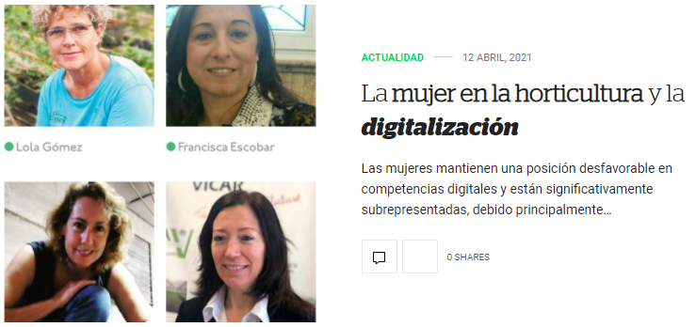
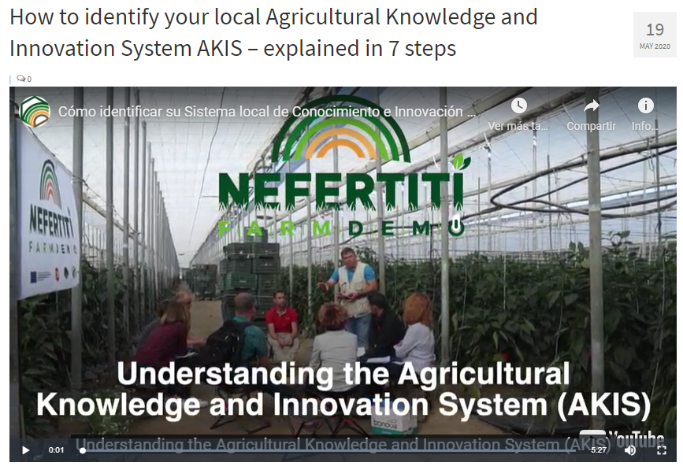
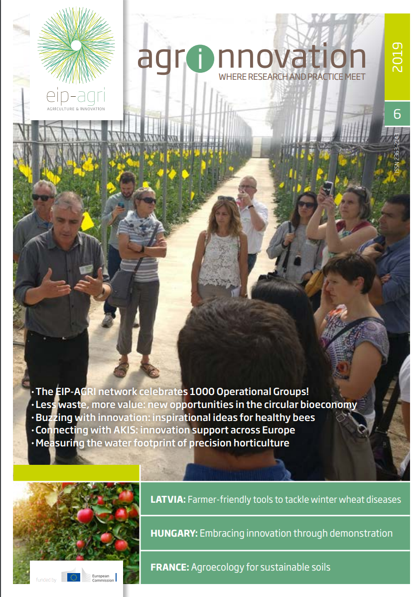
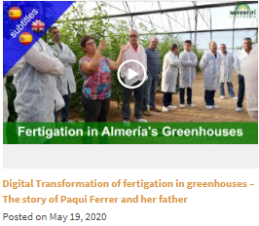
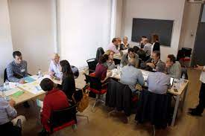
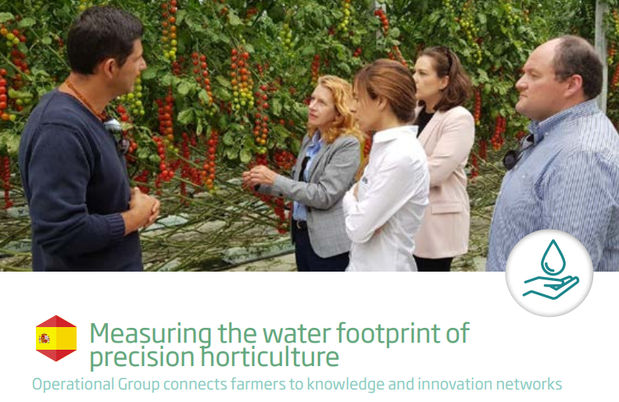
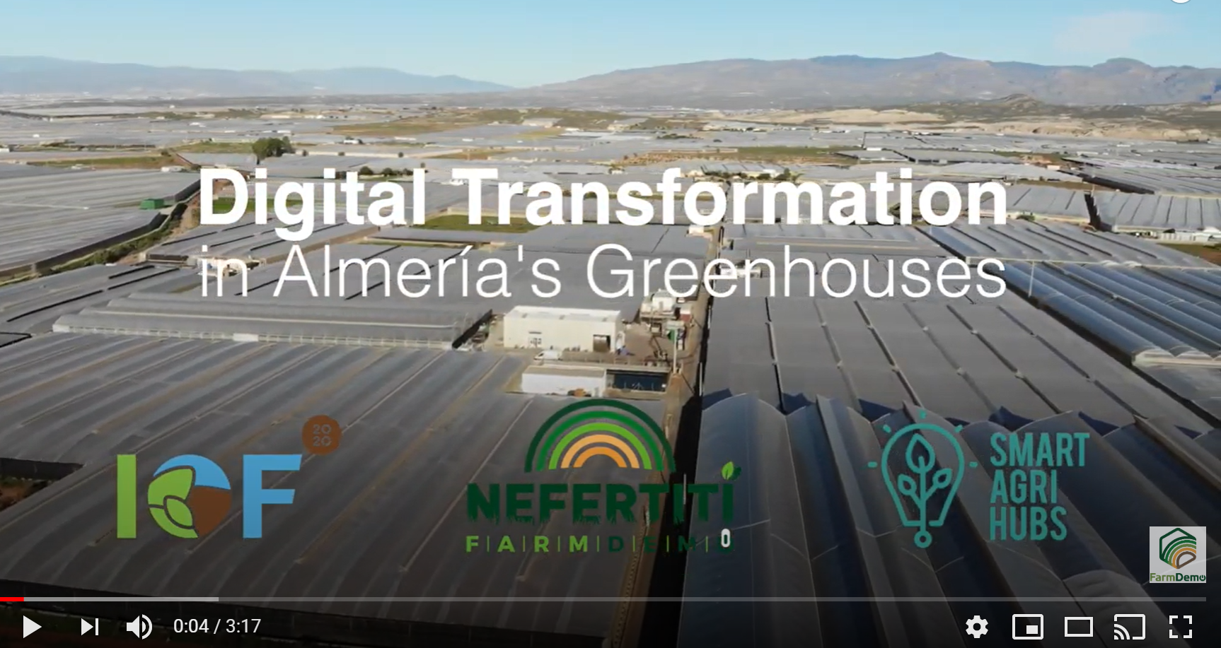
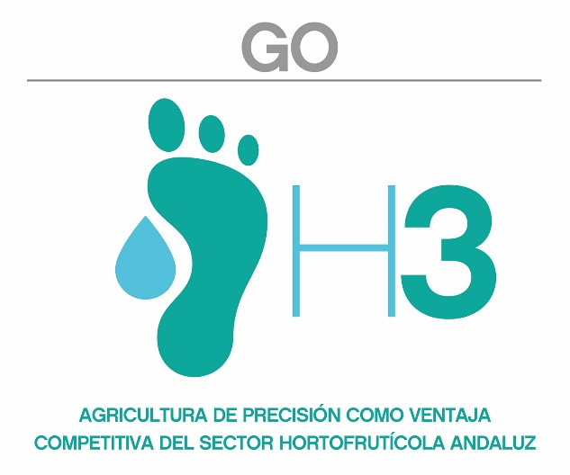

Slide 24
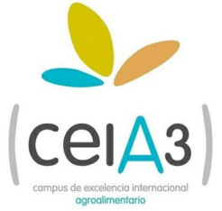
THANK YOU
Cynthia Giagnocavo
Cátedra Coexphal-UAL
Horticulture, Cooperative Studies and Sustainable Development
Department of Economics and Business,
University of Almería
La Cañada de San Urbano s/n, 04120 Almería, Spain
cgiagnocavo@ual.es

