Slide 1
The Multi-actor approach in Horizon Europe Cluster 6 serves transformational research: co-innovation for societal challenges
Inge Van Oost
European Commission DG AGRI, Research and Innovation Unit
EURAGRI webinar, 7 May 2021

Slide 2
1. The Multi-actor approach was strengthened and streamlined throughout the whole Horizon Europe Cluster 6 useable for any topic

Slide 3
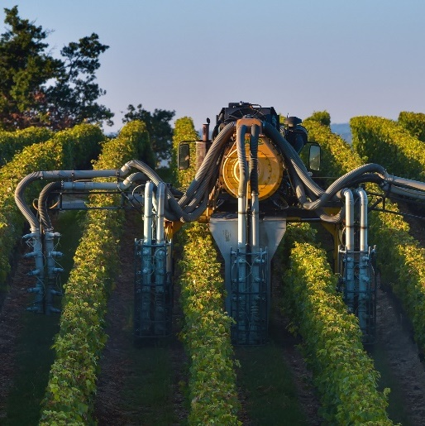
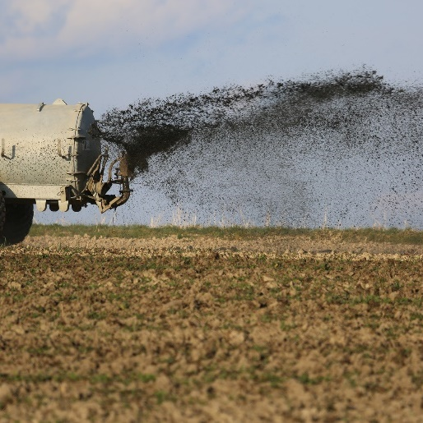
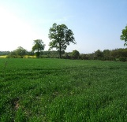
Green Deal & F2F targets: R&I are key enablers…
-50%
-50%
-50%
25%
+10%
+3 bln
-55%
100%
Notes:
For farmers, foresters and rural communities, who are immediate managers of natural resources and the backbone of food systems and the bioeconomy, the European Green Deal sets ambitious targets. They need to:
Contribute to achieving climate neutrality by 2050;
Reduce by 50% the overall use and risk of chemical pesticides and reduce use by 50% of more hazardous pesticides by 2030;
Achieve at least 25% of the EU’s agricultural land under organic farming and a significant increase in organic aquaculture by 2030;
Reduce sales of antimicrobials for farmed animals and in aquaculture by 50% by 2030;
Reduce nutrient losses by at least 50% and reduce use of fertilisers by at least 20 % by 2030, while ensuring no deterioration in soil fertility;
Bring back at least 10% of agricultural area under high-diversity landscape features by 2030; and
Achieve 100% access to fast broadband internet in rural areas by 2025.
Research and innovation (R&I) are key sources of new knowledge and solutions enabling and accelerating the progress required to achieve these challenging targets.
In fact, as we speak, innovations, including digital technologies, are transforming the way farmers manage land and produce food for us.

Slide 4
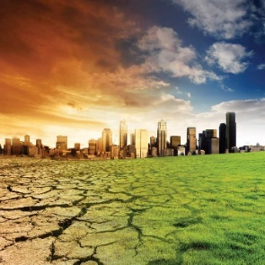
Time to step up the efforts to reach our missions!
-50%
25%
+3 bln
100%
-50%
-50%
+10%
-55%
…by 2030 = 9 years = 9 growing seasons…
Notes:
The Green Deal targets need to be achieved by 2030! It means that we have 9 years, so 9 growing seasons!
Therefore, it is time to step up our efforts!

Slide 5
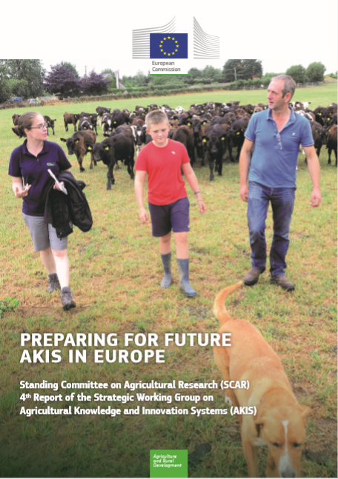
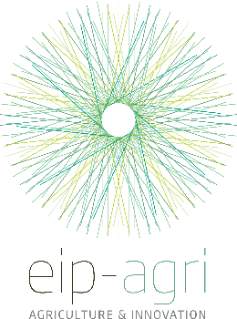
Boosting implementation
The Multi-actor approach: a polyvalent tool strengthened and streamlined throughout the whole Cluster 6 (=>useable for any mission or topic if applicable)
In their CAP Strategic Plans, Member States will need to scale up support for EIP-AGRI and AKIS, and strengthen resources to develop and maintain appropriate advisory services needed to achieve the Green Deal objectives and targets.
CAP
Horizon Europe

Slide 6
Multi-Actor Approach in Cluster 6
Clear list of well defined requirements, forming fully part of the topic requirements and labelled. All MA projects are automatically RRI and make research more demand-driven and ready to apply.
The requirements for the Multi-Actor approach (MAA) are in the introduction of the Work Programme and only very slightly adapted compared with H2020 to suit all topics in Cluster 6: they are a little bit more generic than in 2014-2020 (still focus on inclusion of end-users and multipliers but e.g. literally adding “citizens, consumers, local communities etc as potential actors)
6 bullets of obligations counting under the criterion Excellence: clarity and pertinence of the objectives and soundness of the concept:
Systemic approach: MAA is not a "cross-cutting issue" (as RRI, SSH, gender), it must serve transitional purposes thanks to co-ownership, co-creation, co-decision
Notes:
More information on webinars on Preparing the CAP Strategic Plan and the role of EIP networking in the Member States will be given in session 2 where we are also planning a discussion to consult you on the webinars’ concept.

Slide 7
Multi-Actor Approach in Cluster 6
MAA is not equal to multi/pluri-disciplinarity, nor to Living Labs, nor to a strong dissemination requirement nor to a broad stakeholders' board, although all these are steps in the right direction but miss one of the essential elements.
For strong impact, to really come to transitions, multi-actor approach with an adequate mix of relevant actors is key!
=>'Actor': a partner taking part in project activities, contributing to project outcomes (co-creation, co-decision, co-ownership). Co-responsible !
=>'Stakeholder': person expressing a view/stake at a certain moment(s) during the project: stakeholders' board, regional or national meetings, feels less engaged and regularly disappointed (“not being listened to”). He/she is not fully involved in the project, only a sound board in those cases that project owners want to listen and act upon the advice given
Notes:
More information on webinars on Preparing the CAP Strategic Plan and the role of EIP networking in the Member States will be given in session 2 where we are also planning a discussion to consult you on the webinars’ concept.

Slide 8
Requirements for Multi-Actor Approach in HE Cluster 6
How will the project proposal's objectives and planning target needs/problems and opportunities of end-users of project results? Get your users motivated to help develop and then they will become more motivated to implement the ready-made solutions
The composition of the consortium and the description of the project must reflect a balanced choice of relevant key actors with complementary types of knowledge. Building blocks for innovation are expected to come from science as well as from practice and intermediaries. Targeted choice of actors who can really contribute to the objectives
"all along the project": a clear role for the different actors in the work plan is essential, from the participation in the planning of work and experiments, their execution up until the dissemination of results and the possible demonstration phase. Co-decision and mutual respect unleashes practical (tacit) knowledge of practitioners.
This speeds up the acceptance and dissemination of new ideas/solutions thanks to cross-fertilisation of ideas and views, and to including also multipliers, facilitators and EIP Operational Groups from countries and regions working on similar topics.
Notes:
More information on webinars on Preparing the CAP Strategic Plan and the role of EIP networking in the Member States will be given in session 2 where we are also planning a discussion to consult you on the webinars’ concept.

Slide 9
Requirements for Multi-Actor Approach in HE Cluster 6
Project proposals should illustrate sufficient quantity and quality of knowledge exchange activities. End-users (OF THE PROJECT RESULTS) and practitioners are to be involved, not as a study-object, but in view of using their entrepreneurial skills and tacit knowledge for developing solutions and creating "co-ownership" of results.
Project's added value: demonstrate complementarity with existing research and best practice. Meanwhile there are more than 2000 OGs on similar subjects: get them involved and connect directly with the National Rural Networks or national EIP CAP networks who know the subjects of the OGs in their region/country. (Role of NCPs)
The project should result in practical knowledge, made easily understandable and accessible, which must feed into the existing dissemination channels most consulted by end-users in countries
For EU wide communication, this practical knowledge should also be assembled into a substantial number of 'practice abstracts' in the common EIP format (or equal tools) to share within the EIP network.
Notes:
More information on webinars on Preparing the CAP Strategic Plan and the role of EIP networking in the Member States will be given in session 2 where we are also planning a discussion to consult you on the webinars’ concept.

Slide 10
2. Connecting even better Horizon Europe with the new CAP post 2020

Slide 11
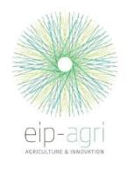
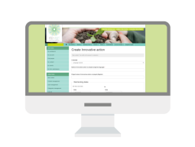
Connecting policies: the bigger EIP picture
CAP/Rural development
(regional/national level)
Research projects
Multi-actor projects
Thematic networks (interactive innovation)
Farmers
NGOs
Advisors
Operational
Group
Agri- business
Researchers
EIP network(s)
OG preparation
OG projects
Innovation support services
OPERATIONAL GROUP
Involvement of OGs is strongly recommended
Unique EU knowledge repository
of contacts and practice abstracts
Spread
the results
Notes:
How does the EIP-AGRI work in practice?
The EIP-AGRI benefits from a unique set of measures and instruments funded under two European policies working in close synergies: Horizon 2020 and the rural development pillar of the CAP.
Operational Groups (local interactive innovation projects) are the cornerstone of the EIP-AGRI under the CAP and support the development of innovations by groups of relevant actors in a fully bottom-up manner. These groups hold huge potential for creating innovative solutions that will make farming smarter, more efficient and more sustainable. Today almost 900 Operational Groups have started under the rural development programmes.
We expect 3 200 such Operational Groups by the end of 2020.
While Operational Groups are working at regional and national levels, over 150 European and international research and innovation projects funded under Horizon 2020 are working on similar issues related to agriculture and rural areas. A cornerstone of the projects is "the multi-actor approach", in which actors with complementary knowledge work together to design innovative solutions that have high chances to be implemented in practice.
EU wide EIP-AGRI network linking actors: communication, partnering, dissemination, knowledge flows and collecting practice needs (Open science)
Horizon 2020 Multi-actor projects
Engage with EIP-AGRI operational groups
Can help create them… or the other way round?
Horizon 2020 Thematic networks
Translate knowledge into practice
Boost impact of all activities
EIP-AGRI Operational groups
Solve specific problems on the ground
Inspire wider European activities
EIP-AGRI Focus groups
Enrich programming
Build multi-actor communities for Horizon 2020
Inspire projects (OGs or Horizon 2020)
EIP-AGRI Networking activities
Enhance knowledge exchange

Slide 12
A wide variety of OG project subjects:
Green Deal ‘avant la lettre’: already about 65% of OGs on environmental-climate issues
EIP OGs have become a useful instrument to test future CAP interventions
Source: European Commission – official data in SFC (May 2020)

Slide 13
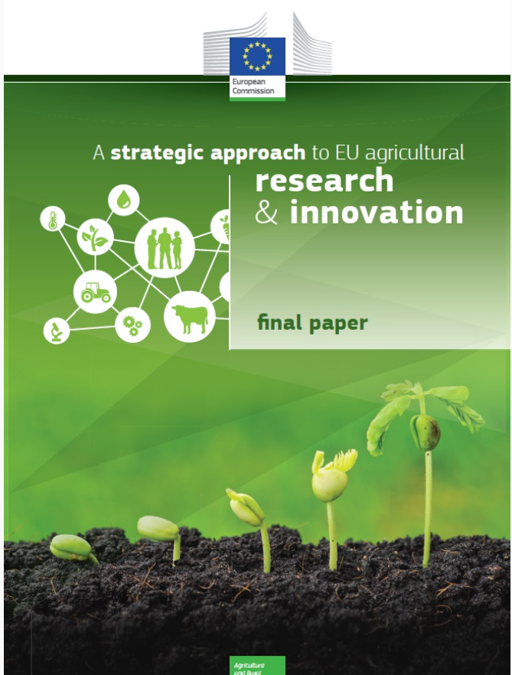
From strategy to action: achievements so far
315 projects – EUR 1,9 billion under Horizon 2020
190 H2020 multi-actor projects (EUR 1 billion), including 29 thematic networks; 50% newcomers
27 Member States implementing the EIP; over 2000 out of 3200 OGs already running or finished, many more coming in 2021-2022 and still 4,5 years to go
A growing and thriving network and an increasing volume of practice-oriented knowledge and innovations: the challenge now is to manage interaction, communication and dissemination
2014
2016
Today
Notes:
As a result, to advance knowledge and develop diverse innovative solutions for sustainable agriculture, the EU has supported since 2014 until today:
315 projects at EU level under Horizon 2020
2000 EIP-AGRI operational groups at local level under the Rural Development Fund of the Common Agricultural Policy (CAP)
And there is a growing and thriving network and increasing volume of practice-oriented knowledge and innovations ready today to be applied (mainstreamed) on the market to accelerate the progress towards the targets and objectives of the Green Deal and future CAP.

Slide 14
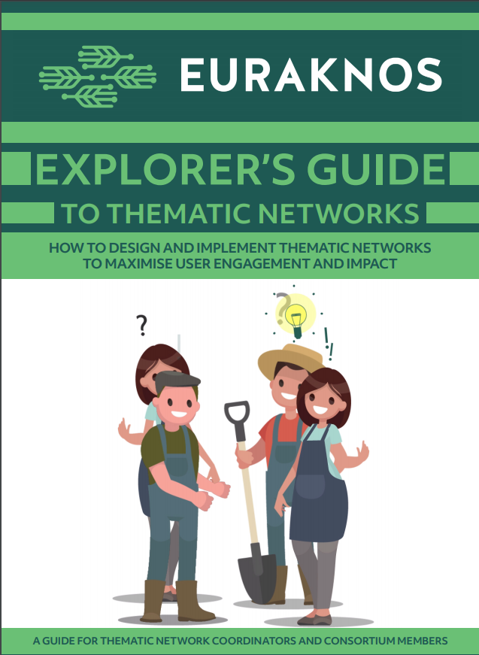
Explorer’s Guide:
How to design and implement Horizon Thematic Network projects to maximise user engagement and impact:
https://euraknos.fra1.digitaloceanspaces.com/production/deliverables/Explorers-guide-EN-interactive.pdf
Notes:
More information on webinars on Preparing the CAP Strategic Plan and the role of EIP networking in the Member States will be given in session 2 where we are also planning a discussion to consult you on the webinars’ concept.

Slide 15
AKIS & EIP-AGRI – preparing for EU knowledge reservoir(s) for practice serving advisors’ back-offices for innovation support and advice
MS already creating dbases (EIP-AGRI in DE, FR, back-office and ISS in LT etc)
EURAKNOS project (Thematic Network of Thematic Networks, midterm Jan 2020)
EUREKA project (feasibility EU knowledge reservoir for practice, kick-off Jan 2020)
Making at EU level an increasing volume of practice-oriented knowledge easy accessible, interactive and attractive!

Slide 16
Towards an EU-wide digital knowledge reservoir for agricultural innovation
Sylvia Burssens
Pieter Spanoghe
Ghent University (project coordinator)
EUREKA has received funding from the European Union’s Horizon 2020 research and innovation programme under grant agreement No 862790

Slide 17
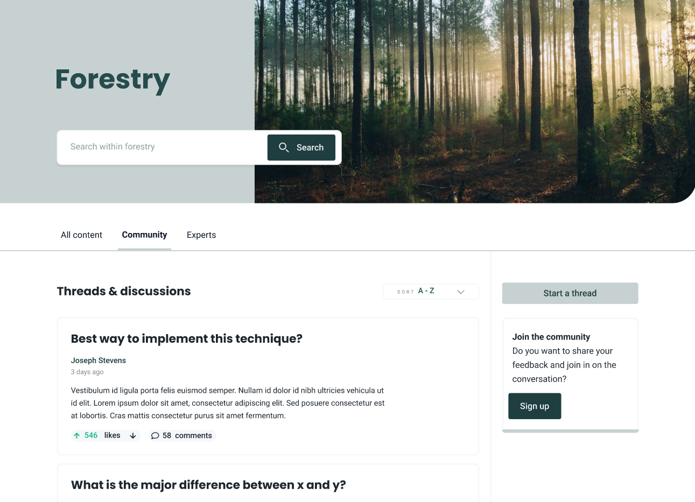
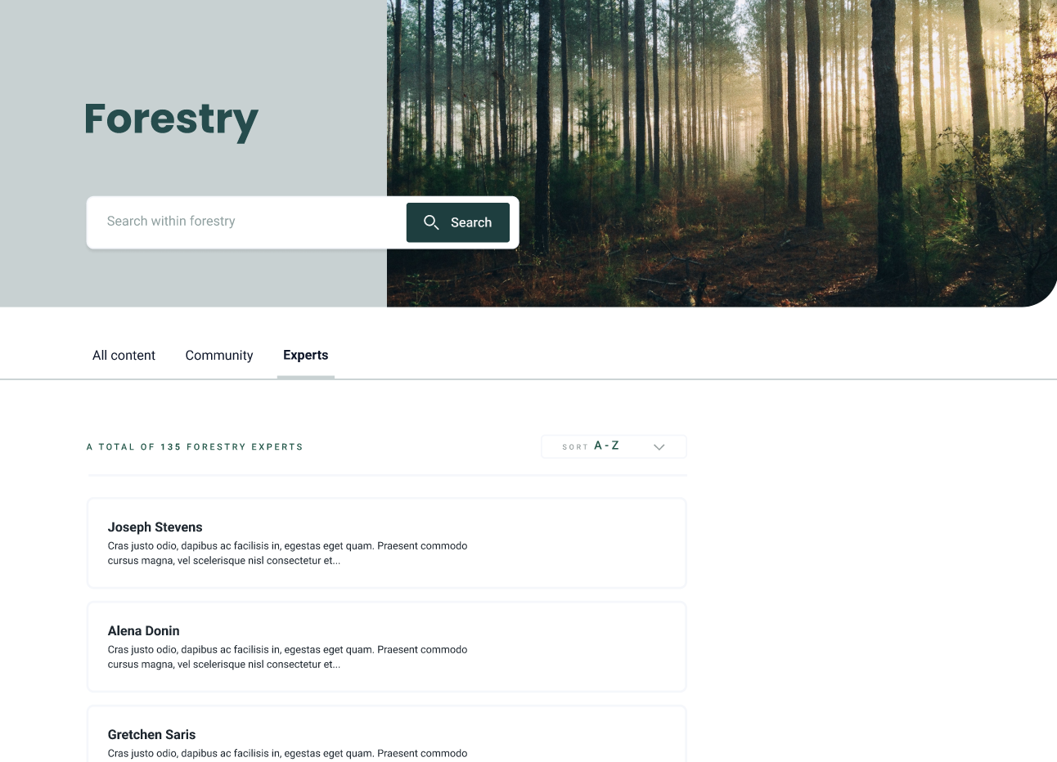
EURAKNOS & EUREKA: The ‘FarmBook‘: attractive easy searchable, interactive and multi-lingual
Community chat
Expert database
Notes:
https://www.figma.com/proto/xm6oSImSDdO1HHEpX1Z24l/(EUREKA)-Platform-(KIP-meeting)?node-id=1551%3A7573&viewport=384%2C207%2C0.0230400450527668&scaling=min-zoom&hide-ui=1

Slide 18
3. The CAP post 2020 also needs transitions We have organised the necessary means

Slide 19
Provisions on modernisation in the CAP Strategic Plan Regulation post 2020
Funding innovative projects…..
…..will now be supported by a whole innovation ecosystem systematically interlinking people and projects (AKIS)

Slide 20
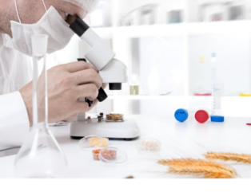
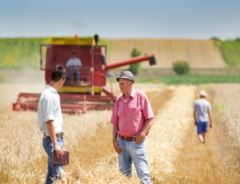
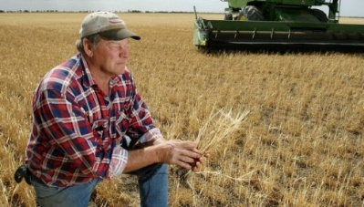
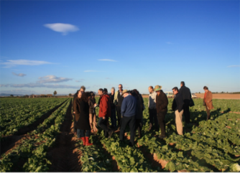
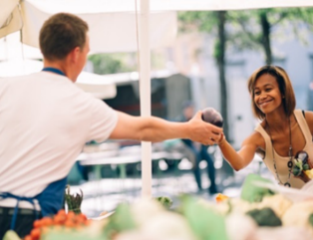
WHY AKIS? A reinforced AKIS integrates all AKIS actors and ensures knowledge flows inside MS & across border
AKIS
Researchers
Advisers
Education
Farmer
at the centre of the integrated Agricultural Knowledge and Innovation System (AKIS) to support modernisation, innovation and knowledge flows
Businesses
Organisations
Media
AKIS coordination will bring actors together on a structured and regular basis, creating continuous interaction to speed up knowledge exchange, knowledge flows, innovation and most of all: implementation in practice

Slide 21
The AKIS at the heart of the agricultural innovation ecosystem
What is an Agricultural Knowledge and Innovation System (AKIS)?
What: AKIS is the organisation and interaction of persons, organisations and institutions who use and produce knowledge and innovation for agriculture and interrelated fields. (def)
Who: The main players of the AKIS are: farmers/foresters, advisors, researchers, (farmer) organisations, NGOs, networks, retailers, media, services, various ministries…: they all produce and need knowledge!
Why: The aim is to create a regional/national innovation ecosystem by enhancing knowledge flows between the AKIS players as well as strengthening links between research and practice.
Brief "What is AKIS": https://ec.europa.eu/info/sites/info/files/food-farming-fisheries/key_policies/documents/building-stronger-akis_en.pdf

Slide 22
AKIS at the heart of the agricultural innovation ecosystem => Cross-cutting CAP support to Systematically share Knowledge and Innovation in Agriculture and rural areas including in whatever farming and rural activities automatically relate to (= landscape, environment, climate, biodiversity,consumers and citizens, food and non-food systems including transformation and distribution chains, etc)
Where does the AKIS policy come from?
In their 2008 declaration, the researchers of the Standing Committee of Agricultural Research (SCAR) stated that the classical linear research model does not function anymore to have real impact in the field. The current CAP AKIS policy and potential interventions can make use of the current formats and experiences from MS. Experts from about 24 MS from the SCAR Strategic Working Group collected this in the AKIS4 report, and based it on their discussions and own practical experiences. In the report much about AKIS in all its aspects is explained and a long series of possible types of interventions and concrete examples given. The report is available on the Europa "Future CAP" website and is called "Report: preparing for future AKIS in Europe". You can download it here: https://ec.europa.eu/info/food-farming-fisheries/key-policies/common-agricultural-policy/future-cap#innovation or ask to you a paper copy

Slide 23
Thanks to the cross-cutting objective on K&I&D, all MS will reinforce their AKIS post 2020
^{INCREASE COMPETITIVENESS}
^{REBALANCE} ^{POWER IN FOOD CHAIN}
^{ENSURE} ^{VIABLE INCOME}
^{CLIMATE CHANGE}
^{ACTION}
KNOWLEDGE INNOVATION digitalisation
^{THE 9}
^{CAP}
^{ENVIRONMENTAL}
^{CARE}
^{OBJECTIVES}
RESPOND TO CITIZENS' CONCERNS in terms of
^{FOOD & HEALTH QUALITY}
^{PRESERVE}
^{LANDSCAPES} ^{& BIODIVERSITY}
^{SUPPORT} ^{GENERATIONAL RENEWAL}
^{VIBRANT} ^{RURAL AREAS}
Notes:
Therefore, the future CAP post 2020 explicitly introduce a cross cutting objective of fostering knowledge exchange, innovation and digitalisation in agriculture and rural areas.
This highlights their pertinent role in delivering on the economic, social and environmental dimensions of sustainable agriculture.

Slide 24
CAP negotiations almost finalised
The CAP Strategic Plan regulation offers many tools for encouraging transitions:
Cross-cutting objective serving all other 9 Specific Objectives
Farm Advice obligatory for MS must cover all sustainability issues and up-to-date knowledge and innovation, by all public and private (trusted) advisors
Funding for advice, demo, knowledge exchange actions, training, etc, all based on the AKIS Strategy
AKIS Strategic Approach and digitalisation
CAP networks have a dedicated innovation strand
EIP Operational Groups now serve all other 9 Specific Objectives, and:
Advanced payments
Support up to 80% from EU
Derogation State Aid
Indicative timeline for agreement regulation: May 2021
CAP Strategic Plans to be submitted formally to the Commission by 1/1/2022
Notes:
More information on webinars on Preparing the CAP Strategic Plan and the role of EIP networking in the Member States will be given in session 2 where we are also planning a discussion to consult you on the webinars’ concept.

Slide 25
4. Horizon Europe’s new structure, logic and support for the future CAP

Slide 26
Horizon Europe: intervention logic
Horizon Europe
(Legal base)
Pillars / Cluster
Intervention areas
Strategic Plan (Programme-level)
EU policy priorities
Key Strategic Orientations for R&I
Work programme (Cluster-level)
Destinations
Expected impacts
Topics
Expected outcomes
Scope

Slide 27
Cluster 6: structure & co-creation
We work with…
Innovative governance models
Biodiversity and Natural Resources
Agriculture, Forestry and Rural Areas
Seas, Oceans and Inland Waters
Food Systems
Bio-based innovation systems in the EU Bioeconomy
Circular Systems
7 Intervention Areas (IAs)
…and across clusters

Slide 28
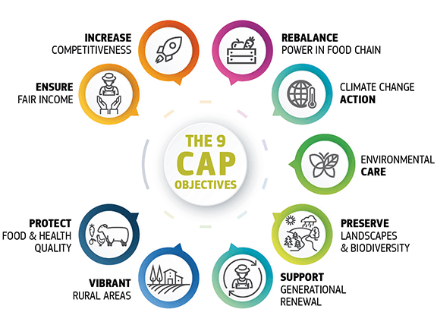
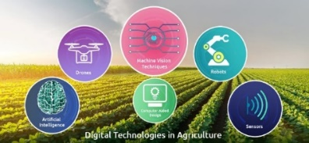
Key R&I priorities for agriculture, forestry and rural areas
Destination 7 Governance, environmental observations and digital solutions in support of the Green Deal:
Innovative tools and methods to support effective CAP Strategic Plans
An EU-wide interactive knowledge reservoir for practice
Thematic networks (+ a new type to connect stronger with OGs)
Advisory networks
Developing the AKIS approach
Strengthening the Multi-Actor approach
Notes:
And last but not least - destination 7:
R&I will help improving the design, implementation and evaluation of EU policies addressing agriculture, forestry and related value chains. To this end, we will have R&I activities, that for example, will support development of innovative tools and method to enhance effectiveness of the CAP Strategic Plans. Looking more long-term to the CAP post-2030, we will also have R&I activities that will look into the EU agriculture within safe and just operating space.
Various innovative digital and data-based solutions will be developed to support the sector to achieve sustainability objectives, strengthen its competitiveness and strengthen policy monitoring and implementation capacities. R&I actions will also add value to the knowledge and inform us about the benefits and risks of the innovative digital and data technologies.
The AKIS, with a key role for the new CAP, will be strongly supported: R&I activities will reinforce the multi-actor approach and promote interactive innovation and co-ownership of results by users. R&I will also support structural networking within national / regional / local AKIS and support an EU-wide knowledge reservoir.

Slide 29
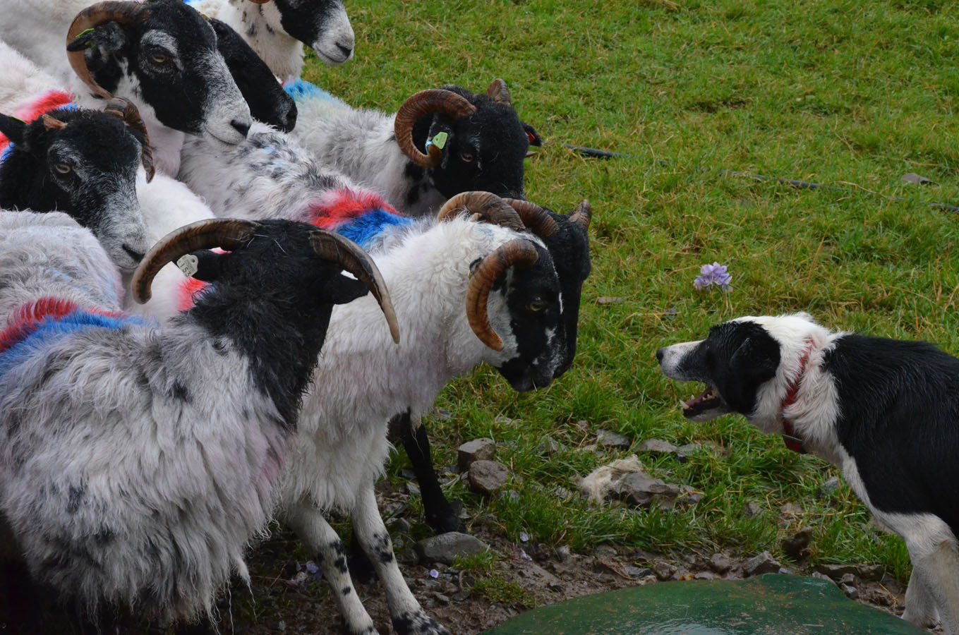
Speeding up transitions through multi-actor research, knowledge exchange and co-innovation
Thanks for your attention
Inge Van Oost – DG AGRI Unit B.2 – Research and Innovation
Inge.Van-Oost@ec.europa.eu

Slide 30
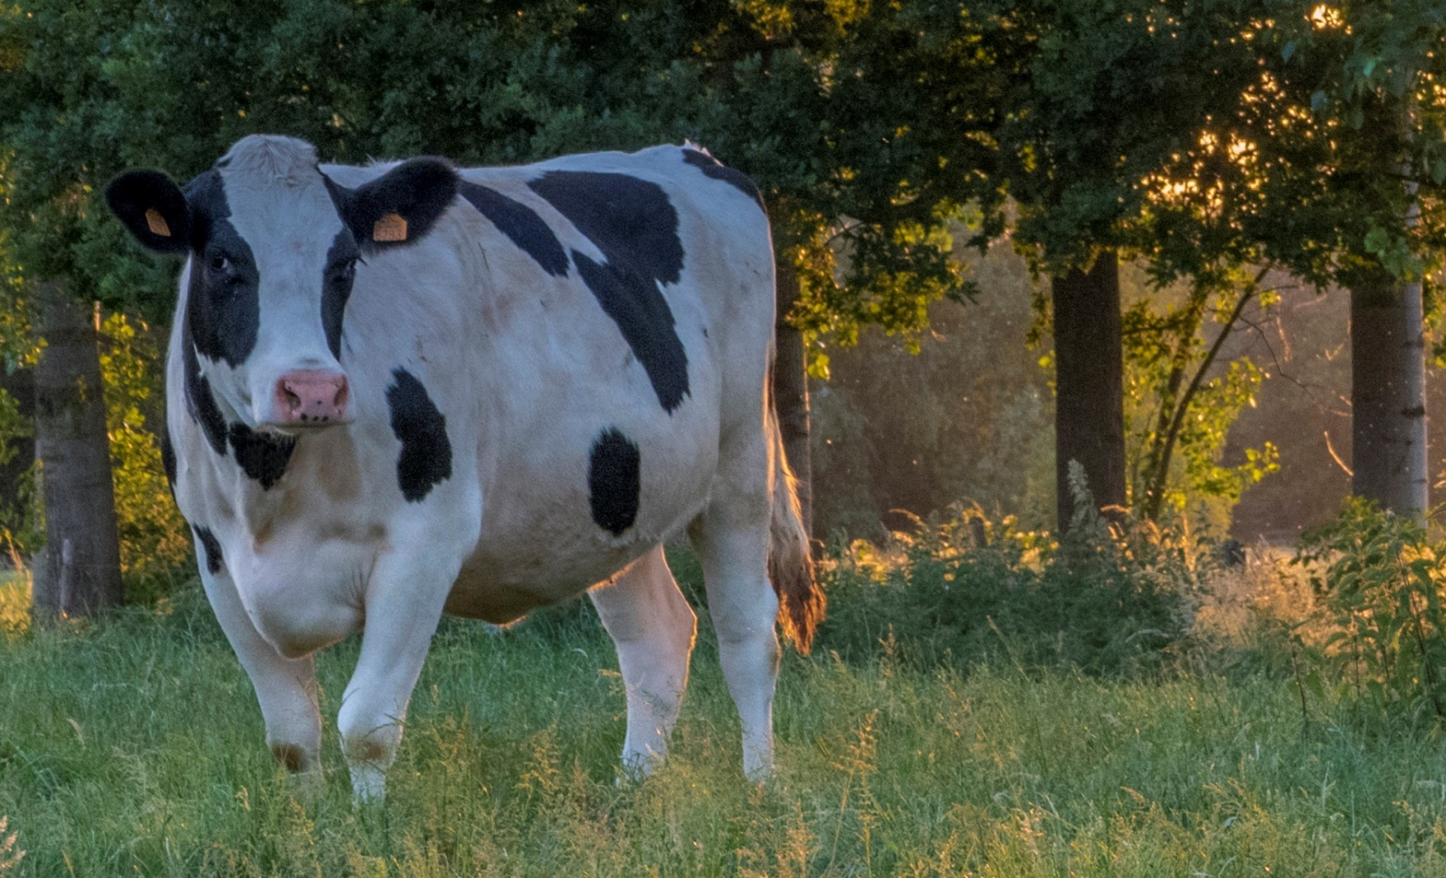
Questions?

Slide 31
Further info on Horizon Europe’s new structure, logic and support for the future CAP ambitions Reaching the Green Deal, the Farm-to-Fork strategy and the 9 specific CAP objectives requires input of relevant research

Slide 32
Key R&I priorities for agriculture, forestry and rural areas
Destination 1 Biodiversity and ecosystem services
Destination 2 Sustainable food systems from farm to fork
Unlocking the potential of agroecological approaches
Destination 3 Circular and bioeconomy
Mainstreaming inclusive small-scale bio-based solutions in rural areas
Fostering breeding of organic crops, legumes and root-base traits
Harnessing the digital revolution in the forest-based sector
Protection and sustainable management of forest genetic resources
Developing vaccines and diagnostics for priority animal diseases; enhancing animal welfare
Digital technologies as enablers for small farms
Strengthening the European forest-based research and innovation ecosystem
Harnessing the digital revolution in the forest-based sector
Notes:
Now more concretely, let me give you a few examples of the co-created R&I priorities (activities).
Destination 1:
To support the Biodiversity Strategy R&I actions will foster breeding of root-based traits, legumes and organic crops adapted to various conditions. These R&I activities will enhance the agrobiodiversity, but in case of organic crop breeding, it will help achieve the 25% organic target.
In addition, there will be a few topics on improving the conservation, management and use of plant and animal genetic resources, thereby preserving and enhancing agricultural and forest biodiversity.
Destination 2:
R&I will be used to speed up progress towards F2F targets. For example, to reduce by 50% the use of pesticides, there we will invest in R&I activities to further develop agroecological approaches as well as to improve plant health.
To reduce the use of antimicrobials (another important F2F target) and improve animal welfare (one of key objectives of the F2F for sustainable production and the 9th objective of future CAP), we will invest in development of vaccines and diagnostics for priority animal diseases as well as improved knowledge and innovative approaches to bring animal welfare to the next 2.0 level.
We recognize also the great potential of digital and data technologies as enabler for the different F2F targets and the need to speed up the digital transition. Therefore, there will be a set of R&I activities that will aim to advance digital and data technologies enabling sustainable agriculture, with a special focus on the needs of small farms.
Destination 3:
The circular bio-based economy is still a largely untapped potential for farmers and their cooperatives. To support farmers in grasping these opportunities, we will invest in R&I activities that will aim to enable the mainstreaming of small-scale, bio-based solutions, involving primary producers and other rural actors.
Forests play a crucial role in climate-neutral bioeconomy and have multiple other functions. The European Green Deal recognise that the EU’s forested area needs to improve, both in quality and quantity, for the EU to reach climate neutrality and a healthy environment. The multifunctionality and the sustainable forest management under rapid climate change will be enabled through a variety of R&I approaches, including the use of intelligent digital solutions.

Slide 33
Key R&I priorities for agriculture, forestry and rural areas
Destination 4 Clean environment and zero pollution
Optimization of nutrient budget in agriculture and enhancing nature-based solutions for nutrient management
Destination 5 Land, oceans and water for climate action
Demonstration network on climate-smart farming
Destination 6 Resilient, inclusive, healthy and green rural communities
Observatories on climate change impacts on and enhancing resilience of agriculture and of forestry
Strengthening evidence for tailored policies enhancing rural communities’ contribution to ecological, digital and social transitions
Unlocking the potential of agroecological approaches, including agroforestry, to climate action
Smart solutions for smart rural communities
Strengthening the European forest-based research and innovation ecosystem
Harnessing the digital revolution in the forest-based sector
Notes:
Destination 4:
The excess of nutrients (especially nitrogen and phosphorus) in the environment, stemming from excess use in agriculture is a major source of air, soil and water pollution, as well as climate and biodiversity impacts. R&I will support the Zero Pollution Ambition (and the F2F target on reducing the nutrient losses by 50% and fertilizer use by 20%) by improving understanding of and optimizing nutrient flows on-farms and across landscapes, including through innovative nature-based solutions to integrated nutrient management.
Destination 5:
Agriculture can be a solution to climate change. Now it is high time to boost the contribution of agriculture to climate neutrality, and mainstream approaches such as carbon farming (F2F strategy). Therefore, we will establish a demonstration networks of innovative approaches to climate-smart farming.
We will also fund several R&I activities to boost the contribution of agroecological approaches, including agroforestry, to climate action.
2020, was a third consecutive year of drought. It shows that climate extremes are increasingly frequent and widespread phenomena in the EU, which hold enormous implications for the agriculture and forestry. Therefore we will establish agriculture and forest observatories of climate change impacts as well as boost R&I to enhance their resilience.
Destination 6:
Transdisciplinary R&I will foster a sustainable, balanced and inclusive development of rural areas and thus the implementation of the Long-term Vision for Rural Areas.
R&I will address rural diversity and strengthen evidence for policies enhancing rural communities’ contribution to ecological, digital and social transitions including.
Attention will be given also to community-led innovation, gender and social aspects, smart connectivity solutions and building capacities through an expertise and training centre on rural innovation.

Slide 34
Leaving space for new approaches
Adaptation to climate change, including societal transformation
Agriculture, Forestry and Rural Areas
Soil health and food
Mission areas
Cancer
Climate-neutral and smart cities
Healthy oceans, seas, coastal and inland waters
Notes:
R&I Mission
Caring for soil is caring for life: Ensure 75% of soils are healthy by 2030 for healthy food, people, nature and climate

Slide 35
Encouraging synergies within the EU and globally
Next Work Programme 2023-2024: large-scale R&I partnerships with the Member States and Associated Countries
Animal health and welfare
Agriculture of data
Agro-ecology living labs and research infrastructure
Circular Bio-based Europe (CBE) → more attention for primary producers
EU-Africa R&I Partnership on Food and Nutrition Security and Sustainable Agriculture (FNSSA) and EU-China FAB
International research consortia (IRC):
Star Idaz on animal health
a new IRC in the area of soil and carbon
Cooperation with the Global Research Alliance on Agriculture Greenhouse Gases (GRA)
Notes:
Given that the EU only represents 10% of public R&I investments made by Member States, it is key to foster synergies with them.
This is why large-scale research and innovation partnerships with the Member States and Associated Countries are being prepared as part of the HE work programme 2023/2024:
1) animal health and welfare;
2) agriculture of data;
3) agroecology living labs and research infrastructure.
In addition, up to EUR 1 billion for the period 2021-2027, will be allocated to the CBE-partnership (Circular Bio-based Europe), where AGRI will take action to reinforce the position of primary producers.
Challenges facing agriculture do not stop at EU borders, hence cooperation with third countries will be key in particular on global challenges.
At the bilateral level cooperation with Africa in the partnership on Food and Nutrition Security and Sustainable Agriculture (FNSSA) will be strengthened (tackling One Health and also agroecology). Cooperation with China in the Food, Agriculture and Biotechnology initiative (FAB) on topics of interest for both sides (e.g. increasing the resilience of forests or better utilisation of agricultural wastes and by-products for the bioeconomy) will also be continued.
At the global level, cooperation will be fostered with continued support to the international research consortium (IRC) STAR-IDAZ on animal health and the establishment of a new IRC in the area of soil and carbon. Cooperation with the Global Research Alliance on Agriculture Greenhouse Gases (GRA) will be sought and rural innovation capacity building will be designed with international partners.

Slide 36
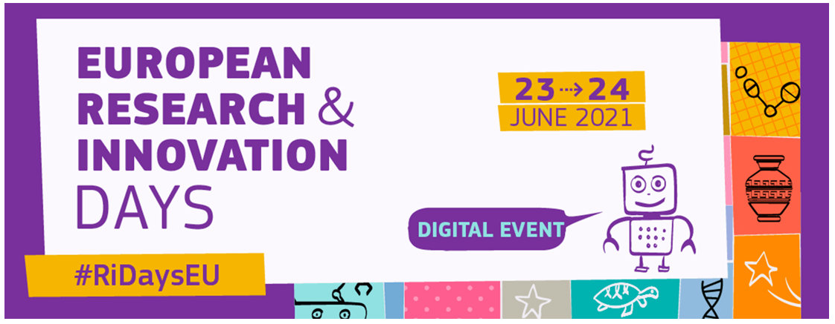
Indicative timeline
Strategic Plan 2021 - 2024
Mid-March 2021: adoption
Programming Committee approved on 23/4
No clarity on the adoption date; earliest possible date at the moment seems to be 7 June, publication 1 day later.
End May-early June 2021: Cluster 6 Info Days
23-24 June 2021: R&I Days
Work Programme
2021-2022

