Slide 1
HOW TO LINK THE CONCEPT OF LLs WITH RESEARCH? The “Mission Board Soil Health and Food” contributing to the EU-R&I programma: “Horizon Europe 2021-2027”. Impressions by Johan Bouma. Em.prof. soil science, Wageningen University. Our Mission report of September 2020: Veerman, C., Bastioli, C., Biro, B., Bouma, J., Cienciala, E., Emmett, B., Frison, E. A., Grand, A., Filchev, L., Kriaučiūnienė, Z., Pinto Correia, T., Pogrzeba, M., Soussana, J-F., Vela, C., Wittkowski, R., sept. 2020. Caring for soil is caring for life - Ensure 75% of soils are healthy by 2030 for food, people, nature and climate, Independent expert report, Eur. Comm. Publ. Office of the Eur. Union, Luxembourg,

Slide 2
For this EURAGRI webinar I will focus on the three suggested questions by the organisers: 1. Are we ready conceptually as well as practically to embrace Living Labs? My answer, frankly, is :”NO”. The LL idea is conceptually embraced just like sustainable development ( how could anyone be against it?) but to consider land users ( from now on: farmers) as leaders and coordinators of a team that develops innovative management for land use systems is still a bridge-too-far for many researchers. But this joint- learning approach is essential! So: what to do about it?

Slide 3
First some basic concepts: Sustainable development is the overall goal for societal development, the:”point-at-the-horizon”. Long rather abstract , it has in 2015 been specified by the 17 UN Sustainable Development Goals (SDGs) , approved by 193 governments. The EU Green Deal (2019)closely follows the SDG concept. For farming some SDGs are particularly relevant: production of healthy food (SDGs2&3), preserving the quality of ground- and surface water ( SDG6), support carbon capture and restriction of greenhouse gas emissions for climate mitigation ( SDG13) and combat land degradation and preserve biodiversity (SDG15).

Slide 4
All farmers agree that soils play an important role in their land management. Soil health can define soil conditions in an appealing manner. Our definition: “soil health defines the continued capacity of soils to contribute to ecosystem services in the line with the UN-Sustainable Development Goals (SDGs ) and the EU-Green Deal”. A modern farmer is like a juggler in a circus: keeping five balls in the air: rather than just produce healthy food, he is also supposed to maintain ground- and surfacewater quality , capture carbon and limit greenhouse-gas emission for climate mitigation and preserve biodiversity.

Slide 5
Why talk about “ecosystem services? “. Ecosystems contain soil, water, air, plants and animals, including man. Ecosystems provide essential “services” t o mankind. But ecosystems call the shots, not man ! Our life depends fully on healthy ecosystems and healthy soils can provide an important contribution. But so does agronomy, hydrology, climatology, ecology, sociology, economics… That’s why we state: ..soil contributions to… Problem 1: This is a difficult message for scientific disciplines that tend to focus on their own field, while working with colleagues in other disciplines is essential. That’s why farmers should be in charge in LLs as they see the entire picture from a practical point of view.

Slide 6
Farmers in LL’s will have to play a key role in keeping all the science-frogs in a single wheelbarrow. Modern farmers are well educated and face a bewildering complexity: soils differ and socio-economic conditions differ, the weather is unpredictable and every farmer has his own style: their strength! Problem 2: the research community is used to linear research: a problem is defined, research is done and a solution is obtained. Experiments have to be repeated several times to allow a statistical analysis before reaching conclusions. But every LL is unique and cannot be exactly “repeated”. No good science? The LL scientists should carefully describe management procedures and measure indicators for ecosystem services and soil health. This form of “applied” research is also cutting edge science!

Slide 7
SO: “We” will be ready when scientists in an interdisciplinary team realize that only seriously working with farmers running Living Labs is the only way to arrive at meaningful results. Because: Remember: 60-70% of our soils are unhealthy ( polluted, compacted, low carbon, eroded). But we know in most cases what to do about it but it is not being done, often for socio-economic reasons ( cover crops, minimum tillage etc).Farmers are guided by their business plans! They have to make a living. Working in LL’s demands not only consideration of socio-economics in general but addressing farmers questions specifically.

Slide 8
About the starting point of LL activities: First , stop asking farmers what they want ( a standard approach of : “involving the stakeholders” as researchers learn while studying) Many inquiries have been made and farmers want action now! Talking time is over! The successful H-2020 LANDMARK program and others showed, for example, common concerns about: - declining income ( market forces don’t work) - binding environmental policies ( unclear and changing) - lack of independant helpful advice ( now often commercially motivated) - adverse climate conditions.

Slide 9
This answers the question: what are the challenges for research institutes and researchers.? Contribute knowledge to the joint-learning process; contribute methodology to measure indicators for ecosystem services and soil health: keep it simple and operational in a real-world context ! Start by applying existing knowledge and initiative new research only when critical gaps show up in existing knowledge.

Slide 10
This leads into the last question: how can LL’s facilitate the uptake of current knowledge? Again, let’s start with questions farmers ask: 1. declining income. Clearly, consumers are not paying realistic prices for agricultural products due to the fierce competition within the supermarket cartel. The common agricultural policy (CAP) (350 billion € for 2021-2027), acts as a life insurance policy ( not a subsidy as for steelproducers and airlines) as it increasingly will focus on and award ecosystem services provided. That is a major reason to focus on ecosystem services.

Slide 11
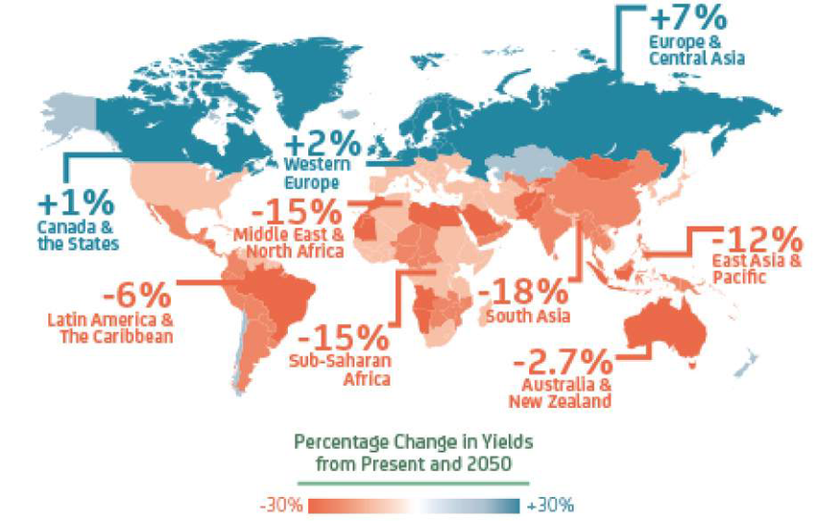
A life insurance policy for society because effects of climate change will be dramatic: too many areas will be too dry and hot for agriculture and fertile soils near rivers and the sea may flood due to sealevel rise. How to feed 2.7 billion people in 2050? This is the real:”point-at-the-horizon”

Slide 12
2. Binding environmental policies Focus is needed on goals to be achieved and meaningful thresholds rather than on means to reach goals.So, for farmers fields: 1.measure water quality rather than prescribe amount of fertilization allowed ( 170 kg N/ha) or cattle density. A EU Water Guideline is already operational since 2000. 2. measure carbon capture and greenhouse-gas emissions. 3. measure biodiversity, also in a landscape context. Numerous modern sensing and monitoring techniques are available and can be applied. Note that 2 and 3 will be legally binding soon, so let’s be ahaed of the game!

Slide 14
Key message in my perception: let farmers be farmers again! No bureaucrats in charge! Set clear environmental goals that are in line with the SDGs and the Green Deal and pay for ecosystem services provided ( as a life insurance premium ) . Farmers know that healthy soils make major contributions to achieving ecosystem services. So apply the soil indicators to assess soil health But management is key: poor management of a healthy soils does not produce good ecosystem services! In fact every farm is a Living Lab, the ones of the MISSION work closely with researchers. Communicate effective management practices on the basis of :SHOW and TELL. No preaching. Colleague farmers pick up what they can use. Farming styles are important sources of uinspiration.

Slide 15
There are many, inspiring, farming styles being promoted through internet and the social media: biologic, biologic-dynamic, circular, nature-inclusive, regenerative, enrichting, high-tech precision and others. Ecosystem services and soil health are directly relevant to all systems and their measurement can provide clarity to the mission of modern agriculture to contribute to sustainable development.

Slide 16
In summary: I feel we need a new paradigm for research , emphasizing a comprehensive systems approach in line with the complexity of modern farming. Well educated modern farmers are in charge in Living Labs being inspired by interdisciplinary research focused on achieving ecosystem services in line with the SDGs and the Green Deal. Soil health will play a major role in contributing to ecosystem services and showing this role, rather than pontificating about the importance of soils, is the best way to promote the profession.

Slide 17
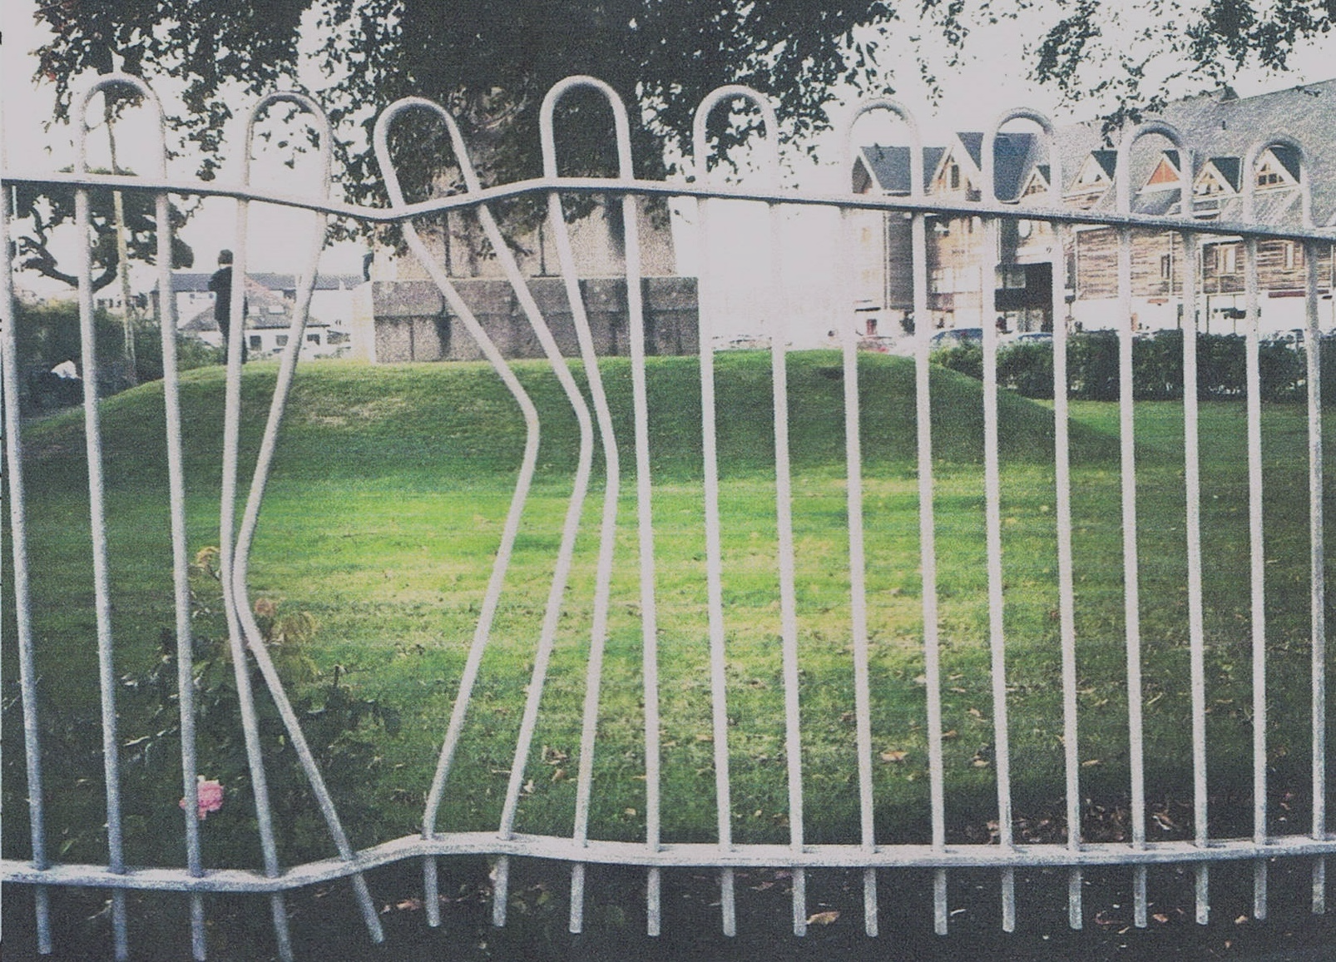
Researchers: avoid overkill. Sometimes making holes in fences may be more effective than tryiing to remove them!

