Slide 1
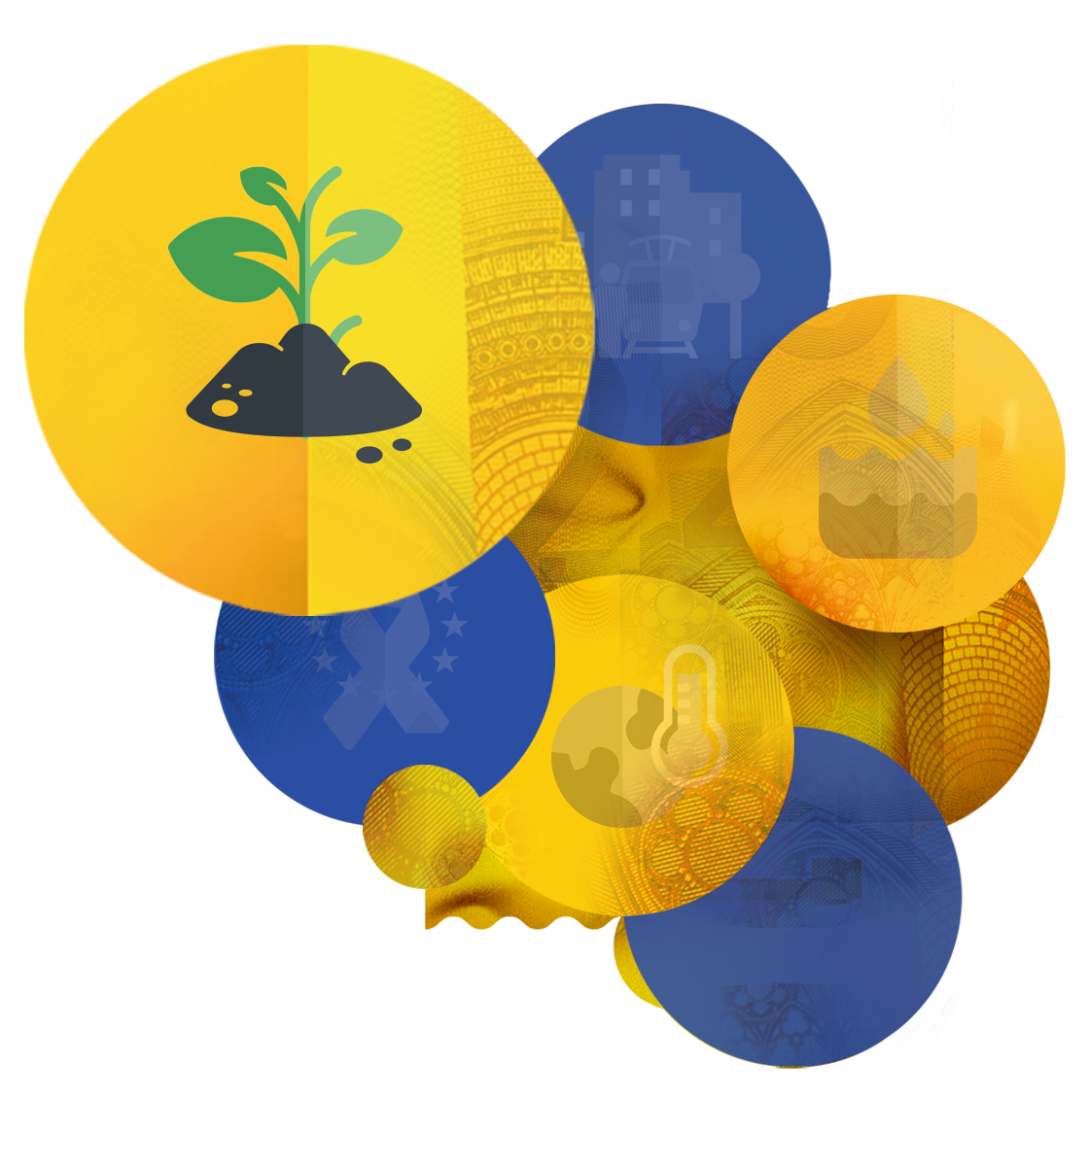
How to implement LLs and how do they foster innovation in the farming community?
#HorizonEU #MissionSoil
Alfred GRAND
Member of Mission Board for Soil Health and Food
This presentation is delivered by a member of a Horizon Europe Mission Board, which is an informal group of experts set up by the European Commission to provide advice for the identification and implementation of missions in the future Horizon Europe programme. The contents of the presentation do not represent the official views of the European Commission nor do they constitute a commitment of any kind on its behalf.
09.06.2021

Slide 2
Expected mission objectives:
Engagement of land managers, citizens, businesses, regions on soil health; communication and training material for different target groups; skills for specialised “soil advisors”
1. R&I programme
3. Soil monitoring and indicators
4. Soil literacy, communication citizen engagement
2. 100 Living labs and lighthouses
Knowledge on soil functions, ecosystem services and soil health; knowledge infrastructures and platforms; development of solutions for management practices, business models, technologies to achieve
Harmonised indicators and a European soil monitoring framework to track changes in soil health and ecosystem services in a more systematic way
A network of real-life sites for co-creating, testing, demonstrating and upscaling of solutions in rural and urban areas

Slide 3
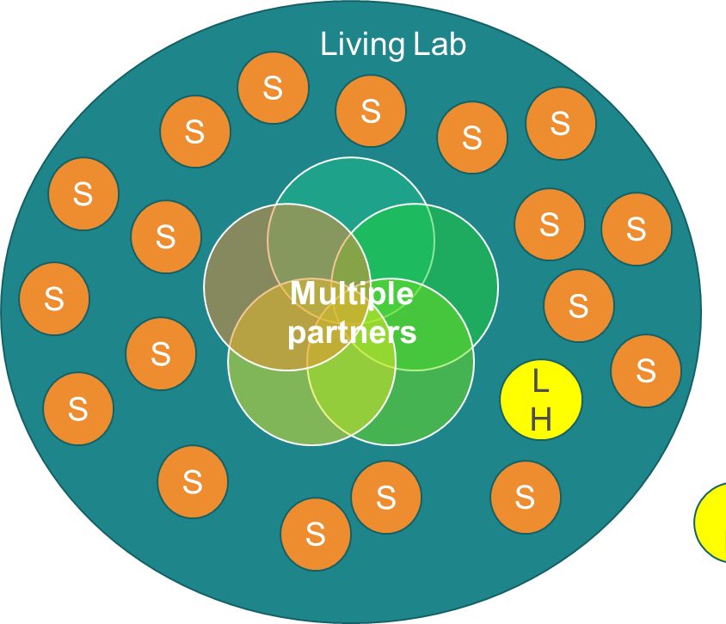
Mission objective 2: living labs and lighthouses – co-creating and accelerating innovations
The target is to establish 100 living labs in the EU 242 NUTS2 regions, each living lab including experimental sites and additional Lighthouses.
Living lab = regional/sub-regional scale, multi-partner
Lighthouse= one exemplary site
Horizon Europe
Pillar 2

Slide 4
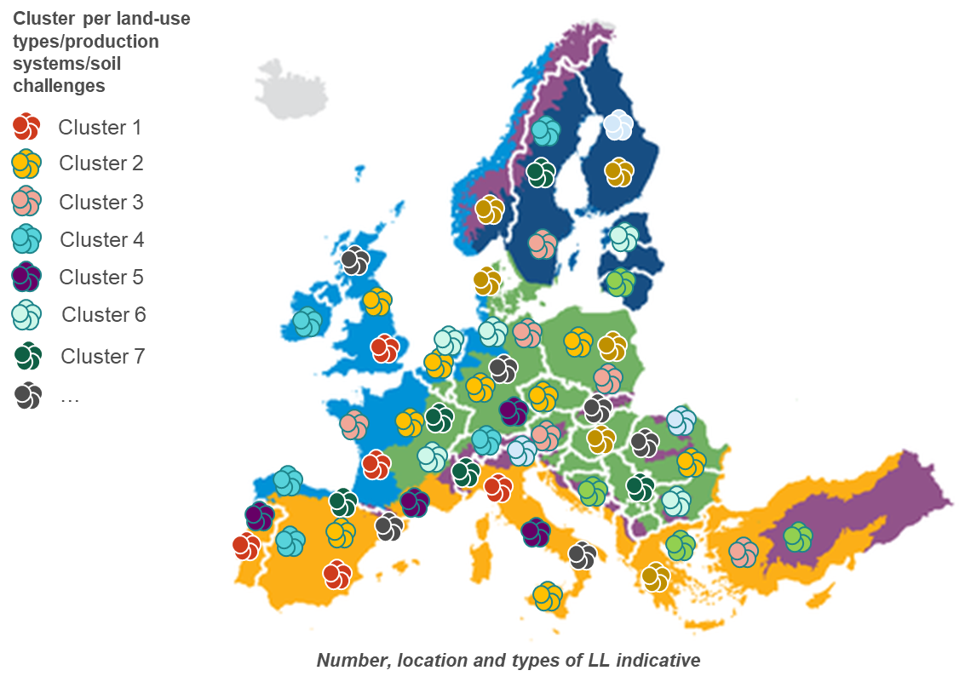
Living labs and lighthouses:
Reflections on implementation model
One large European Soil LL& LH coordination network:
Networking activities
Interfacing with:
other initiatives (EJP, EIP, other missions and partnerships etc.)
‘Transnational cluster’ projects funding 3-5 living labs in different countries
Within each project: common challenges/themes
Strong portfolio diversity between projects (territorial coverage, thematic, mission objectives, soil challenges etc.)

Slide 5
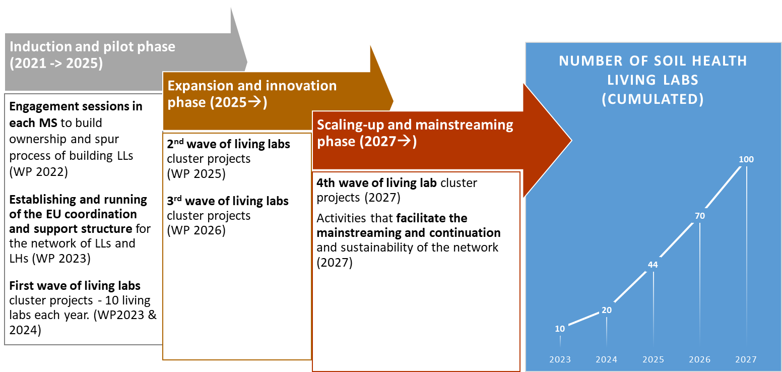
Co-create, and upscale solutions to improve soil health: 100 Living labs and lighthouses
Living Labs: Participatory, place-based and transdisciplinary research and innovation approaches to conduct systemic research in real-life settings. Serve to identify practitioners’ knowledge needs (land managers and other actors), and to co-design, test, monitor and evaluate solutions to improve their effectiveness and early adoption.
(WP 2021)

Slide 6
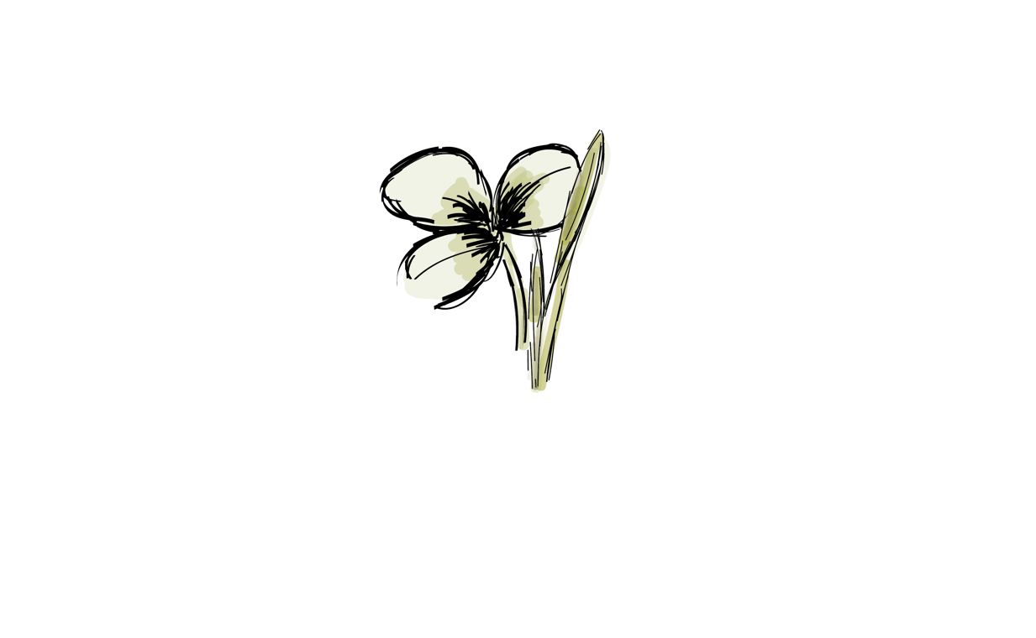
Example for a possible integration into the
network design:
Network design:
- flexibility is key
- adaptation to dynamic environment
- incorporation of exiting networks
- agile methods as basis
- „Spotify model“ with #tagging method
Farm
Research
Arable
Horticulture
English
German
Agroforestry
Regenerative
Soil Health
Austria
trAEce
Notill
Roller-Crimper
Mixed seeds
Composting
Best4Soil
Landmark
Vermicomposting
Earthworm
Organic
Internship

Slide 7
Why do we need to implement Living Labs?
Complex challenges cannot be solved by single stakeholders
Lack of trust between stakeholders
Different language (a handful of something)
Different approach (solution driven to problem driven)
Different goals (solution for practice vs publishable results)
Practical solutions from one farm are not widespread
Practical solutions are not evaluated
Lots of motivated farmers, still difficult for them to get heard
…

Slide 8
What to expect from cooperating in Living Labs?
Cooperating in a multi-stakeholder team makes you …
… become inspired
… learn to think out of the box
… better understand each other
… accept different perspectives from different stakeholders
… aim for the same goals
… work together instead of side by side
… find faster, more evaluated (from different perspectives) and therefore easier scalable solutions
…
User-centred innovation
Multi-actor (agri + adv. science + ind. etc.)
Social
and behaviour sciences
Place-based landscape + Long-term
More actors (public, consumers)
Identifying Needs from practice
Knowledge exchange

Slide 9
How do living labs foster innovation in the farming community?
Communication to other stakeholders
Implementing ideas and questions from practice
Learning from listening to each others input
Being included into the discussion
Through implementing co-creation
Raising awareness for challenges on a farmer's level
Demonstration activity starts communication with society
Enhance cross cutting innovations, like other missions or challenges (Climate Change, Water, Biodiversity
…

Slide 10
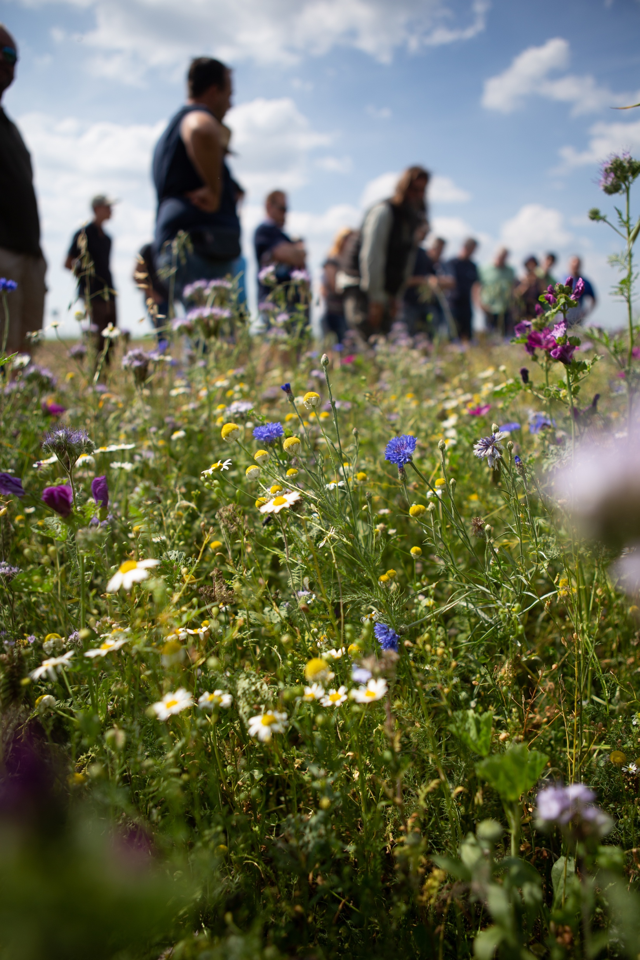
How does the living lab network foster innovation in the farming community?
Communication with farmers from other regions with similar challenges
Communication with other stakeholders working on similar topics
Learning from and meeting with people from other regions
Copying and adapting methods from other regions
…

Slide 11
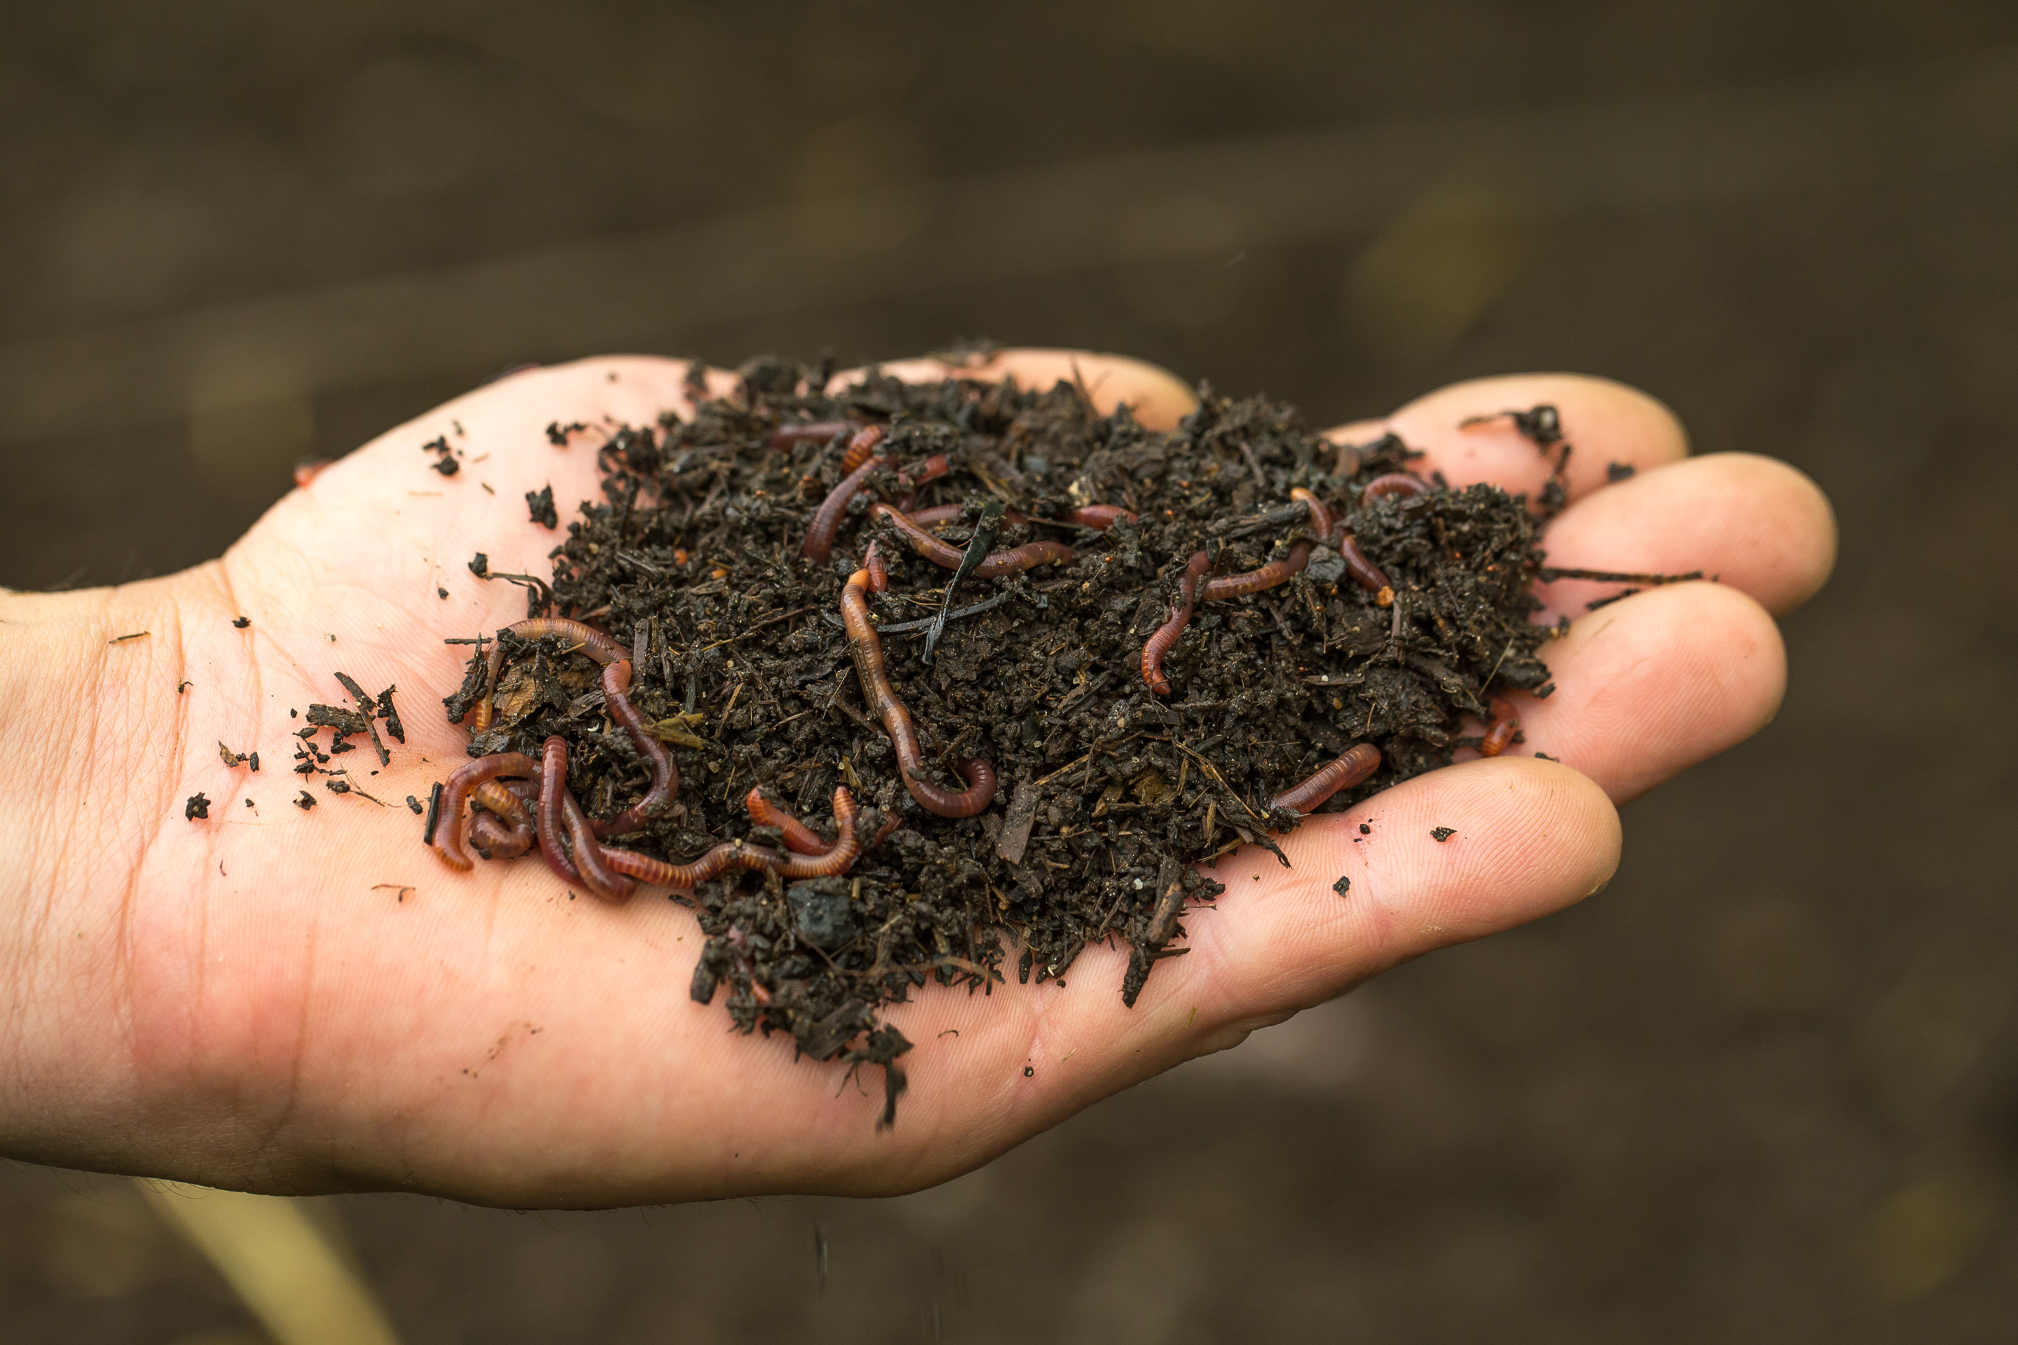
Thank you for your interest in Mission Soil Health and Food!
Caring for Soil
is caring for Life!

