Slide 1
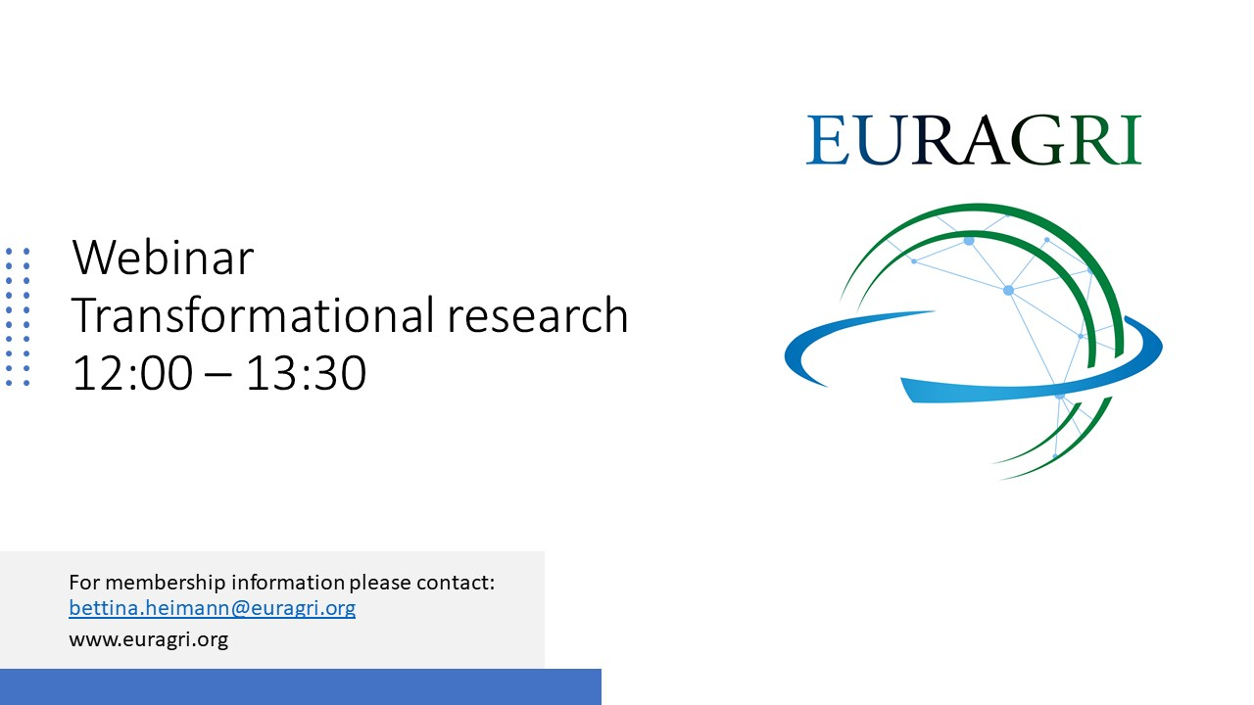

Slide 2

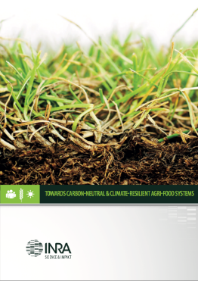
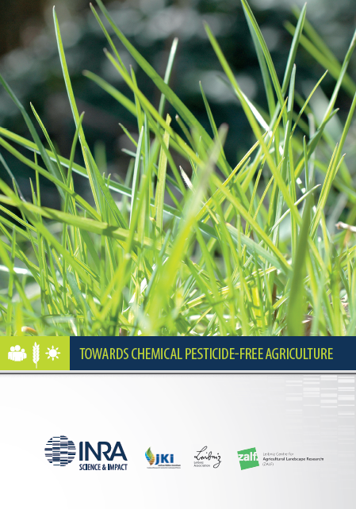
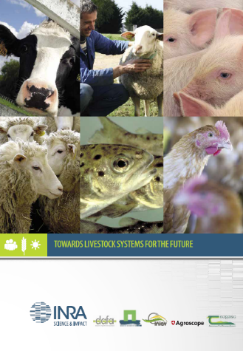
Transformational research
Mission oriented research – The implementation
Inrae, France, as a case study
Christian Huyghe,
Scientific Director, Agriculture

Slide 3
Mission-oriented research: where to go?
In its strategic plan INRAE2030, Inrae defined 5 strategic scientific orientations = 5 visions
  Responding to environmental challenges and their associated risks
  Accelerating agroecological and food transitions
  Building bioeconomies based on the efficient circular use of resources
  Promoting a holistic approach to health
  Facilitating transitions by mobilizing data sciences and digital technologies
Based upon some major paradigms
  Agroecology
  Land-sharing
  Bioeconomy and circularity
Based upon analysis of the scientific literature, of foresights, of national, European and international strategic agendas (Green Deal for instance)
Prepared in a collaborative process: internally, with Ministries, with our partners, with the society

Slide 4
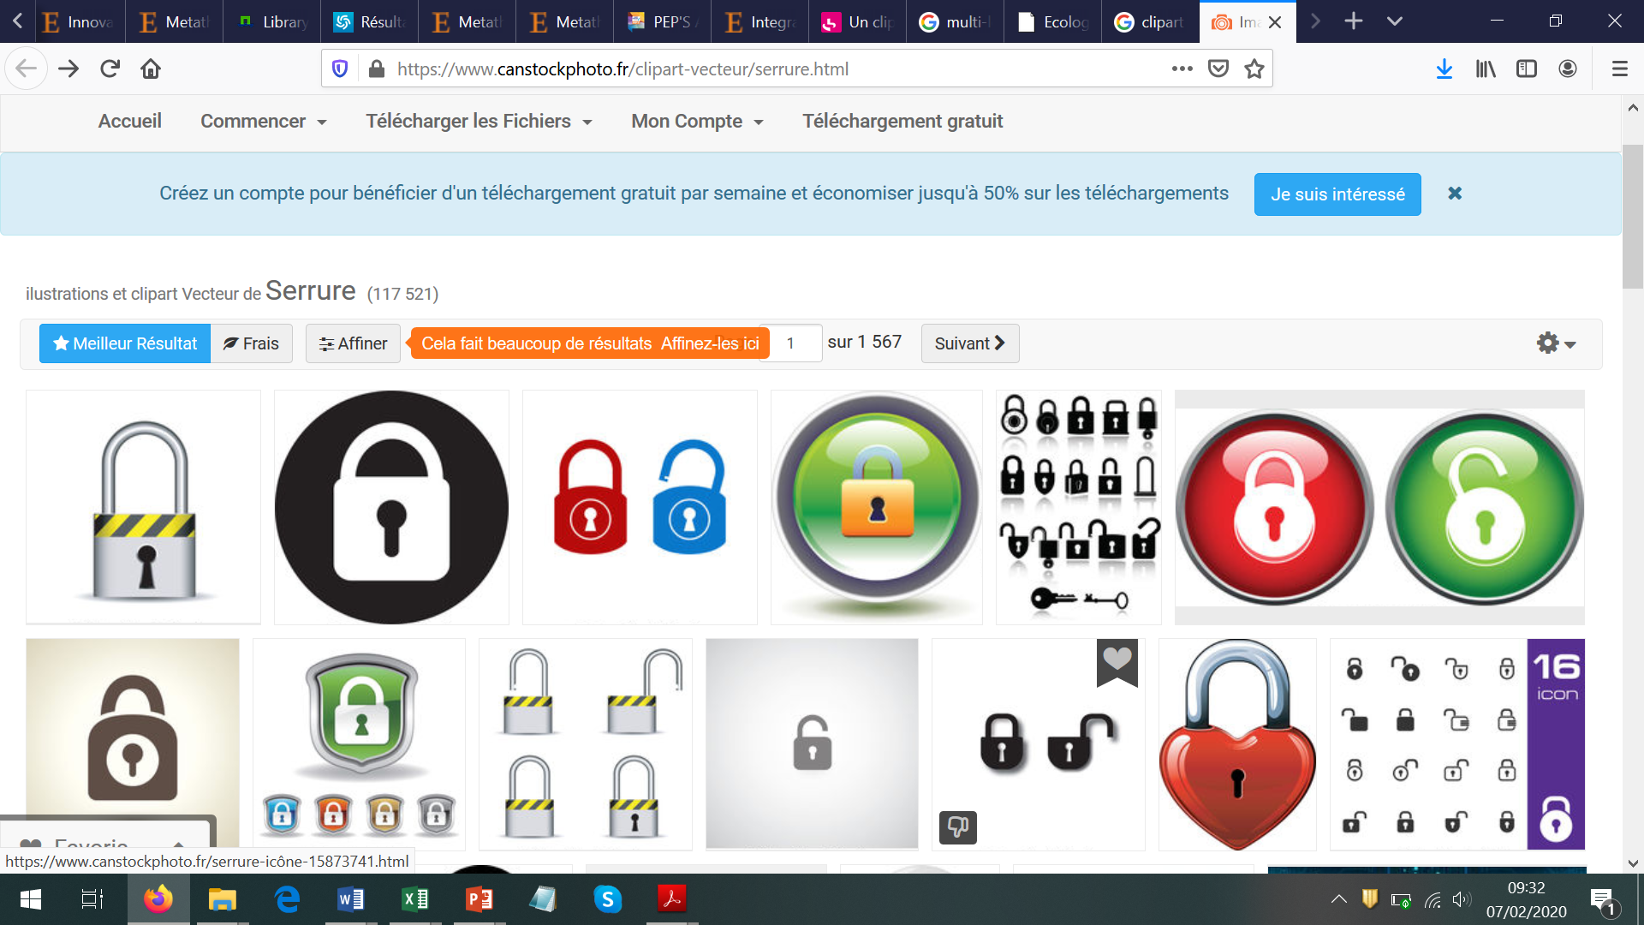
These challenges require systemic changes, in context where lock-in situations are dominant
Boosting changes in the socio-technic landscape: policy including CAP, regulations, society expectations
Destabilise the regime
How to go beyond?
Setting extreme scenarios
Participatory sciences and living labs
Support niches
Supporting innovation. R&I is essential
(adapted from Olivier et al., 2018
who adapted it from Geels, 2002)

Slide 5
Inrae missions
Scientific publications
Original knowledge
Expertise and support to public policies
Innovations
INRAE
Partnerships with industries
Projects with technical institutes
Networks with farmers groups
Participatory and open sciences
Expertise and prospective studies for French Ministries and for Europe (Commission, Parliament)
Implementation of public policies
Living Labs
Open Data policy

Slide 6
A research programming based upon science orientations and strategic pillars
Inrae interdisciplinary research programs
National Priority Research Programs
European Alliances
International Priority Programs with collaborating institutes
Strategy of scientific divisions
Research infrastructures
Scientific foresights
Strategic plan Inrae 2030

Slide 7
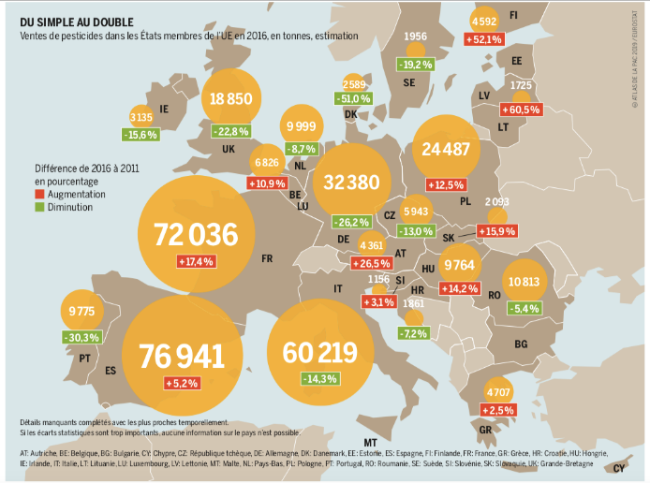
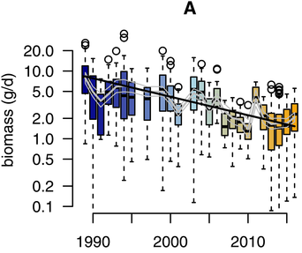
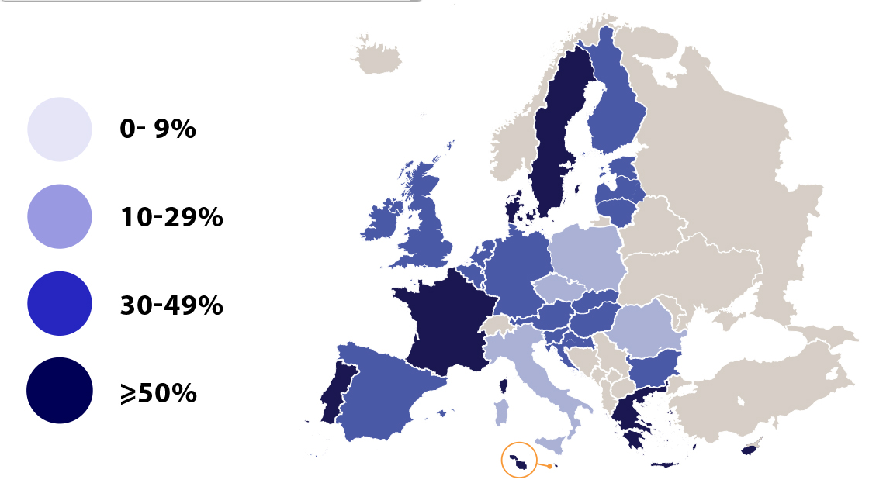

An example on pesticides
Large and steady use in Europe to ensure crop protection
Green Deal Objective: -50% of pesticides and hazardous pesticides in 2030
Unsustainable pressure on biodiversity
A strong societal demand
EFSA, 2019: How many citizens are concerned about...
Pesticides residues in food
Hallmann CA et al. (2017) PLOS ONE 12(10): e0185809. https://doi.org/10.1371/journal.pone.0185809

Slide 8
Our research programming to contribute to the crop protection objective
National public-private partnerships
(Biocontrol consortium, Carnot Institute Plant2Pro, Plant Alliance)
National plan Ecophyto
International Program with Cirad
Agroecology and crop protection
Joint Technology Units and networks with technical institutes
Sustainable crop protection
European Research Alliance
Towards a chemical pesticide-free agriculture
Scientific expertises
GEVES
CEPP
National disease surveys
Support to public policies
Chemical pesticide-free agriculture
Foresight study: Pesticide-free European agriculture in 2050
Territoire d’innovation
VitiRev
Research in scientific divisions
Agronomy
Plant breeding
Plant protection
Economy
- Sociology
National Priority Program (Cultiver et Protéger Autrement)
Metaprogrammes
Smach
Metabio
Selgen
Biosefair
10 large 6-years projects
Research Units
Experimental Units
Farm networks

Slide 9
Cereals and legume associations
Intercropping
Cropping systems
Plant Breeding
Biocontrol
Agroequipments and
Digital Agriculture
Inrae research strategy
Social sciences
Agroforestry
Resistance to pests and diseases
Adoption & transition
Plant immunity
Public Policies
Genetic resources
Markets
Biotech
Phytobiom
Institut de convergence Digital Agriculture
Sterile Insect Technology
Chemical ecology (odorscape)

Slide 10
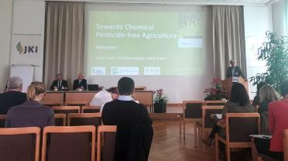
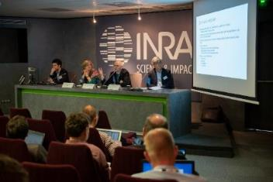
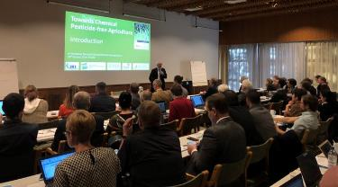
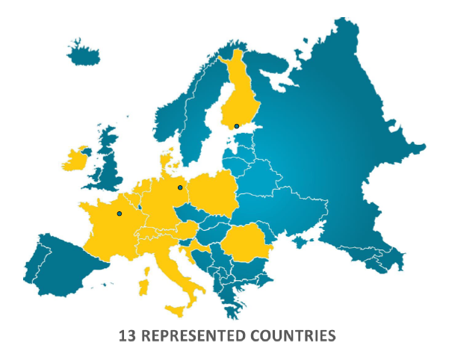
European Research Alliance
Towards Chemical Pesticide-free Agriculture
3 workshops organized at
  Inra, Paris, October 2018
  JKI, Berlin, May 2019
  Luke, Helsinki, October 2019
Signature of the MoU
  SIA, Paris, February 2020
Today
34 organisations
20 countries
Achievements
An increasing scientific community
Webinars (for a prospective study)
A Cost project under evaluation
A GD project perimeter C under evaluation

Slide 11
Thank you for your attention

